Slide 1
Gynko
A new approach of Hysteroscopy

Slide 2
GYNKO OVERVIEW

Slide 3
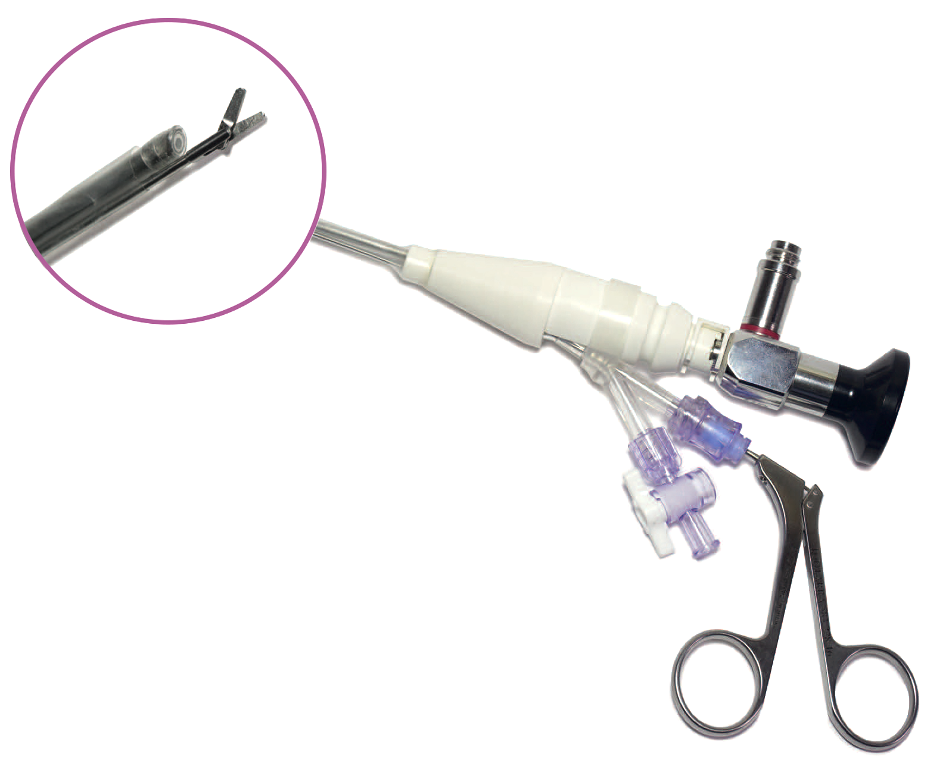
A sterile & single use diagnostic/operative sheath
Sheath used to protect rigid endoscopes and keep their sterility during hysteroscopy examination.
Gynko is composed of two sheaths:
  An inner sheath covering totally the hysteroscope
  An outer sheath allowing irrigation and an operative channel (5 or 7Fr) between the inner and outer sheath
Enable the use of a unique and single endoscope per day for several hysteroscopies.

Slide 4
The strengths
Gynko has many advantages:
  Single use → no risk of cross-contamination.
  Small diameter (3mm for diagnostic and less than 4mm with an instrument, even 7Fr.) → An improved patient comfort.
  Easy assembly with the hysteroscope.
  Transparent distal lens of quality → no image quality alteration.
  Limit the investment on several endoscopes.
  No limit on the number of hysteroscopies per day → more important recruitment → reduced waiting lists.
  Good anti-reflux sealing cap on the operative channel.

Slide 5
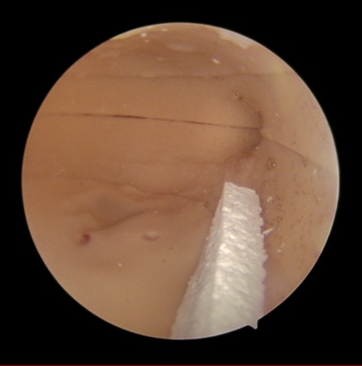
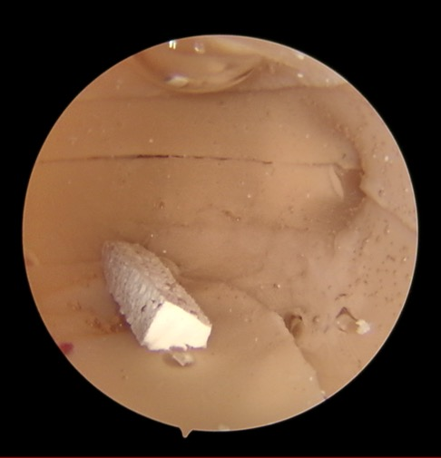
Preserved image quality
With Gynko sheath | Without Gynko sheath

Slide 6
The different available references
References | Specifications |  |  | Price (€, HT)
 | Hysteroscope | Camera cover | Operative channel | Public | Distributor
D300 110 060 | 2,9mm 0° | Yes | 5Fr. | 42,00 | 34,00
D300 110 061 | 2,9mm 0° | No | 5Fr. | 42,00 | 34,00
D300 110 062 | 2,9mm 30° | Yes | 5Fr. | 42,00 | 34,00
D300 110 063 | 2,9mm 30° | No | 5Fr. | 42,00 | 34,00
D300 110 064 | 4mm 0° to 30° | Yes | 5Fr. | 42,00 | 34,00
D300 110 065 | 4mm 0° to 30° | No | 5Fr. | 42,00 | 34,00
D300 110 066 | 2,9mm 0° | Yes | 7Fr. | 42,00 | 34,00
D300 110 067 | 2,9mm 0° | No | 7Fr. | 42,00 | 34,00
D300 110 068 | 2,9mm 30° | Yes | 7Fr. | 42,00 | 34,00
D300 110 069 | 2,9mm 30° | No | 7Fr. | 42,00 | 34,00
D300 110 070 | 4mm 0° to 30° | Yes | 7Fr. | 42,00 | 34,00
D300 110 071 | 4mm 0° to 30° | No | 7Fr. | 42,00 | 34,00

Slide 7
GYNKO and its competitors

Slide 8
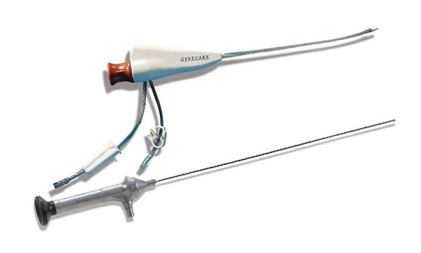
J&J - VERSASCOPE
The | The
Quick-lock connection with the endoscope 2mm diameter without instrument | Compatible with their 1,8mm fiber hysteroscope → low image quality Only 2mm operative channel (between 5 and 7Fr.)
Jonhson & Jonhson proposed the Versascope :
(Discontinued product)

Slide 9

PiEmme Med
The | The
 | Very few availble references: only 2,9mm 0° or 30°endoscopes and only a 7Fr operative channel. No camera cover possible. A rigid channel for irrigation and instrument.
PiEmme Med propose the HysteroCare :

Slide 10
How to use GYNKO ?

Slide 11
The aim
Why ?
For diagnostic hysteroscopy and See&Treat application (small operating acts such as DIU removal, small polypes …)
For whom ?
For every patient who needs hysteroscopy. No contraindication.
Where ?
Dedicated to office or consulting / ambulatory room in health center but can also be used in operating room.

Slide 12
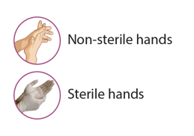

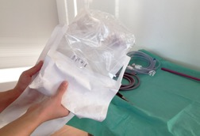

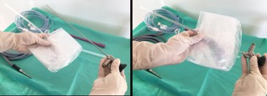
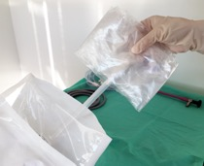
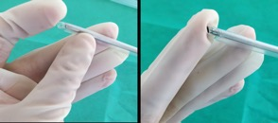
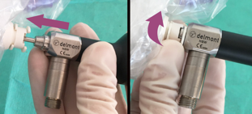
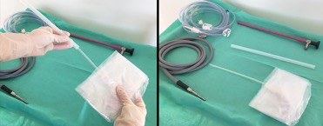
Usage Protocol (1/2)
Step | Photo | Description
Opening
1 |  | Open the package towards the person with sterile hands.
2 |  | Take the Gynko sheath out of the package.
3 |  | Remove the protective tube from the Gynko cover.
Step | Photo | Description
Assembly
4 |  | Take the sterile endoscope and slip it into the Gynko sheath.
5 |  | Check the correct positionning of the endoscope at the distal tip. If necessary, gently press the lens of the Gynko sheath to securely place it to the endoscope.
6 |  | Finalize the assembly by locking the Gynko sheath to the endoscope. To do this, slide the endoscope up to the notch in the Gynko locking ring. Then turn the locking ring a quarter turn (90°).

Slide 13
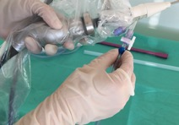
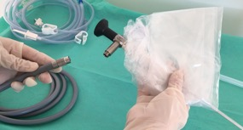
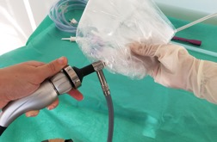
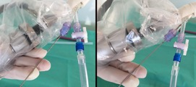
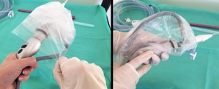
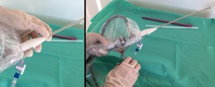
Usage Protocol (2/2)
Step | Photo | Description
Assembly
7 |  | Connect the light cable to the endoscope. Pass the other end of the light cable to the person with non-sterile hands for connection to the light source.
8 |  | Hold the endoscope eyepiece towards the person with non-sterile hands.
 |  | Connect the camera head to the endoscope.
9 |  | Pull the sterile cover in order to hold the camera head.
Step | Photo | Description
Assembly
10 |  | Connect the irrigation tubing to the corresponding stopcock and hand the strikers to the person with non-sterile hands.
Use
11 |  | Perform the hysteroscopy. If the use of an instrument is necessary, then insert it into the anti-return sealing cap of the operating channel, making sure that the instrument jaws are properly closed.
12 |  | Position two fingers at the beginning of the operating channel to guide the instrument as it passes along the operating channel until it appears on the screen.

Slide 14
Exemples

Slide 15

Usage exemples

