Slide 1
EasyCare
The comprehensive solution for the safest See&Treat hysteroscopies

Slide 2
EASYcare OVERVIEW

Slide 3
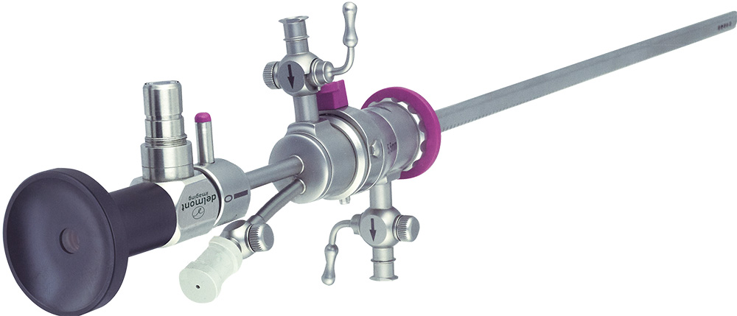
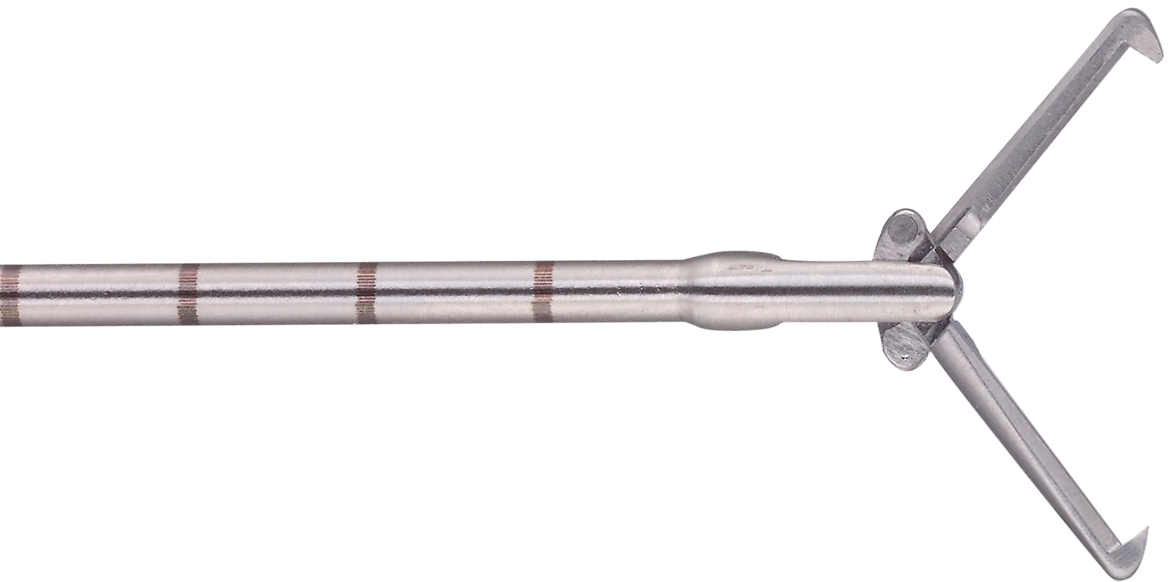
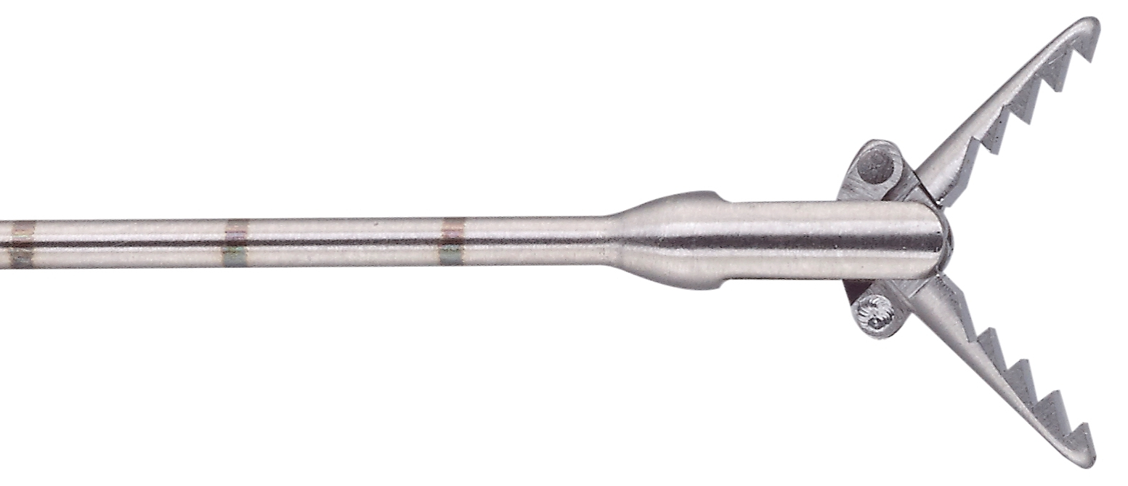
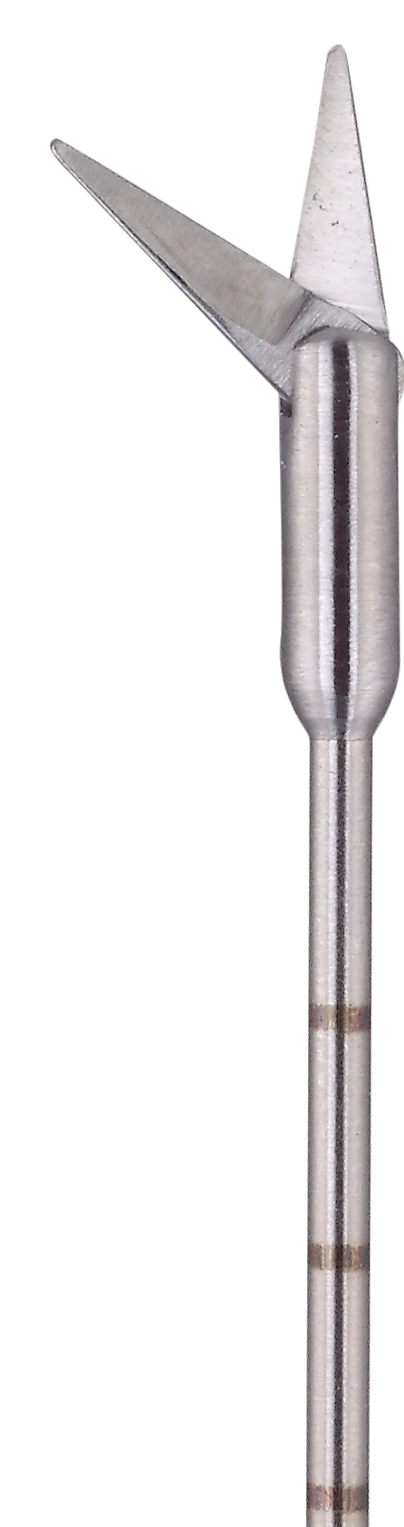
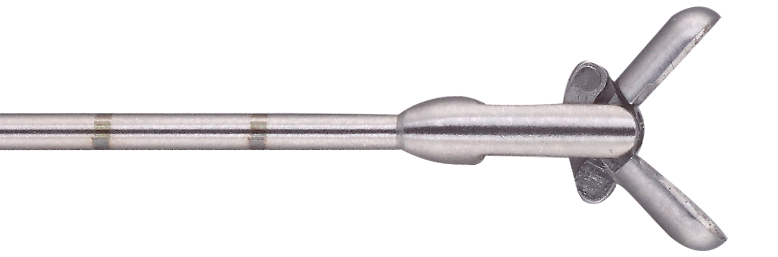
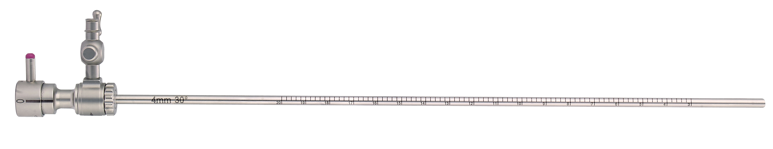
What’s in the set ?
The EasyCare set includes the following products:
  1 HD hysteroscope 2,9mm, 30°
  1 inner operating sheath 4,9mm
  1 outer operating sheath 5,5mm
  1 graduated diagnostic sheath 4mm
  4 instruments 7Fr.
  1 light cable with Storz connectors
Optional:
  a complete sterilization basket
  a 5Fr. bipolar electrode with tip
  a 5Fr. bipolar electrode button
Notes:
Bien spécifier que la chemise opératoire est en 2 morceaux (3 avec l’hystéro) et que le câble de lumière n'est pas illustré

Slide 4
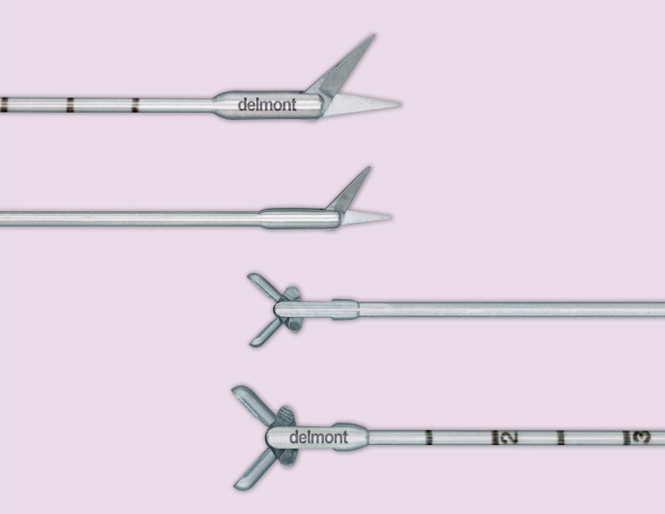
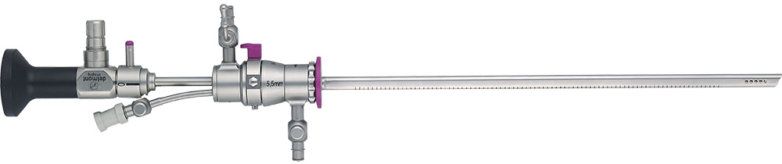
A 7Fr. Operating sheath
7Fr. Instruments are more efficient, accurate and durable.
Each instrument is graduated to ease surgical marks.
Quick-Lock
connection
Distance markings on the inner and outer sheath
7Fr. Operating channel
Rotatable stopcocks
Notes:
Diamètre externe n'est que de 5,5mm mais qui propose un canal de travail de 7Fr. permettant d'utiliser des instruments de 2,34mm dont les qualités sont à rapprocher de ceux de cœlioscopie de 3mm.

Slide 5
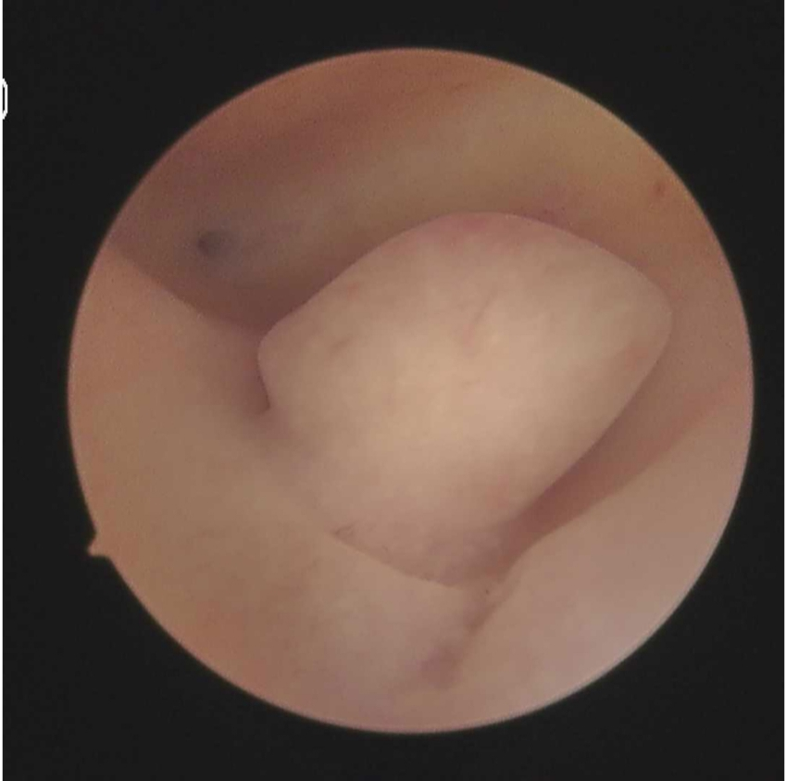
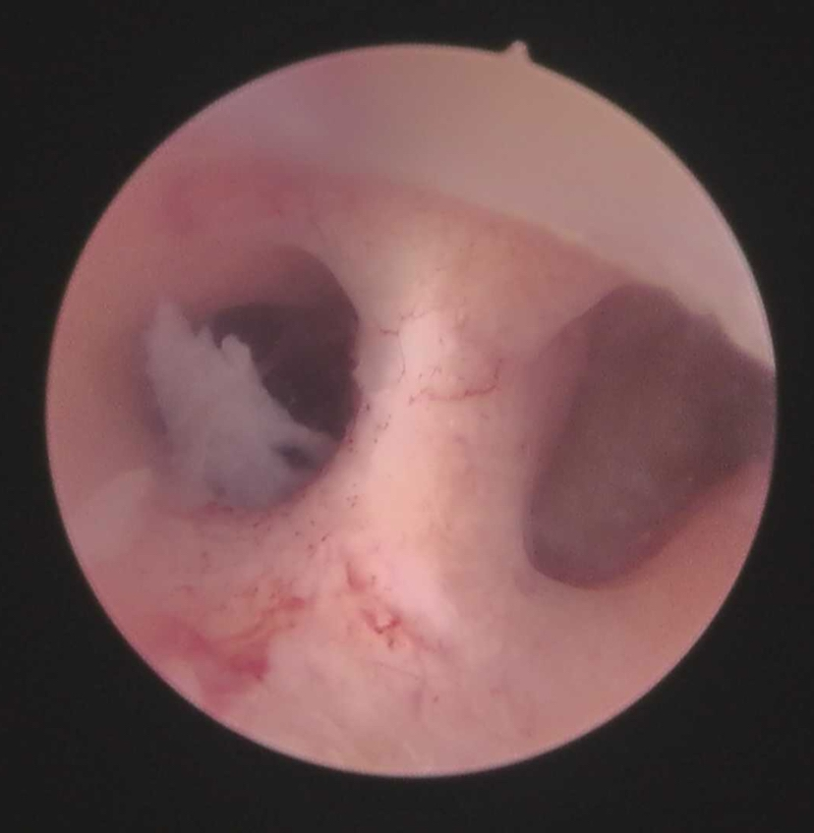
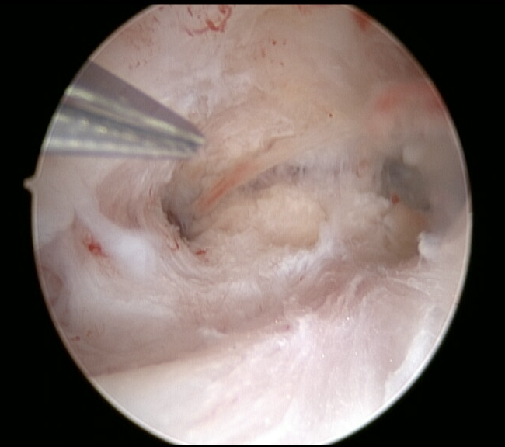
A HD quality vision
The next generation of 2,9mm, 30°, HD Hysteroscope
High resolution images with an even distribution of the luminous intensity
Large depth of field
Autoclavable
Durable and resistant thanks to its 3 tubes design

Slide 6
EaSYcare AND ITS COMPETITORS
Notes:
Seront présentés que les chemises qui fonctionnent avec des hystéros 2,7 ou 2,9 !

Slide 7
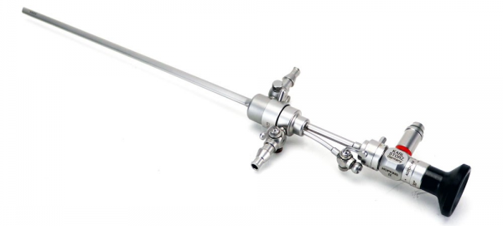
STORZ
Storz proposes :
Outer Ø | Inner Ø | Operating channel | The | The
5,0mm | 4,3mm | 5Fr. |  | Working lenght of 200mm No Quick-Lock No distance markings No rotatable stopcocks
5,5mm | 4,9mm | 7Fr.
Notes:
Optique 2,9mm de 30°

Slide 8
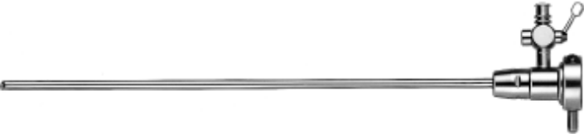
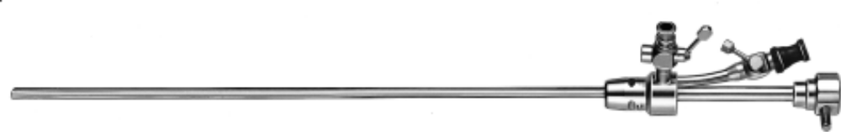
R. Wolf
R. Wolf proposes :
Outer Ø | Inner Ø | Operating channel | The | The
5,0mm | 4,3mm | 5Fr. |  | 2,7mm endoscope of lower quality Working lenght of 205mm No Quick-Lock No distance markings No rotatable stopcocks
5,5mm | 4,9mm | 7Fr.
Notes:
Optique de 12 ou 30°
Optique ancienne aussi

Slide 9
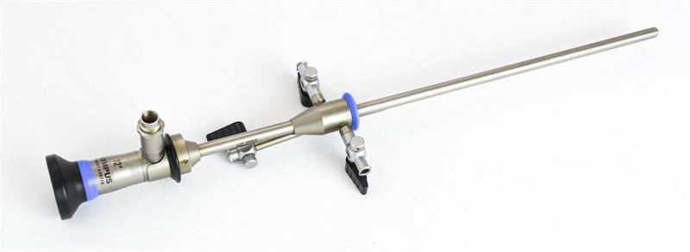
OLYMPUS
Olympus proposes :
Outer Ø | Inner Ø | Operating channel | The | The
4,5mm | - | 3Fr. | Endoscope/ Sheath Quick-Lock 3mm, 30° endoscope | Working lenght of 187mm Endoscope/ sheath captive connection Monobloc sheath No distance markings No rotatable stopcocks
5,5mm | - | 5Fr.
6,5mm | - | 7Fr.

Slide 10
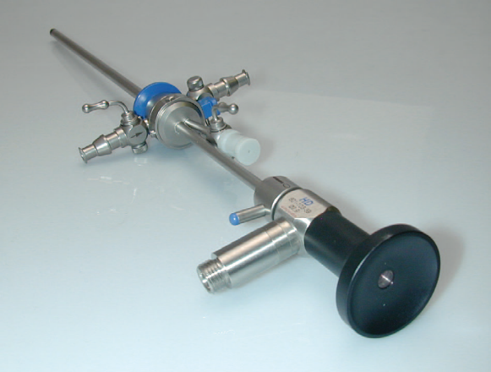
TONTARRA
Tontarra proposes :
Ø externe | Inner Ø | Operating channel | The | The
5,4mm | 4,3mm | 5Fr. |  | Working lenght of 194mm No distance markings No rotatable stopcocks
Notes:
Optique 2,9mm de 30°

Slide 11
HOW TO MAKE A DEMO WITH EASYcare ?

Slide 12
Indications in consulting room
Patient :
Nulliparous women and infertile couples are our core targets.
Pathology : (the See&Treat pathologies)
  IUD removal
  Targeted biopsies
  Throphoblastic retention
  Minor synechiaes removal (1 and 2 types)
  Small polyps exeresis (pedicled)
Notes:
L'objectif clinique étant la prise en charge sans énergie des polypes, des cloisons et des synéchies, les retraits de corps étrangers et les biopsies ciblées.

Slide 13
Indications in OR
Patient :
Nulliparous women and infertile couples are our core targets.
Pathology :
  IUD removal
  Targeted biopsies
  Throphoblastic retention
  Synechiaes removal(1, 2 , 2.a and 3 types as appropriate)
  Polyps exeresis (up to 2cm)
  Myomas removal (0 type)
  Uterine septum treatment (fibrous)
Notes:
L'objectif clinique étant la prise en charge sans énergie des polypes, des cloisons et des synéchies, les retraits de corps étrangers et les biopsies ciblées.

Slide 14
The adjutsments of the bipolar generators for electrodes
Model | Settings | Notes
Covidien / Valleylab Force Triad | Cutting : 40 Coagulation : 60 | To increase if required by the medical condition
Erbe Vio | Cutting : Effect 3 Coagulation : Effect 3 | Possibility to lower these values but keep Effect 3 for standard use
BOWA | Cutting : Effect 2 Coagulation : Effect 2

Slide 15
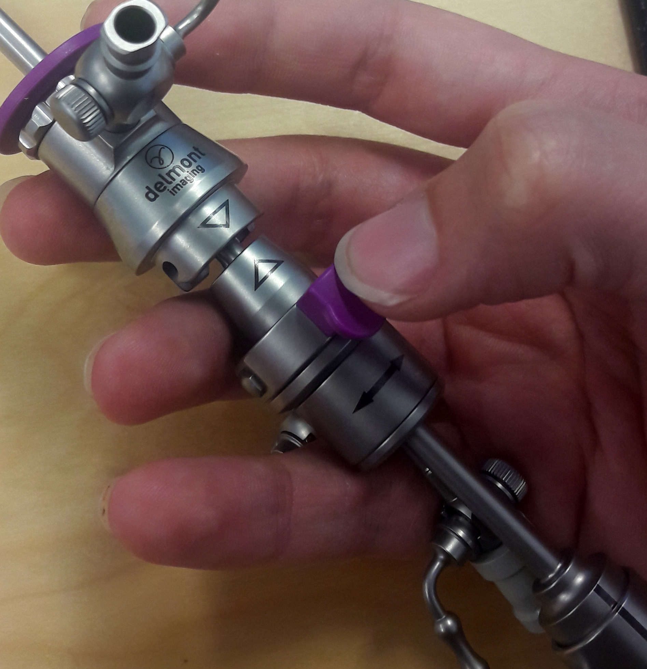
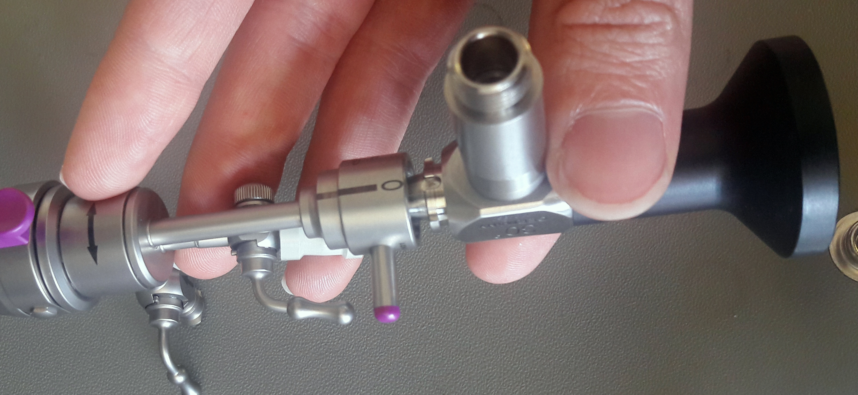
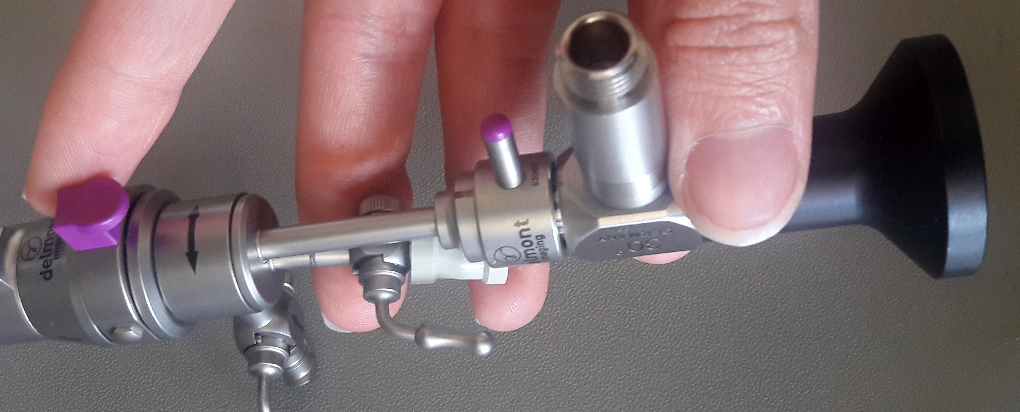
Tips & tricks
Inquire beforehand about the equipment available: bipolar generator and light source
  Provide appropriate cables/connectors.
On the demo’s day:
  Set the generator correctly (if electrodes are used in OR)
  Assist the doctor to assemble EasyCare
  Recommend a dilatation up to 5,5 (if in OR)
Notes:
Parler de la possibilité de faire des essais mixant ReseCare & EasyCare

Slide 16
exAmple

Slide 17
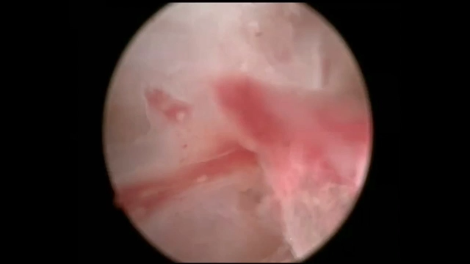
Synechiaes removal by Pr. Fernandez

