Slide 1
Our Colposcopes
Performance and ergonomics

Slide 2
Presentation of our colposcopes

Slide 3
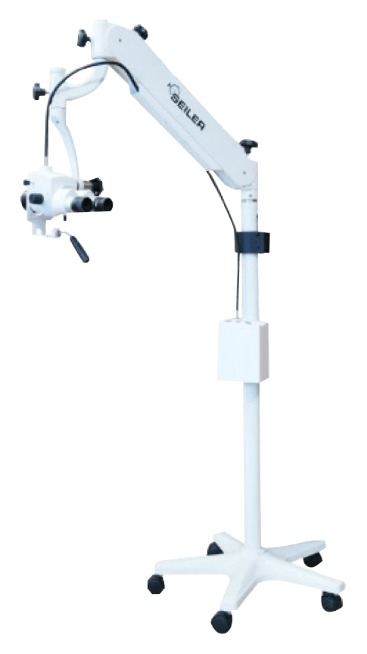
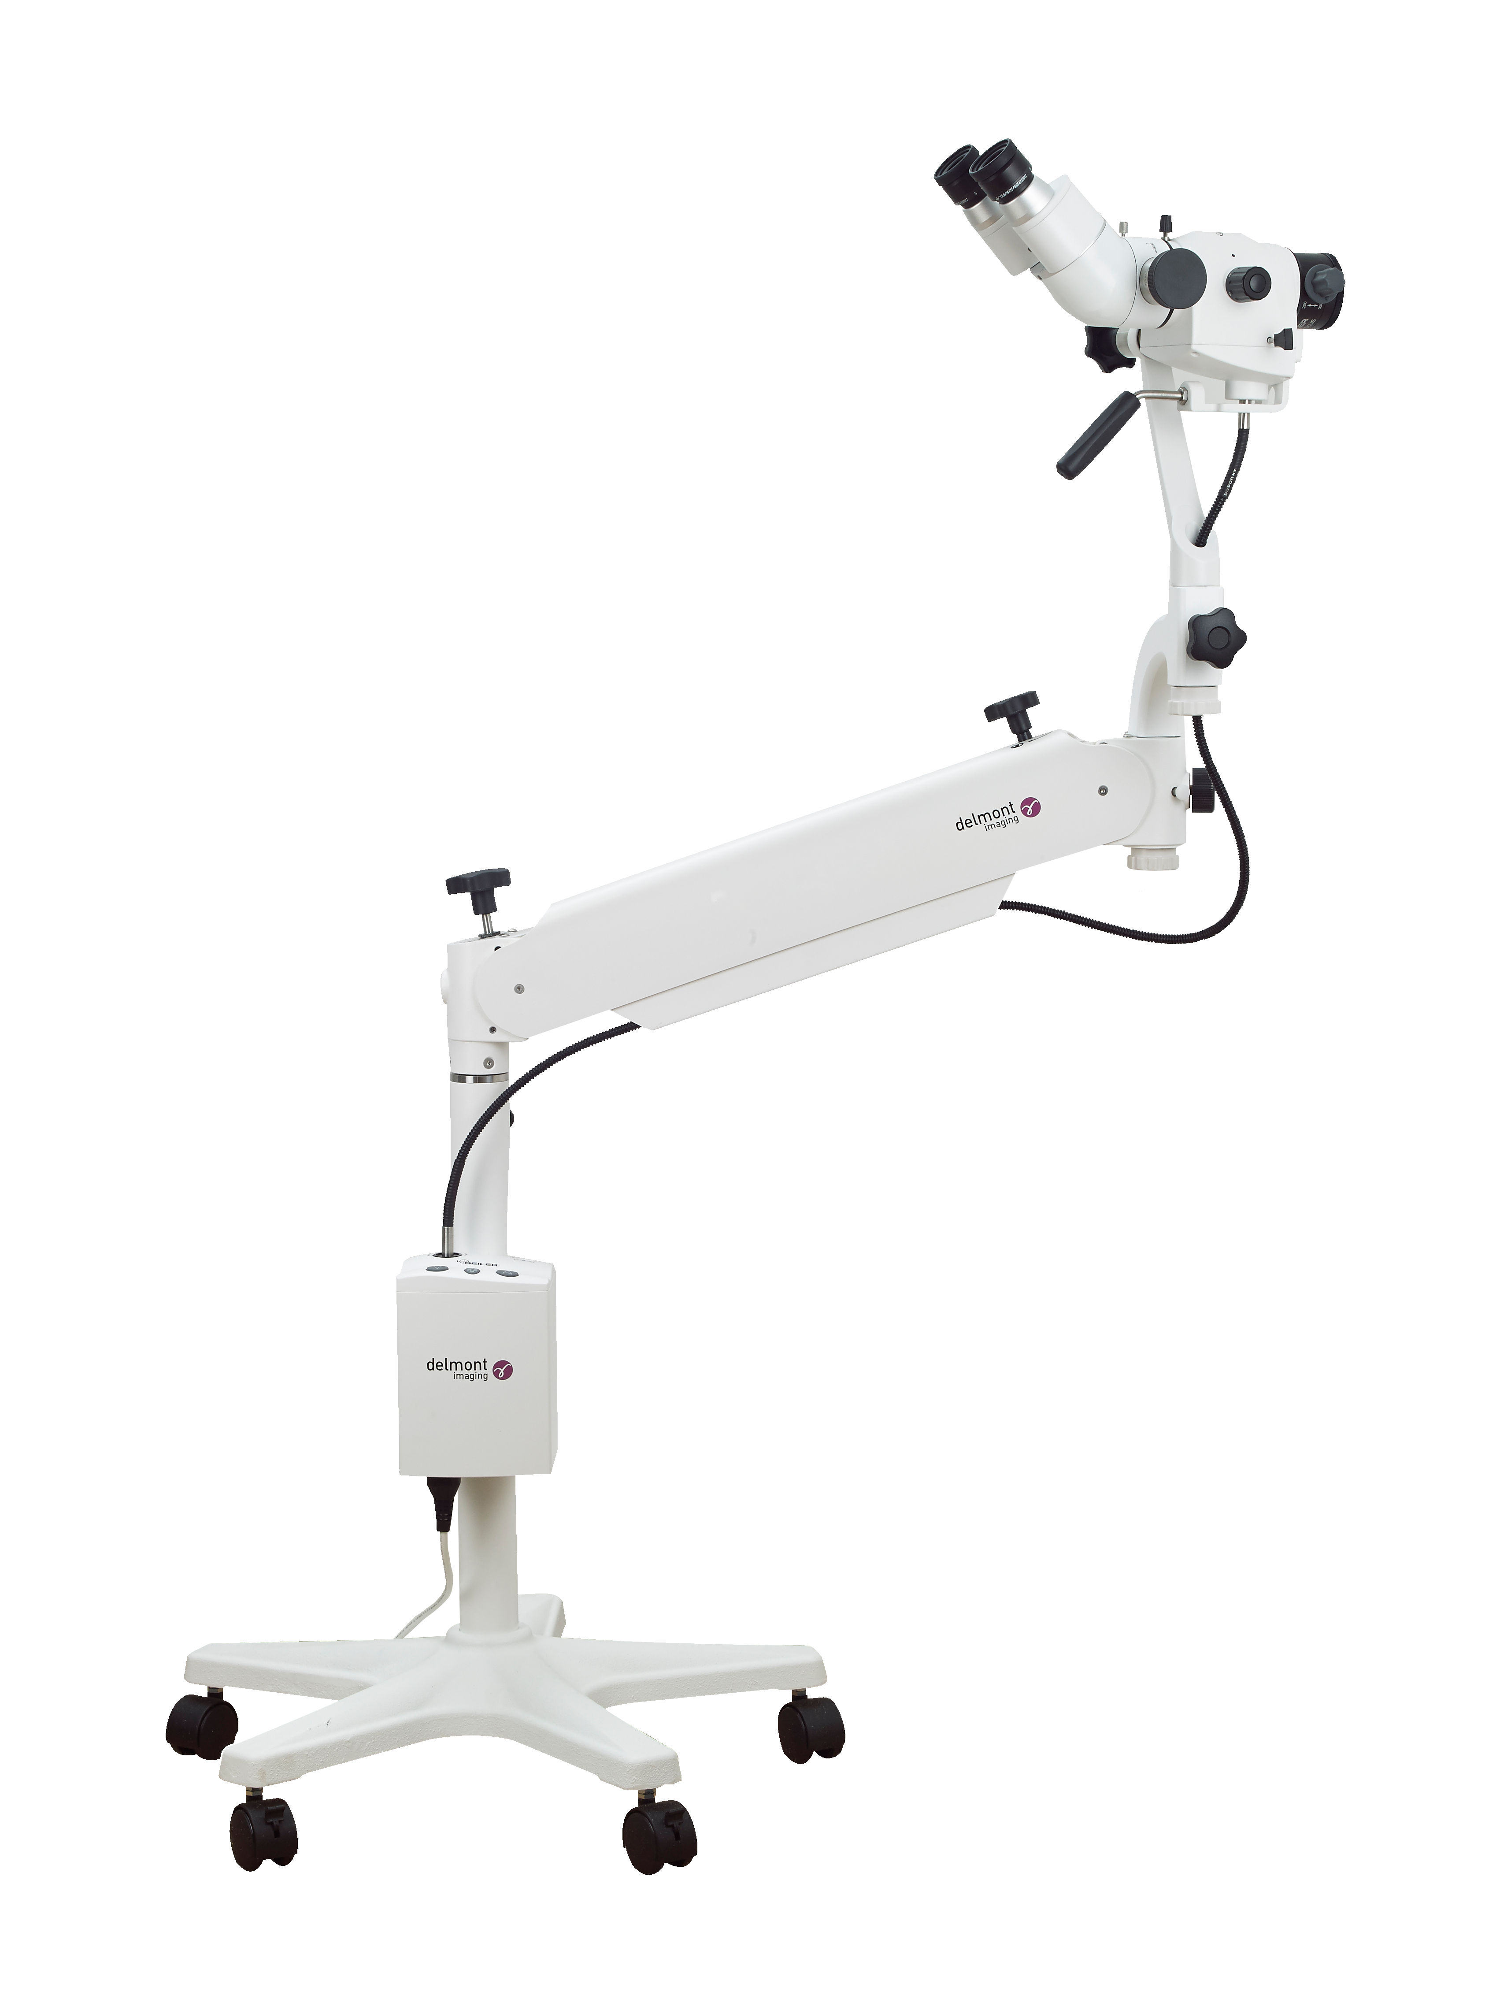
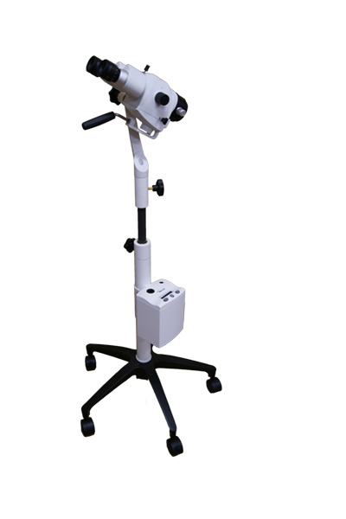
Our ergonomics
Vertical post colposcope
Adapted to small rooms
Swing arm colposcope
For the ease of use
Adaptable on Schmitz chair
Over the shoulder colposcope
Adapted to operating theater

Slide 4
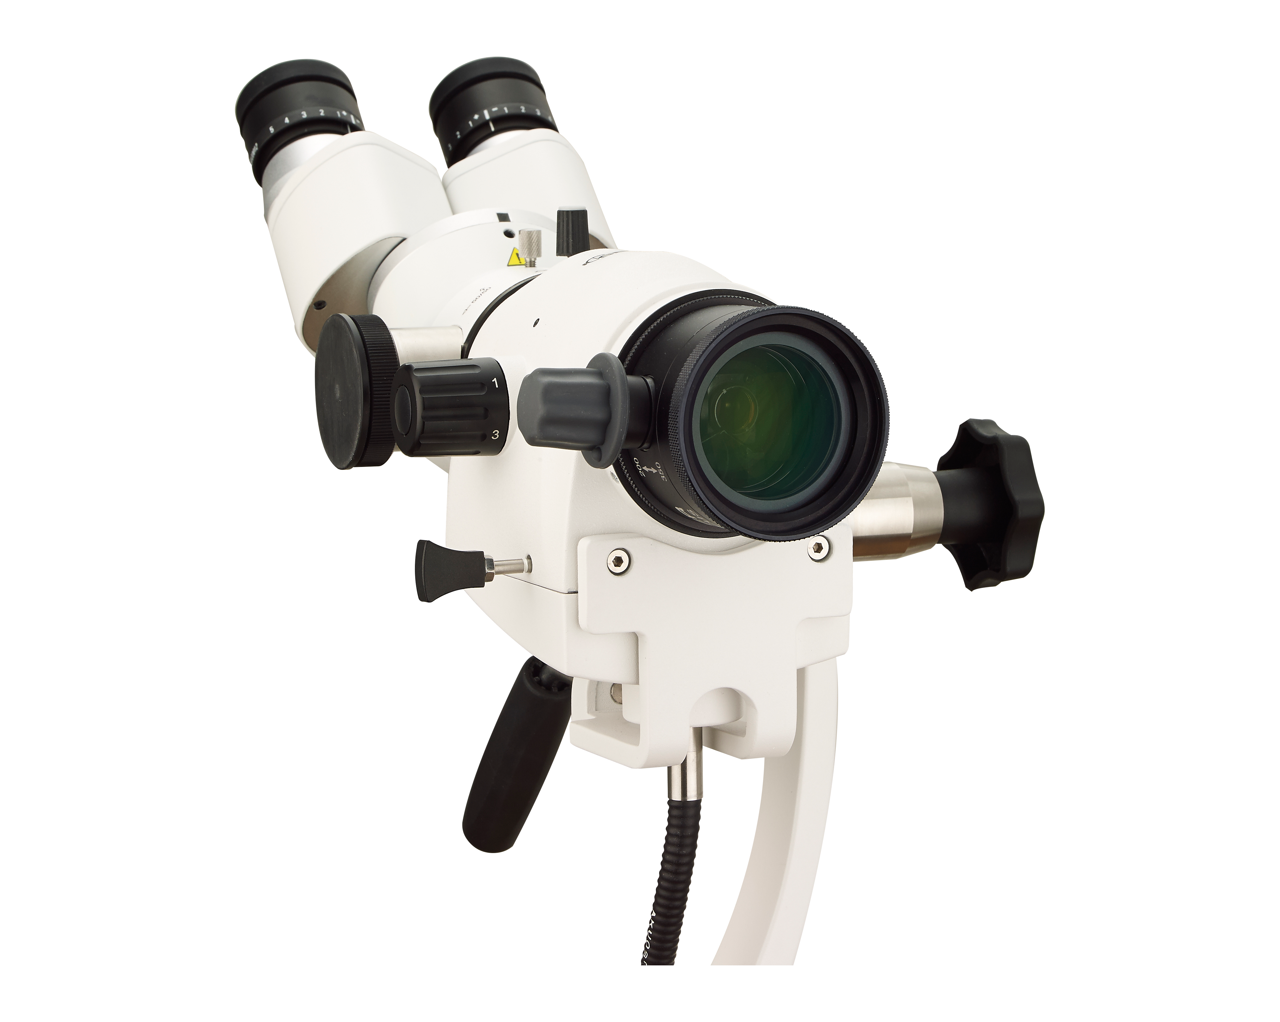
Colposcope head
Adjustable interpupillary distance and diopter
Magnification knob
(3 or 5 magnifications)
Head mobility adjustment
Green filter
Variofocus: 200-350mm
OR Fixed lenses: 175 ; 200 ; 250 ; 300 ; 400mm (fine focus range of 11mm)

Slide 5
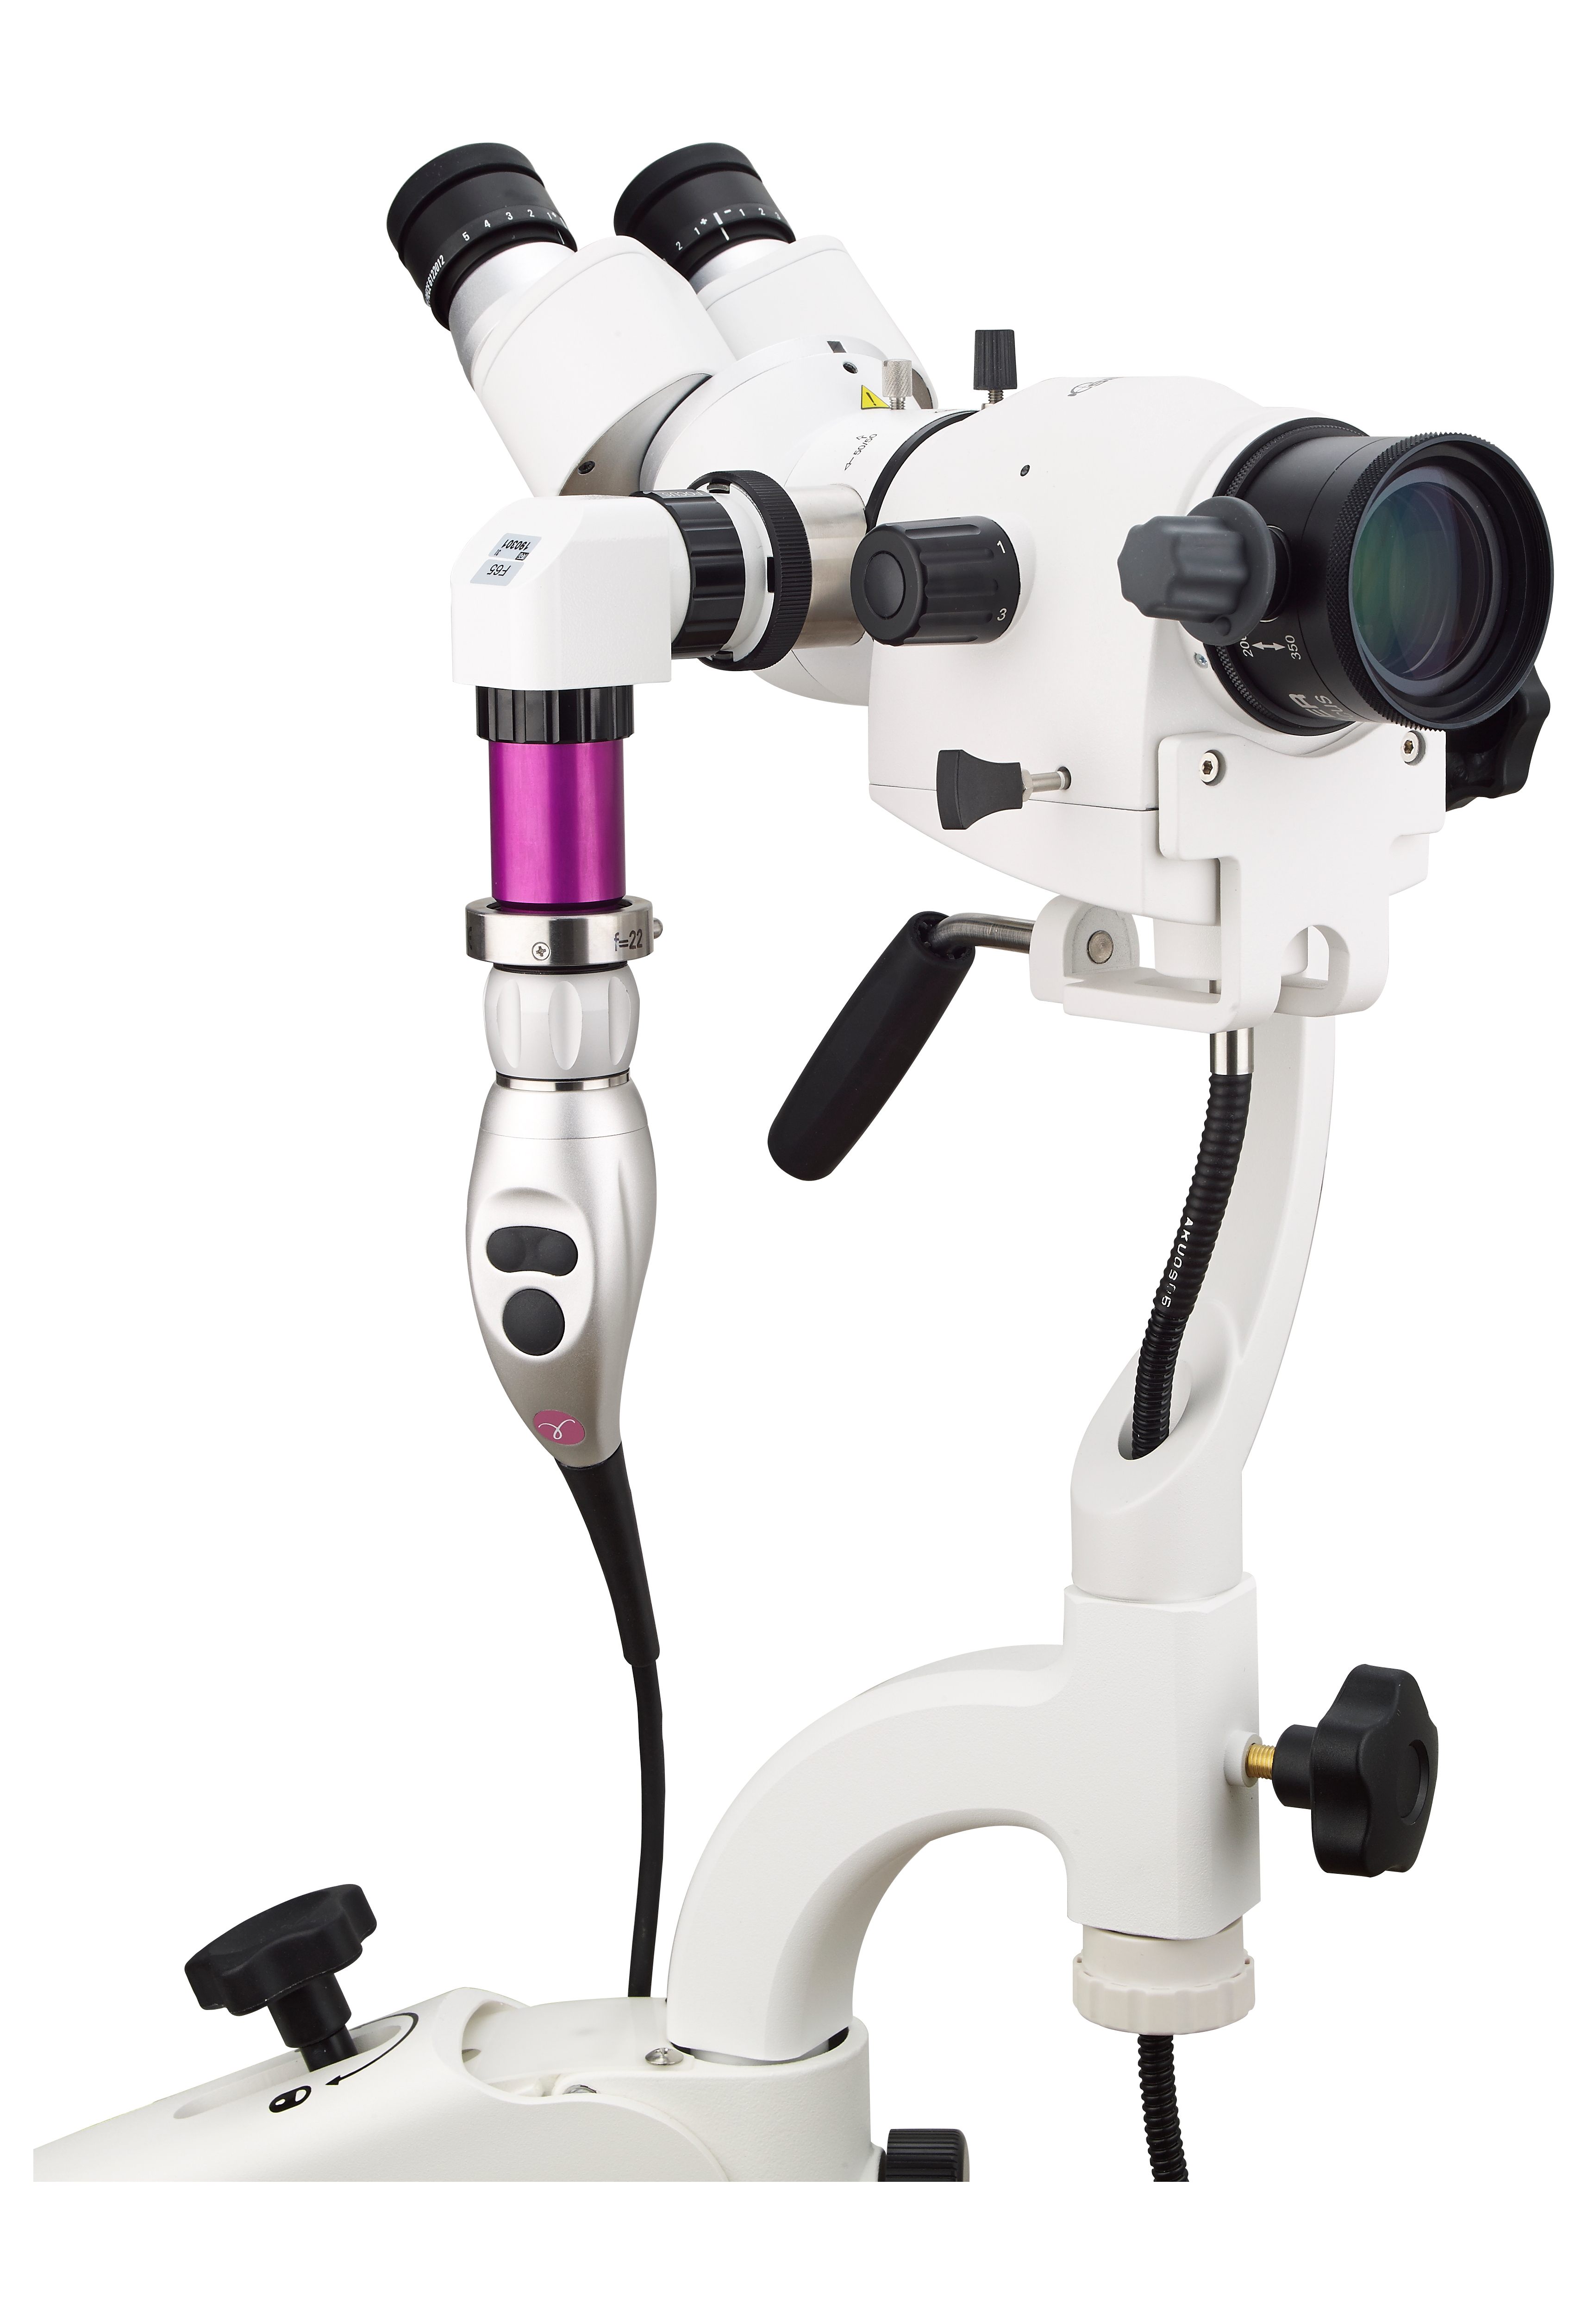
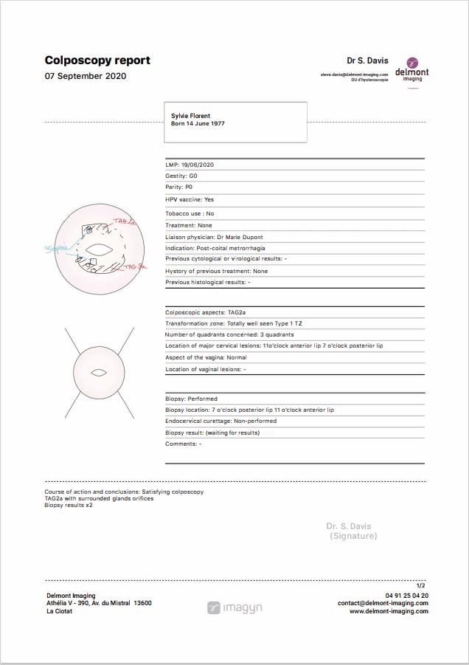
Connection with iCare
Double beamsplitter
Adapter for video camera
Endoscope eyepiece adapter
iCare camera

Slide 6
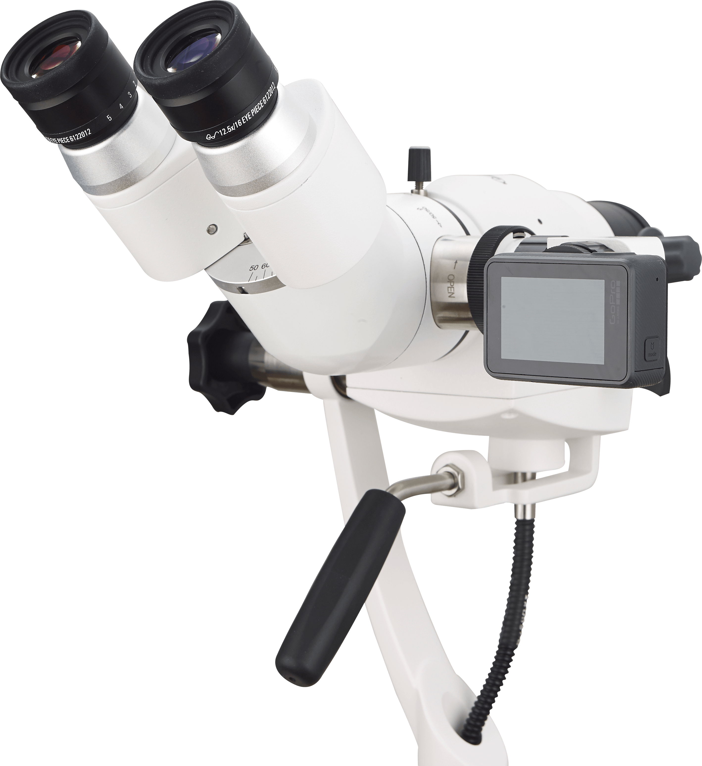
Photos and videos
A camera adapter allows to connect a camera on the colposcope. A video camera adapter allows to connect a GoPro or a video camera (iCare for instance) for taking photos and videos.
Examples of compatible cameras:
- Nikon D3300
- Canon EOS Rebel T
We offers these two models in our catalog. Sending photos and videos taken by these cameras can be done in various ways (cable connected to a PC, Wi-Fi, SD card).

Slide 7
Strenghts
Our colposcopes have many assets:
  Large range of ergonomics and accessories → highly customizable
  Optic components of high quality → exceptional image quality
  Green filter → essential functionality
  Variofocus available from 200 to 350mm → allows sharpness at the cervix and at the vagina walls without moving the colposcope
  Compatibility with our iCare camera and imagyn application → complete and aesthetic report rapidly

Slide 8
the competition

Slide 9
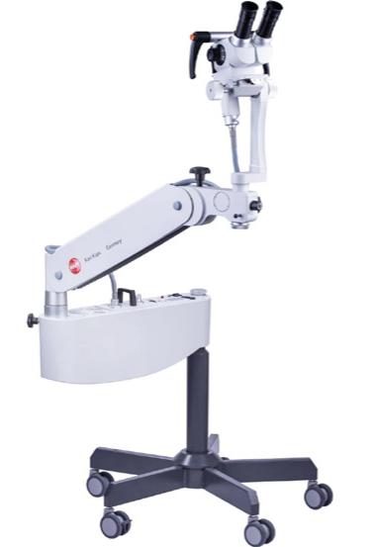
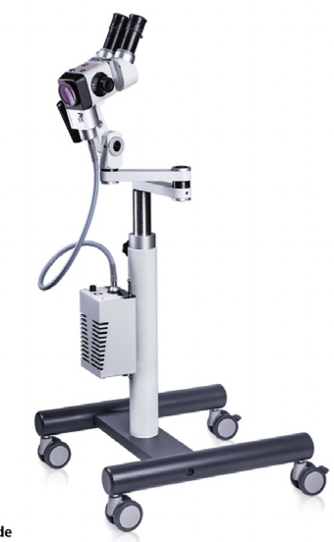
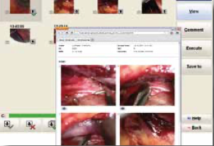
KAPS – binocular colposcopes
The | The
Adaptable to chair Manual or automatic (motorized) variofocus on the swing arm colposcope | No variofocus on the small model Price Quality of the software & report
KAPS offers the KP 3000/3000 S
&. SOM 52/42 :

Slide 10
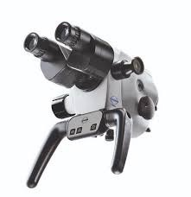
ATMOS – binocular colposcope
The | The
Adaptable on chair or on a vertical post Measuring scale | No swing arm ergonomic No dedicated software No objective with variable focales
ATMOS offers i View 21/31 :

Slide 11
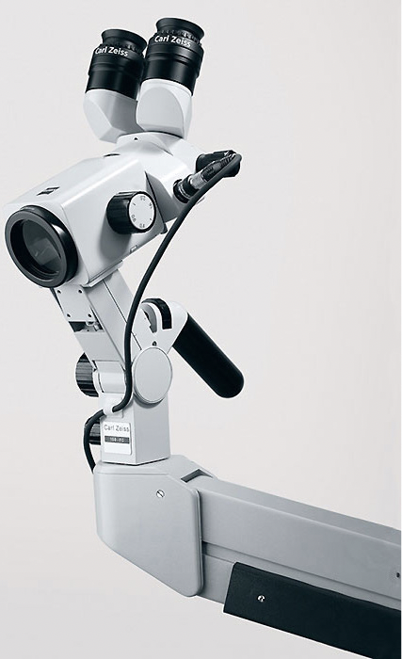
Zeiss – binocular colposcope
Les | Les
The | The
 | Halogen source No zoom lens No objective with variable focales
Zeiss offers KSK 150 FC :

Slide 12
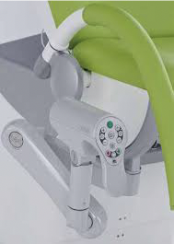
Schmitz – video colposcope
Schmitz offers the VIDAN II :
The | The
Automatic focus | No laser adapter No 3D vision Price

Slide 13
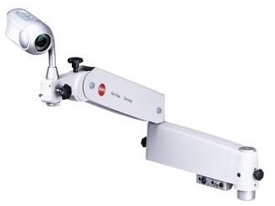
KAPS – video colposcope
The | The
Manual or automatic focus Adaptable on chair | No 3D vision Price Quality of the software & Report
KAPS offers the Vico S HD :

Slide 14
Colposcope Assembly

Slide 15
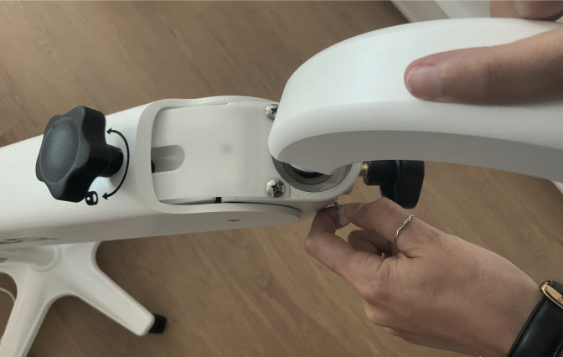
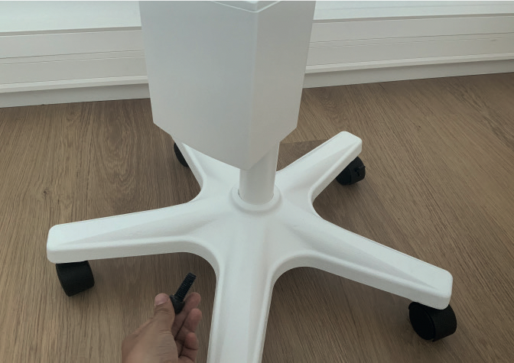
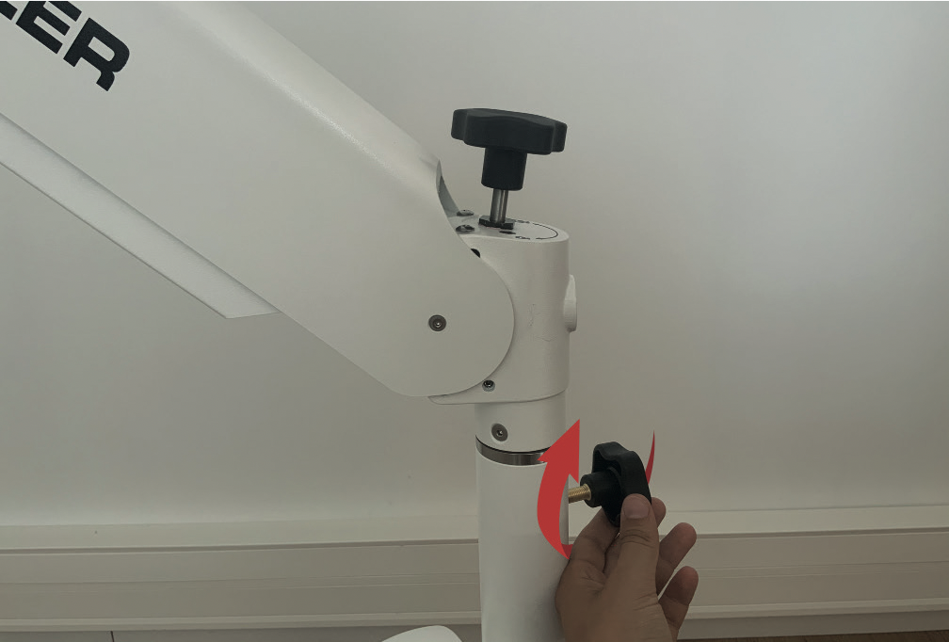
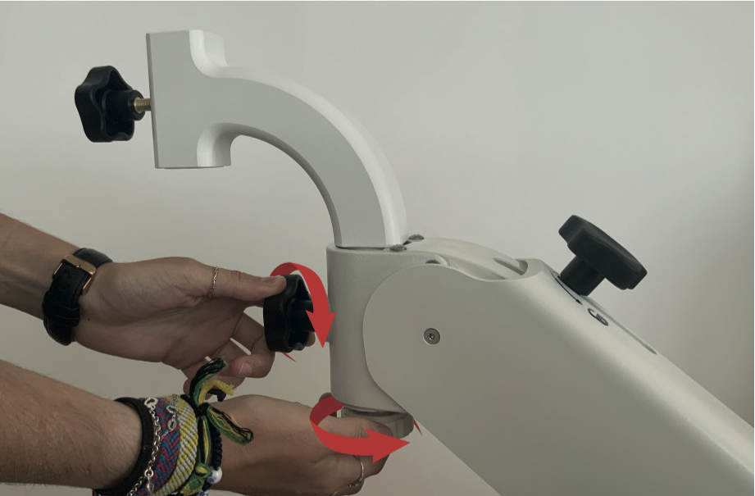
Swing arm colposcope (1/4)
1 | 2 | 3
Insert the main post into the base with rollers | Assembly the first swing arm to the main post | Assembly the second swing arm
Screw the post under the base with casters. | Screw the two parts. | Pull the white Pull-tab to allow the insertion. Tighten the two screws to complete the assembly.

Slide 16
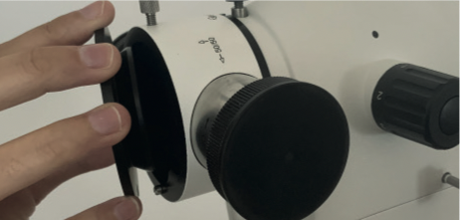
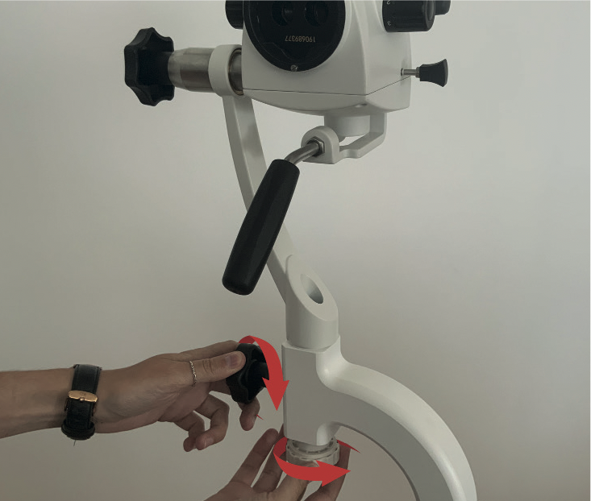
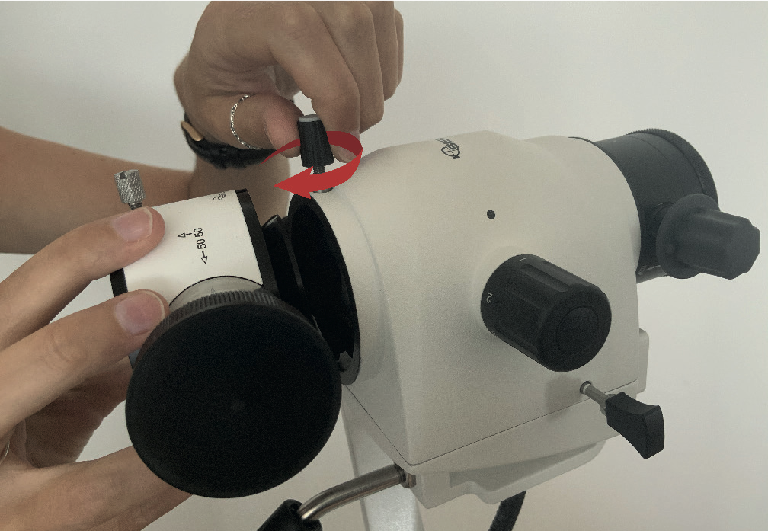
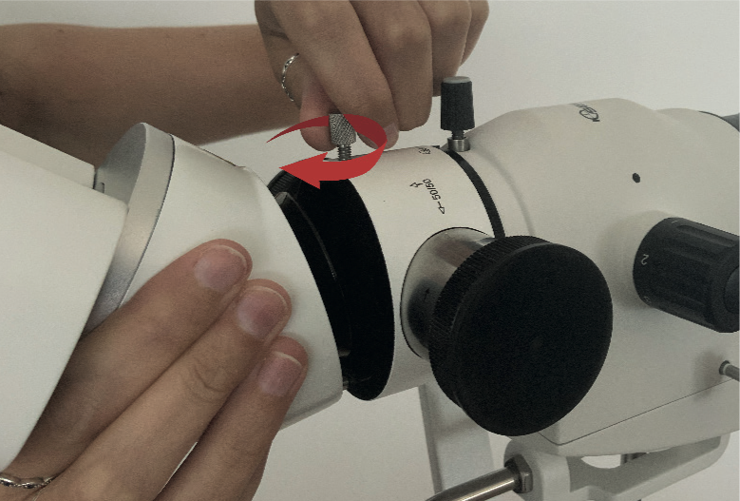
Swing arm colposcope (2/4)
4 | 5 | 6
Assembly the colposcope head | Screw the beamsplitter (optionnal) to the head | Assembly the binocular head to the beamsplitter
Tighten the two screws to complete the assembly. |  | Remove the protective cover of the beamsplitter. Assembly and screw the binocular head.

Slide 17
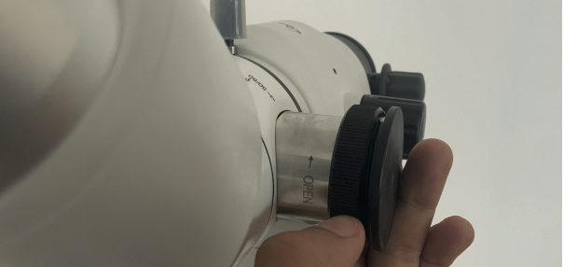
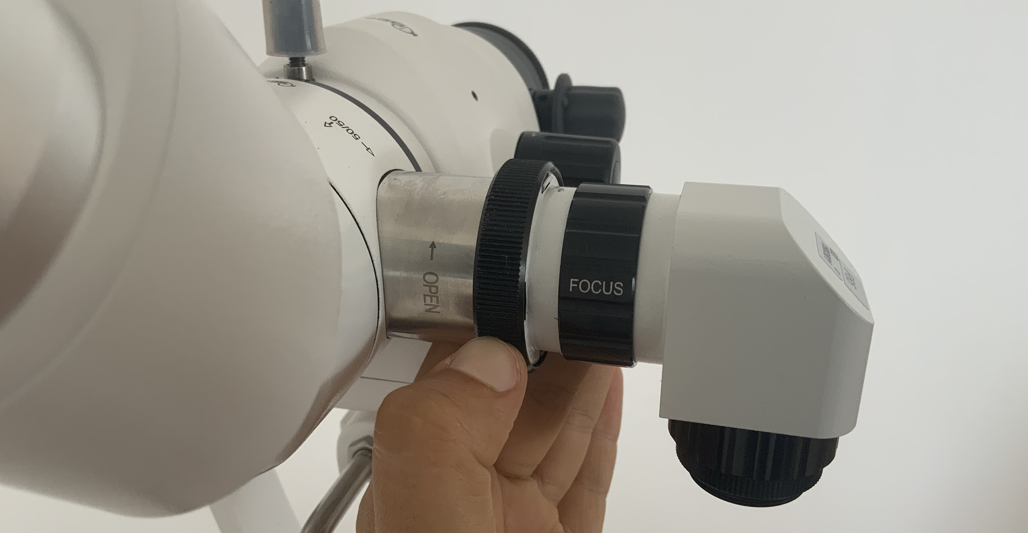
Swing arm colposcope (3/4)
7 | 8 | 9
Assembly the video camera (optionnal) | Screw the endoscope eyepiece adapter (optionnal) | Connect the iCare camera
Remove one of the two covers unscrewing the clamping ring. Place the video camera adapter and screw the ring.

Slide 18
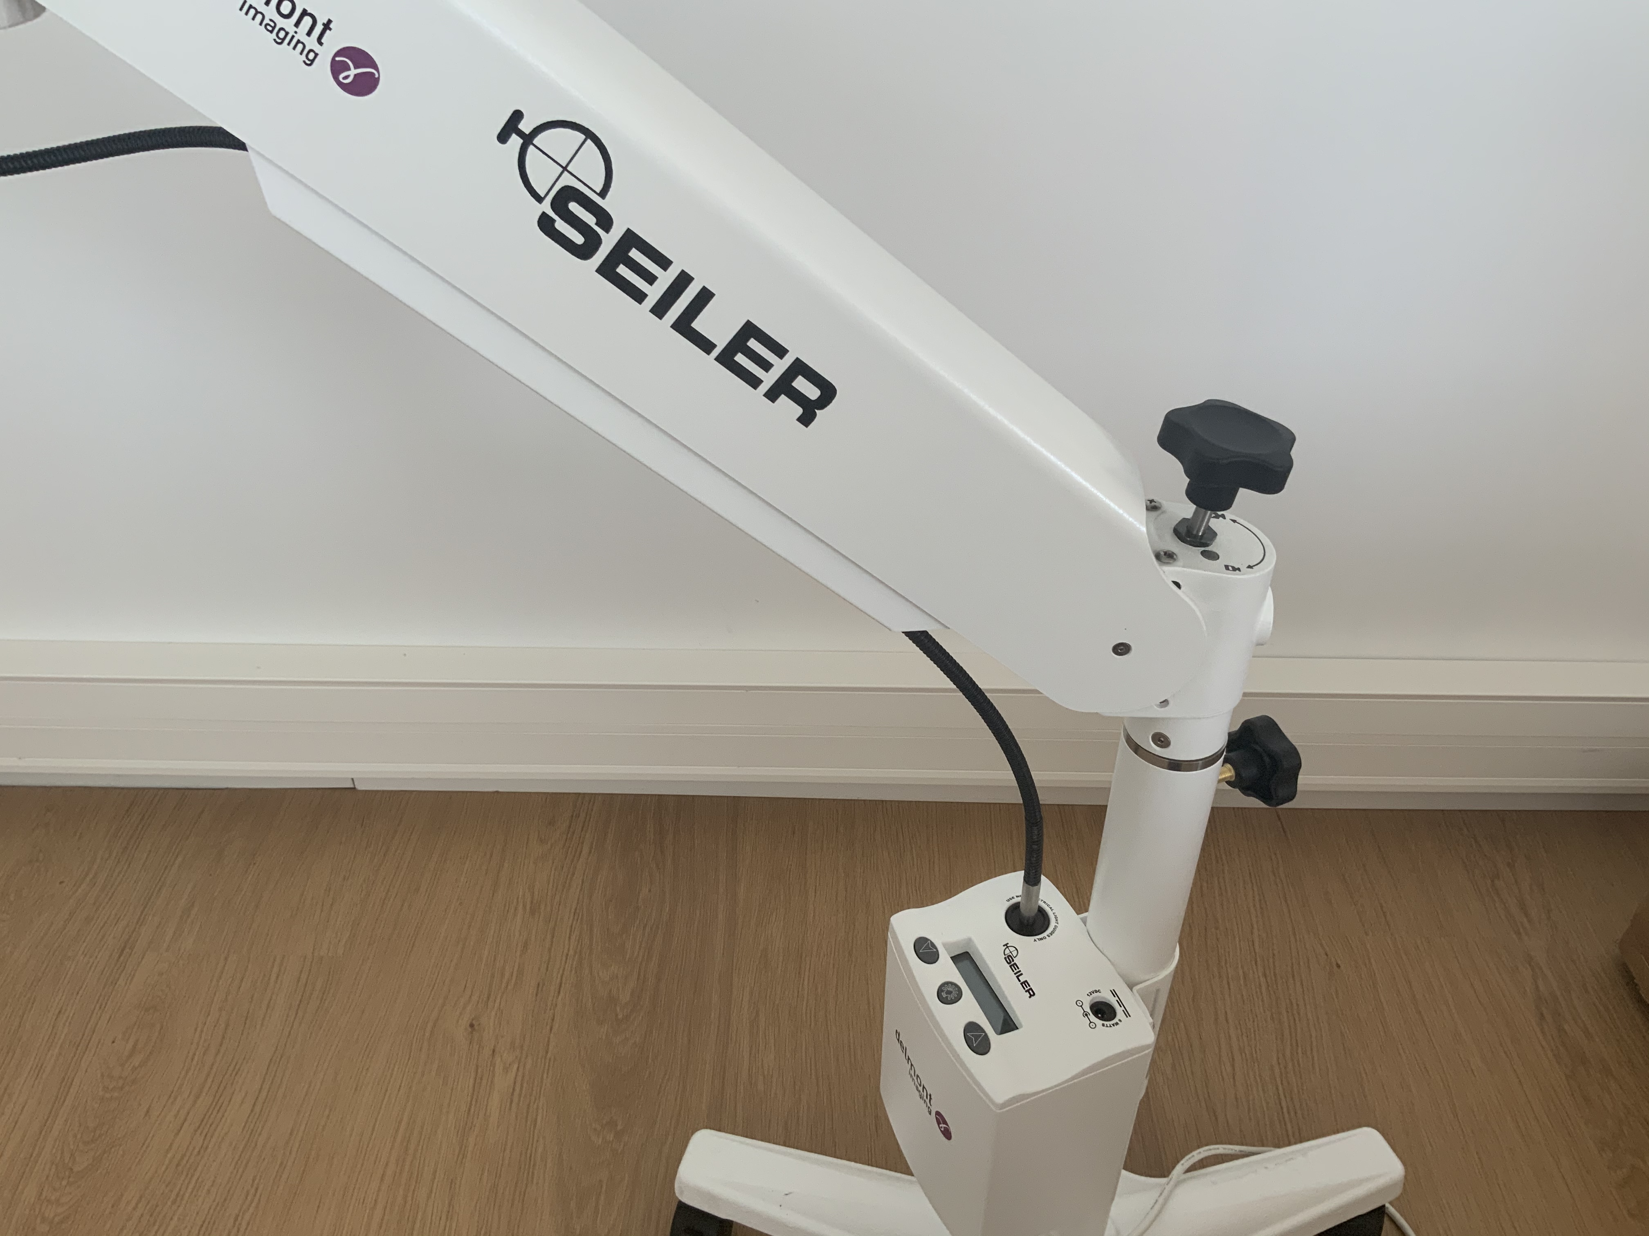
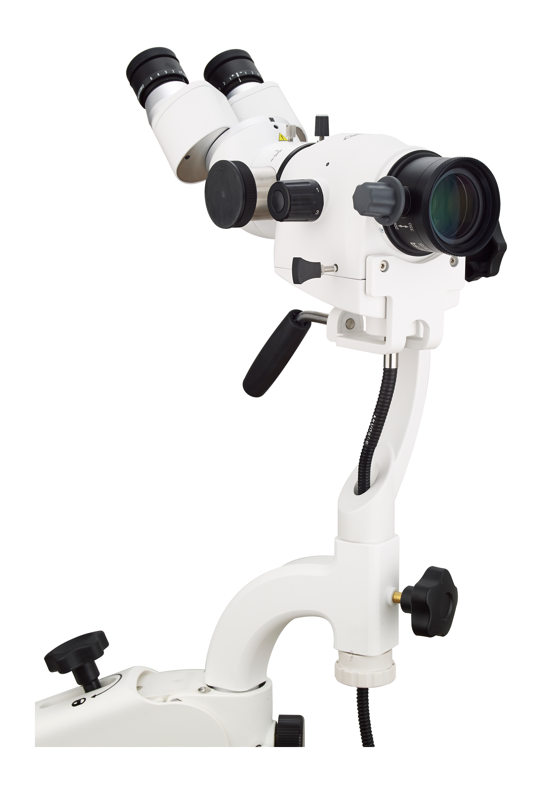
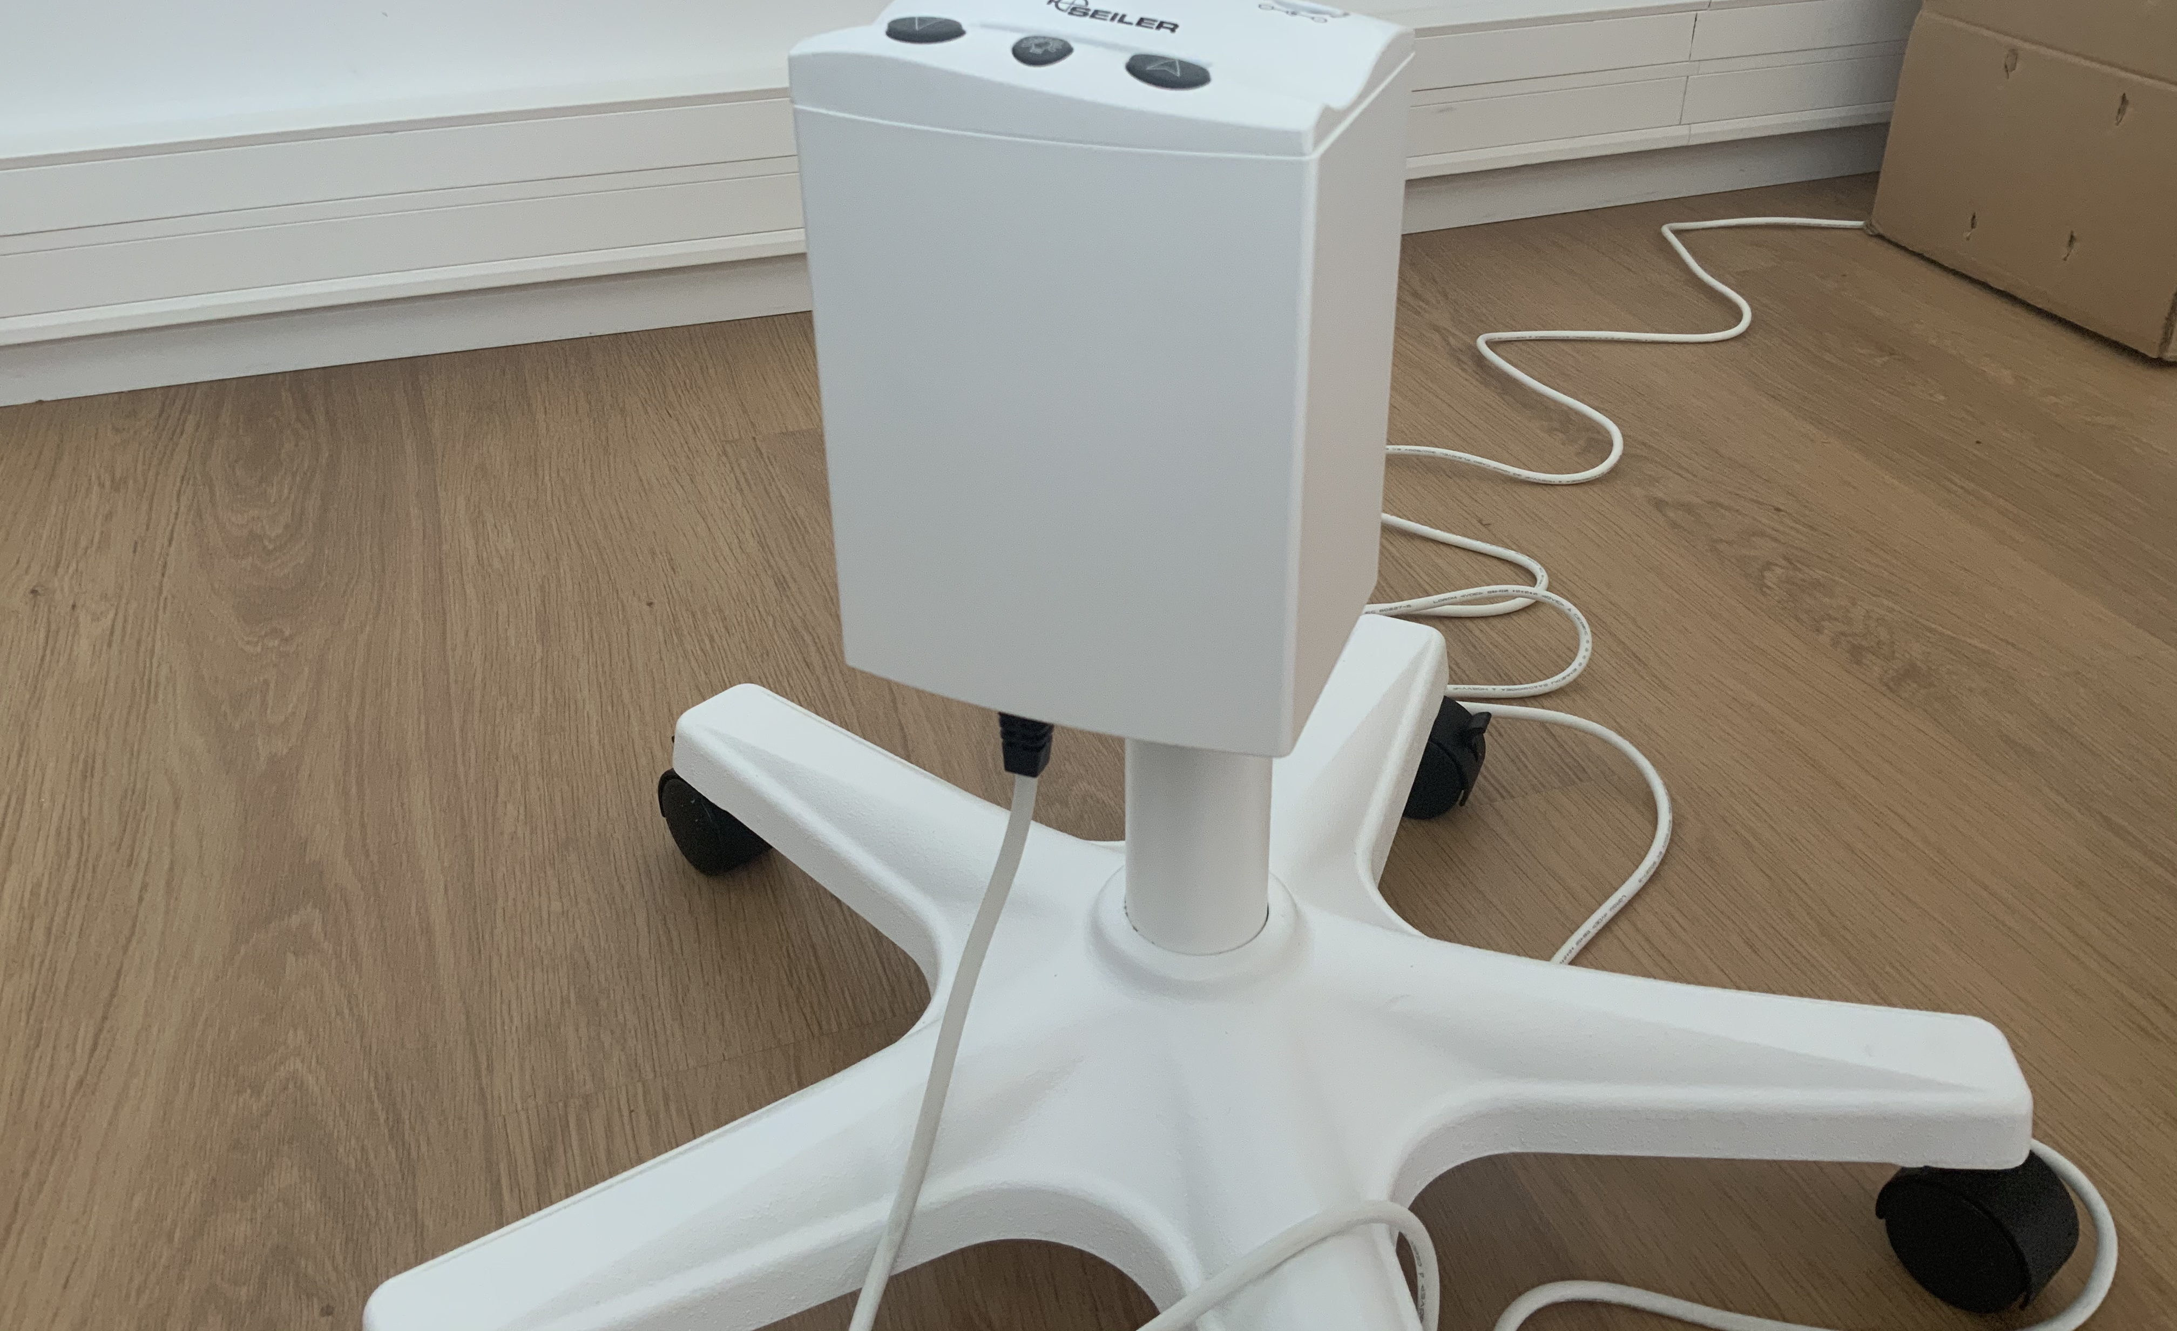
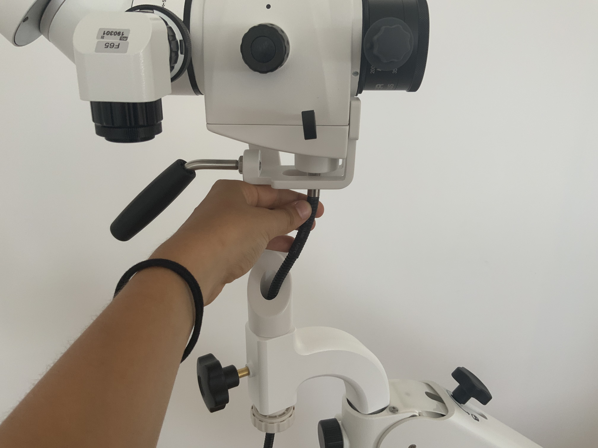
Swing arm colposcope (4/4)
10 | 11 | 12
Connect the light cable between the light source and the colposcope head | Connect the power cable under the light source | Adjust the balance of the colposcope
Slide the cable through the two cable tubes. | Connect the plug to a power outlet. | Turn the wheel. The adjustment is correct when the position of the colposcope can be changed « with one finger».

Slide 19
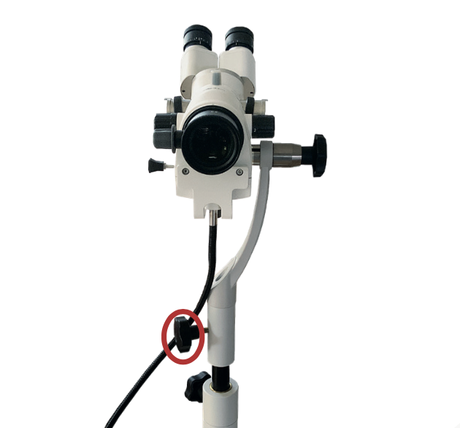
Vertical post colposcope
The assembly is basically the same:
  Assembly of the vertical post to the base with casters.
  Assembly of the colposcope head directly to the post.
  The rest is identical with the assembly of the swing arm colposcope.
During the assembly, do not loosen the knob shown aside (which allows the colposcope height adjustment) as long as the colposcope head is not inserted into the base!

Slide 20
Colposcope use

Slide 21
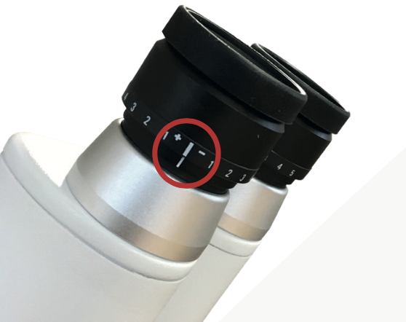
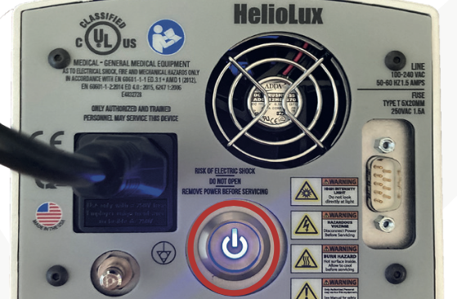
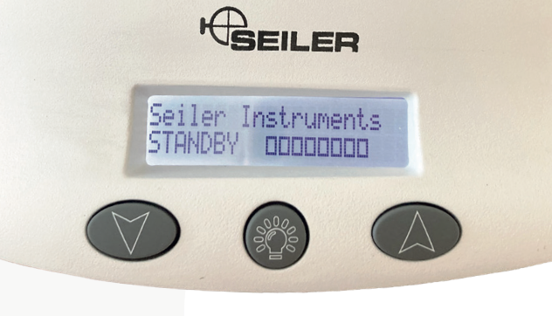
Use of the colposcope (1/2)
1 | 2 | 3
Switch on the colposcope | Adjust the luminosity | Adjust the diopter
Turn on the colposcope by pressing the ON/OFF button under the light source. | Switch on the light source with the dedicated button and adjust the light intensity using arrows buttons. | Adjust the diopter on 0 or suggest the doctor to adjust it according to his/her vision (see quick-start file).

Slide 22
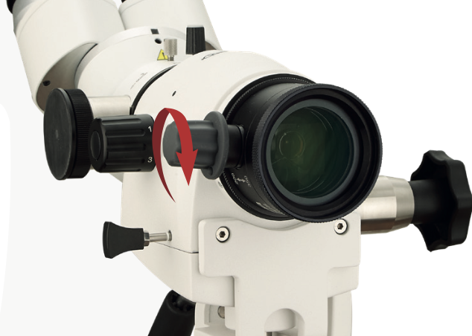
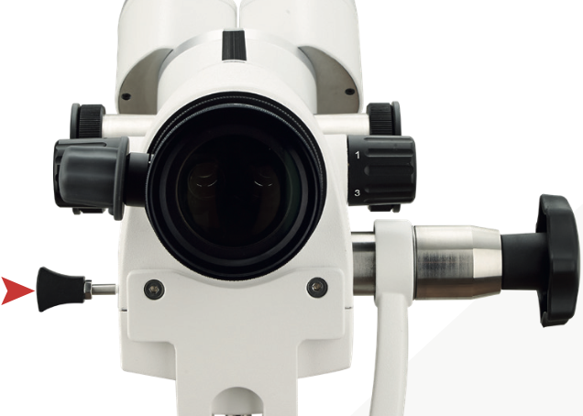
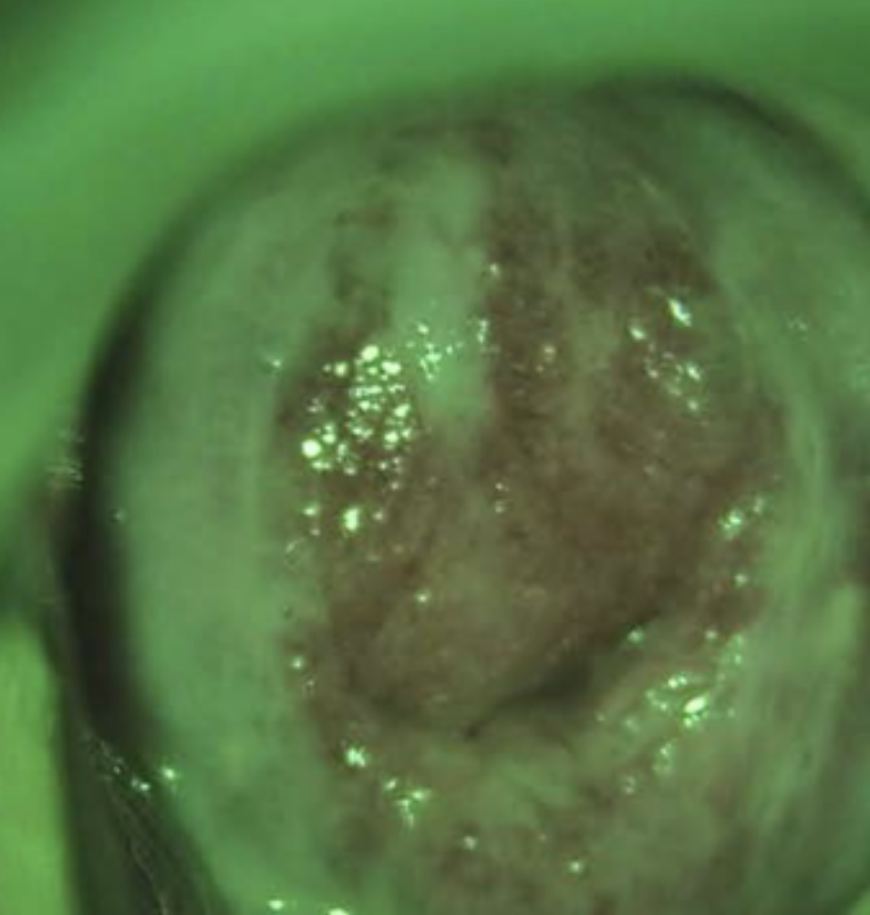
Use of the colposcope (2/2)
4 | 5
Focus | Green filter
Position the colposcopse to the desired height and distance (ideal working distance around 30cm) and set the magnification knob on position 1. Focus with the variofocus. | When needed, pull the the Pull-tab to activate the green filter.

Slide 23
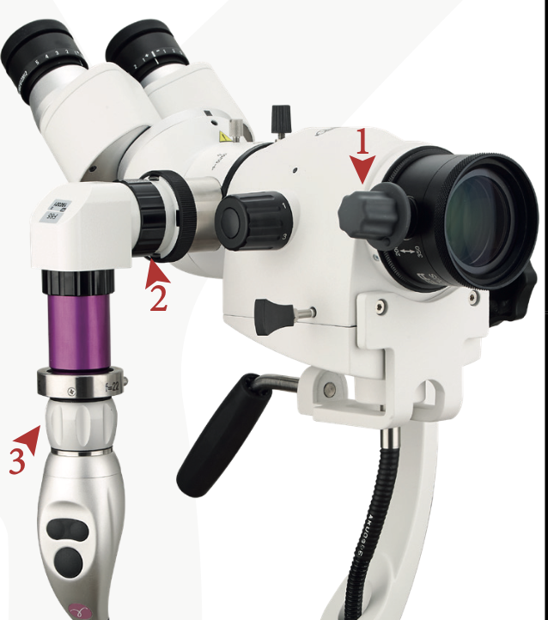
Operation with iCare
Focusing
Place the colposcope at about 30cm in front of the visualization site. Set the magnification knob on position 1.
Focus on the visualization site with the variofocus (1) while looking into the binoculars.
Focus, looking at the image on the screen, with the focus rings (2) and (3).
Once the focus is achieved, do not manipulate the focus rings (2) and (3) anymore. During the examination, only manipulate the variofocus knob (1).
Other particularities
Switch on the iCare light source without connecting a light cable in order to remove the « Please switch on the light source » message on the screen.
Do the white balance of the iCare camera switching on the colposcope light source.

