Slide 1
Company Profile
2021

Slide 2
KEY DATA

Slide 3


Ces solutions reposent sur les deux piliers que sont :
Des sets d'instruments de chirurgie plus respectueux de l'intégrité de la patiente.
Une station d'imagerie moderne, exploitant pleinement les possibilités offertes par internet et le Cloud.
Our ambition
Delmont imaging’s mission is to improve the care and management of all patients, regardless of age and future, by providing the profession with innovative, effective and less traumatic solutions.
Our products are in line with the general trend of the outpatient surgery and more particularly with the
«See & Treat» concepts.

Slide 4






Key markers
B 3 500
2 811
2 200
SAS registered in January 2016
RCS Marseille : 817 710 411
1 500
710
Initial equity : 200 K€
Fundraising : 800 K€ over two years
ISO 13 485 Certification, version 2016
CE certificate for Class IIa and IIb products
Head Office: Athélia V
390, Avenue du Mistral
13600 La Ciotat - France
An eco-responsible approach highly committed
Offices : 228 rue de la Convention, 75015 Paris - France

Slide 5

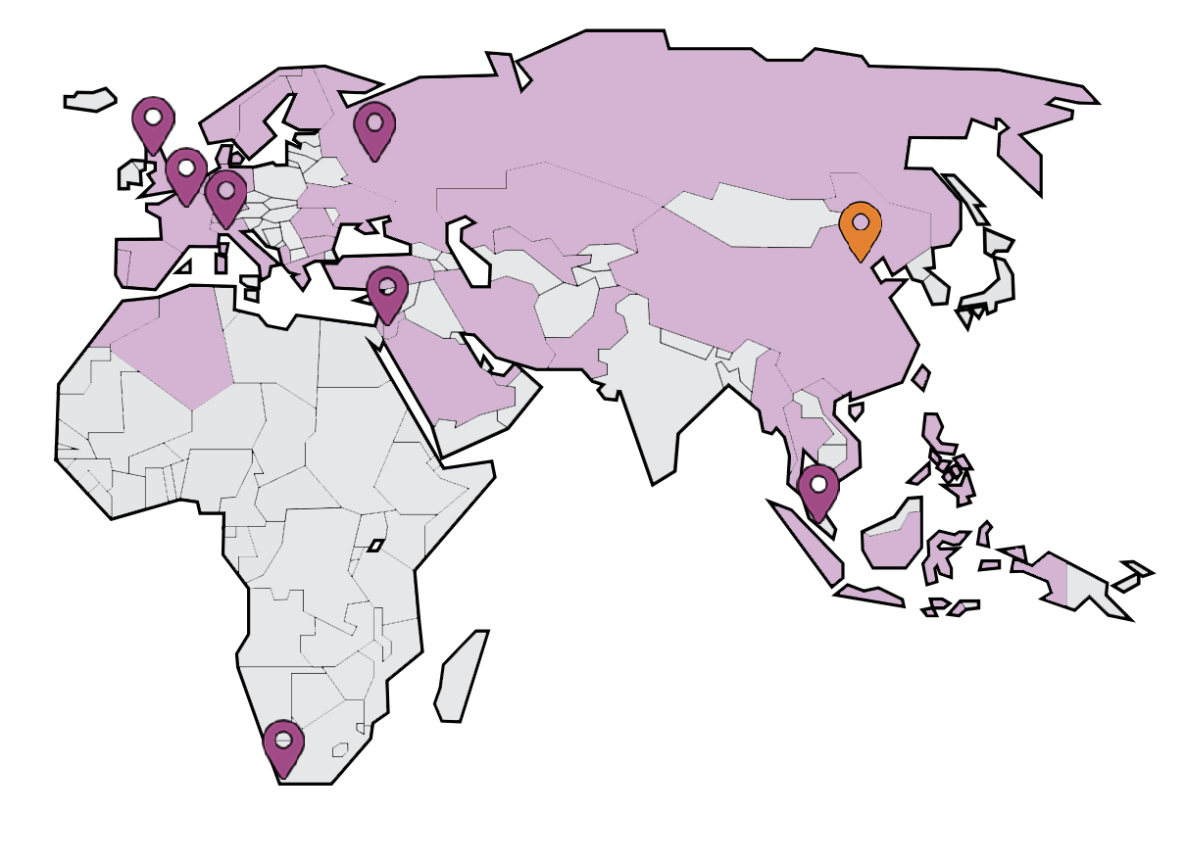








The teams
Our presence in the field
10
Employees at headquarters
8
International agents
Our advisers and some of our users around the world
Partners
worldwide
12
Agents in France
36
Prof. Hervé Fernandez
Dpt, Head OB/GYN of KB. Paris
President of the scientific council
Dr. Olivier Chanelles
Château’s medical center. Paris
Prof. Gil Dubernard
Croix-Rousse Hospital. Lyon
Prof. Aubert Agostini
Conception Hospital. Marseilles
Prof. Grigoris Grimbizis
Genesis Hospital. Thessaloniki.
Prof. Ettore Cicinelli
Polyclinic of Bari.
Dr. Jan Palmø
Holbaek Hopsital.
Prof. Prudence Aquino-Aquino
St. Luke’s medical center. Philippines
Prof. Tô Minh Hương
Vinmec Hospital. Ha Noi.
Dr. Elie Sneifer
Snaifer Clinic. Beirut
Dr. Nabil Moulay
Capitale Clinic. Rabat.
Dr. Farid Benaibouche
Sidi Yahia Clinic. Alger

Slide 6
KEY produCTS

Slide 7
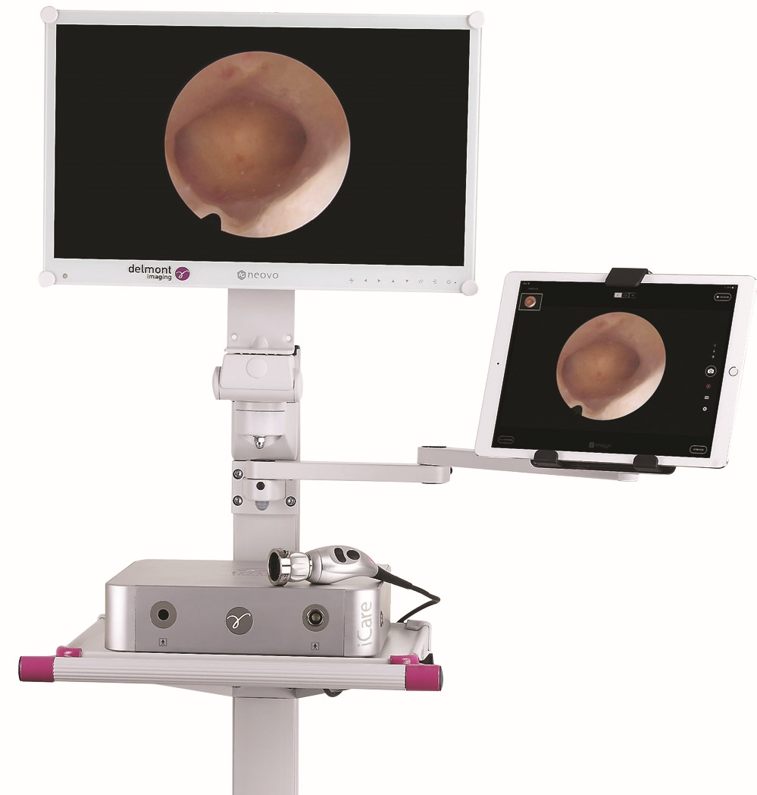



Imaging
iCare+ is a complete imaging column dedicated to hysteroscopy in consultation or ambulatory rooms. Quality, simplicity and efficiency are the values of this solution.
It includes an HD camera, an LED light source, a compact cart and an iPad Pro with applications that can be downloaded from the AppleStore.
imagyn : allows patient management, viewing of the iCare video stream and to complete and high quality hysteroscopy report.
MyReport : imagyn App but with a generic report.
iZap : Allows control and monitoring of iCare.

Slide 8
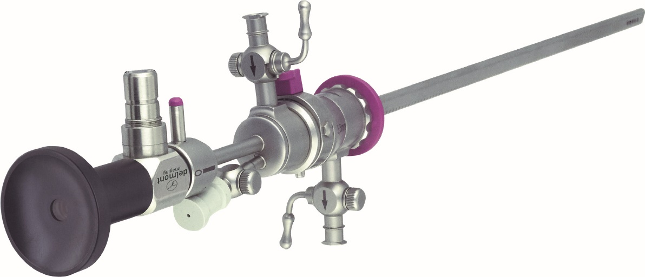
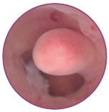
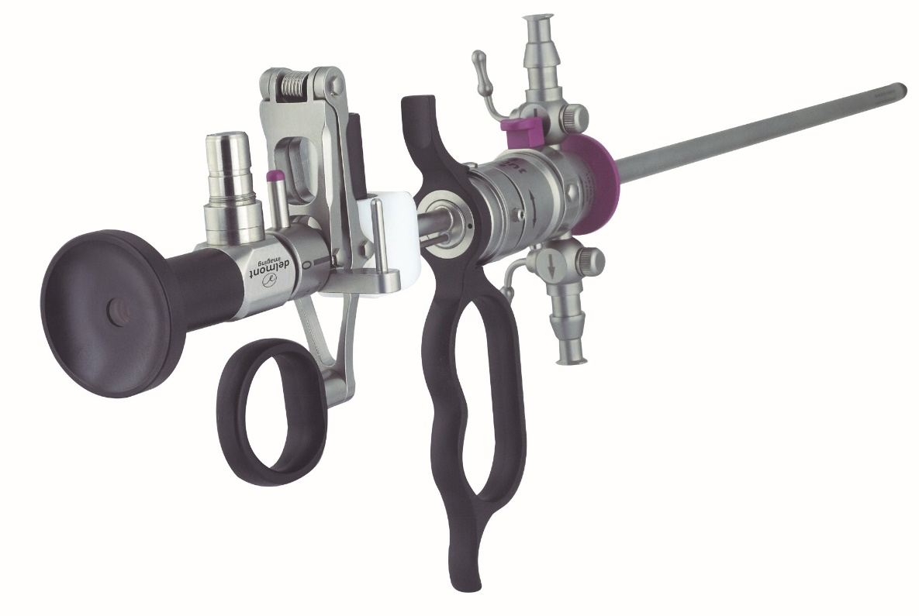
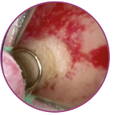
Hysteroscopic instrumentation
Our range of hysteroscopic instrumentation features two key products:
EasyCare.
An energy-free instrument set, combining performance and reduced diameter, making it ideal for nulliparous patients and infertile couples.
ReseCare.
A bipolar resector with a 6mm diameter.
The reduced dilatation makes it ideal for nulliparous patients, infertile couples and menopausal women or with a stenotic cervix.
Our electrodes are available sterile or reusable.

Slide 9
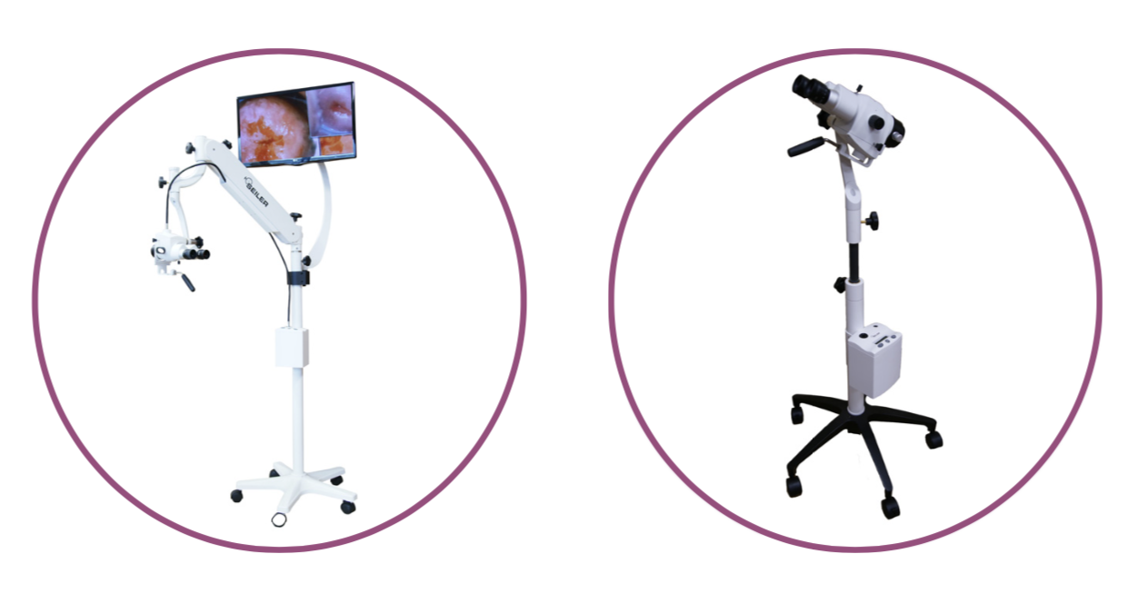
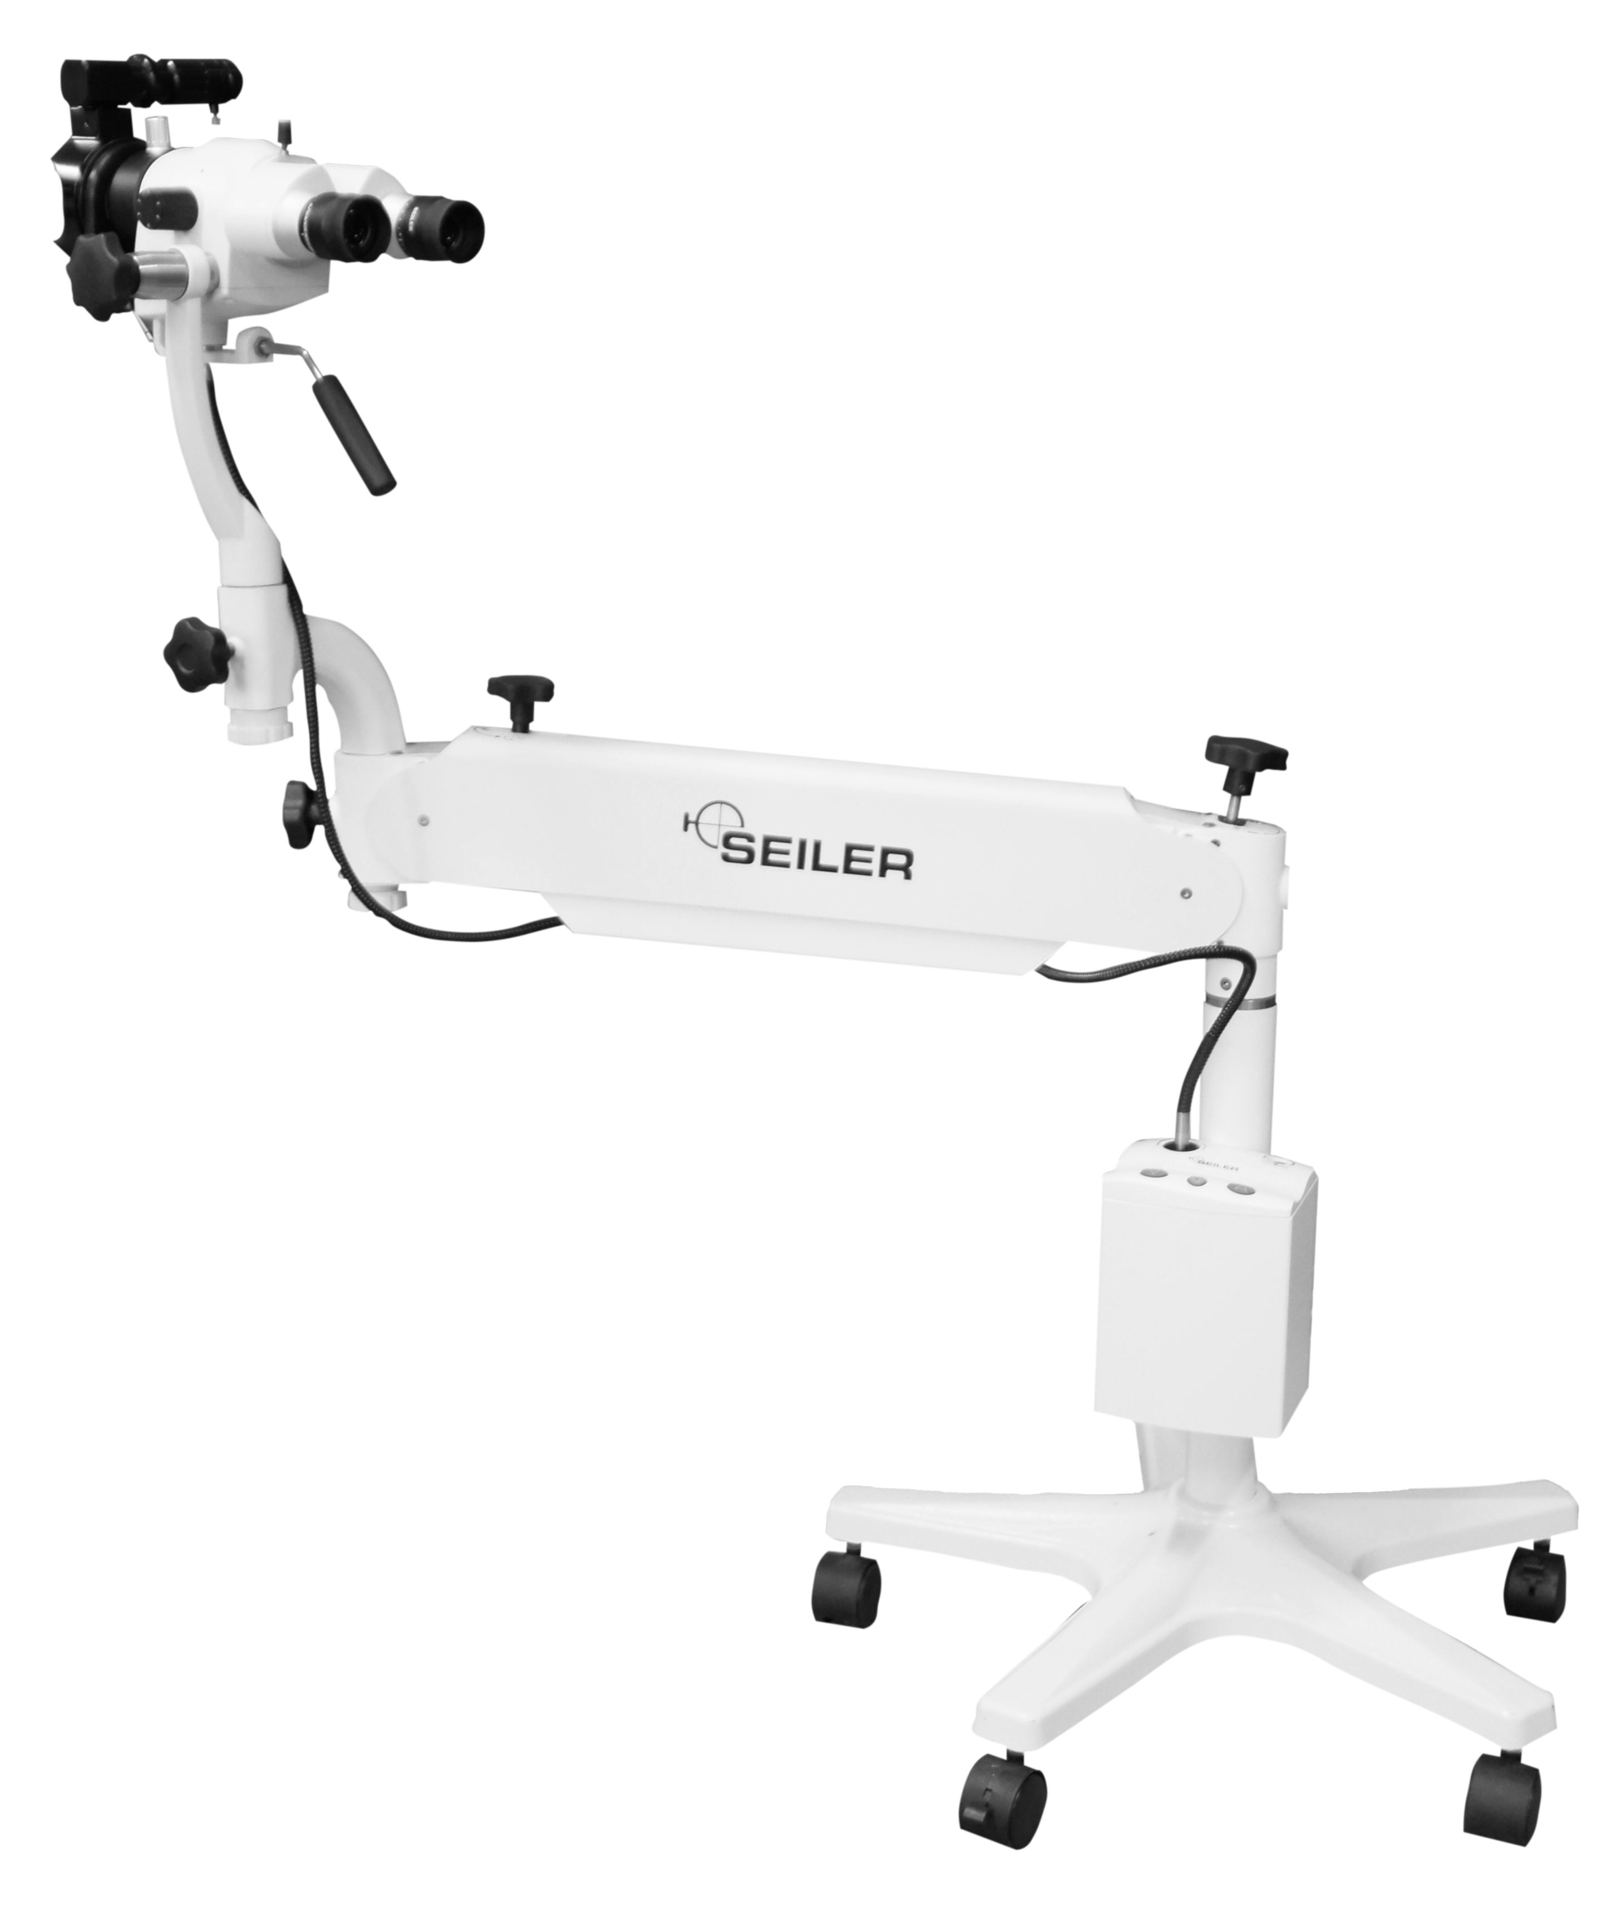
Colposcopy
The ideal complement to our solutions for gynaecology consulting rooms, with the same standards of quality, ergonomics, reliability and efficiency.
Several configurations are available for ergonomics, magnification levels or choice of lens. A large list of accessories is also available.
Our imagyn application has also evolved to include colposcopy reports in addition to hysteroscopy.

Slide 10
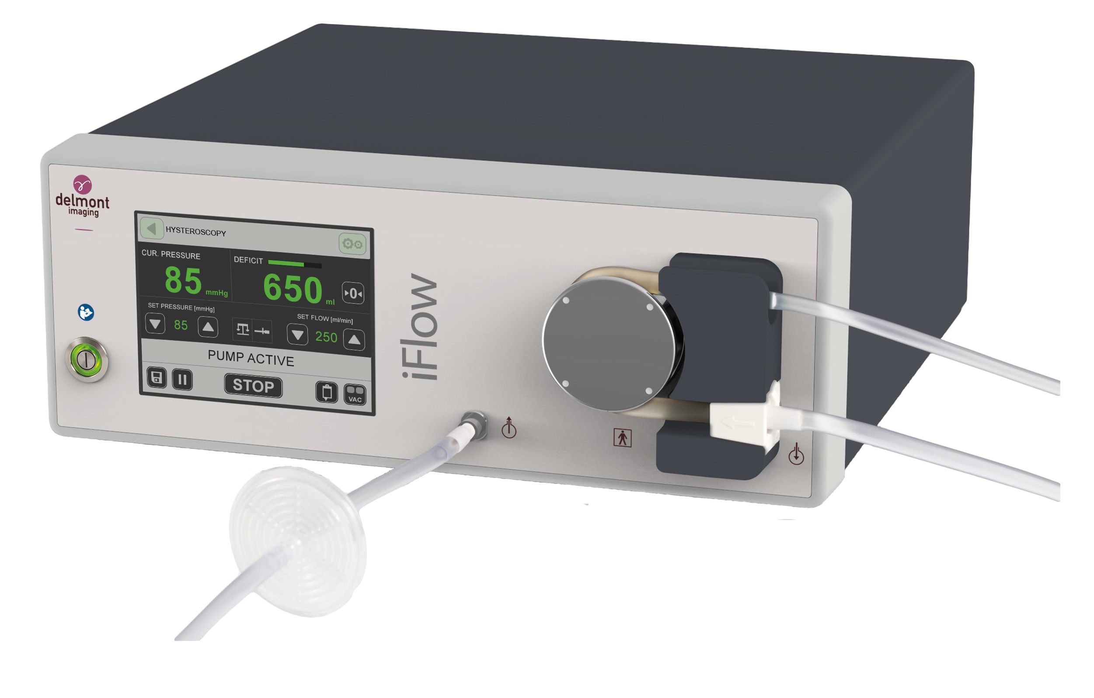
The irrigation pump
The irrigation pump is an essential complement to a quality and safe hysteroscopy.
iFlow is mainly proposed in hysteroscopy but its many programs make it suitable to operate also in Urology, Laparoscopy and Arthroscopy.
Its main key points:
Accurate pressure measurement
Controlled suction via 2 speeds
RFID control of irrigation tubes
Clear display of key information and alerts
Easy handling of the pump and tubing
Automatic deficit calculation

Slide 11
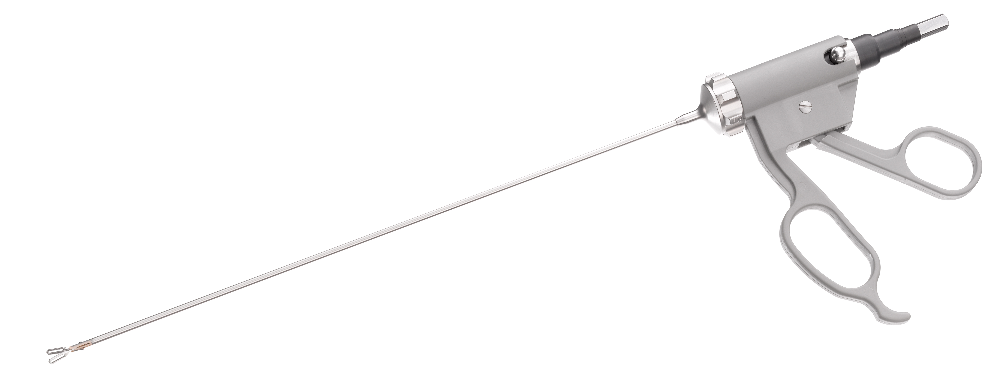
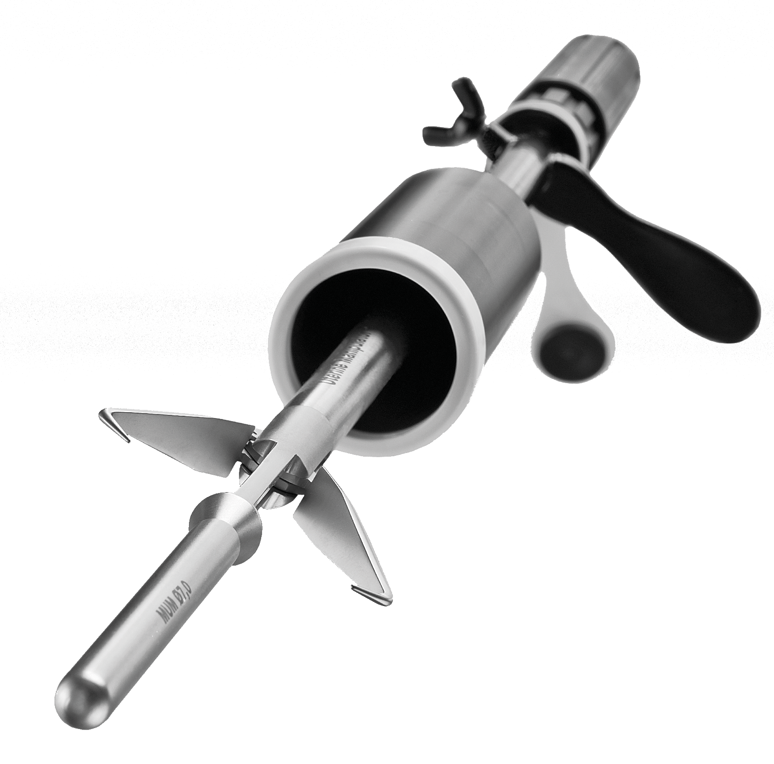
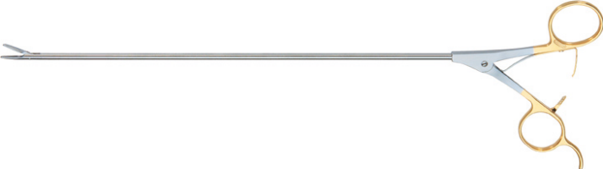
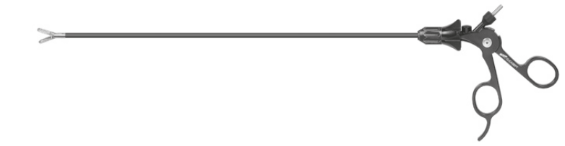
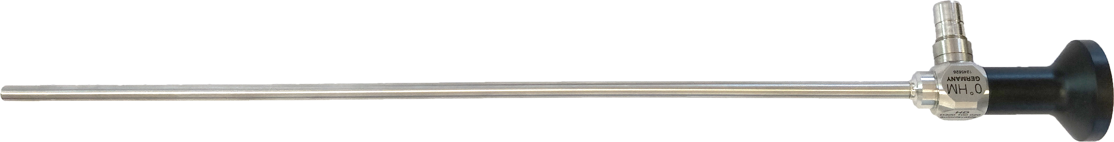
The laparoscopic range
This new catalogue contains more than 150 referenced instruments such as:
Laparoscopes
Trocars
Grasping and dissecting forceps
Biopsy instruments and scissors
Suture and ligature
Accessories
Uterine manipulators

Slide 12
DEPARTMENTS

Slide 13
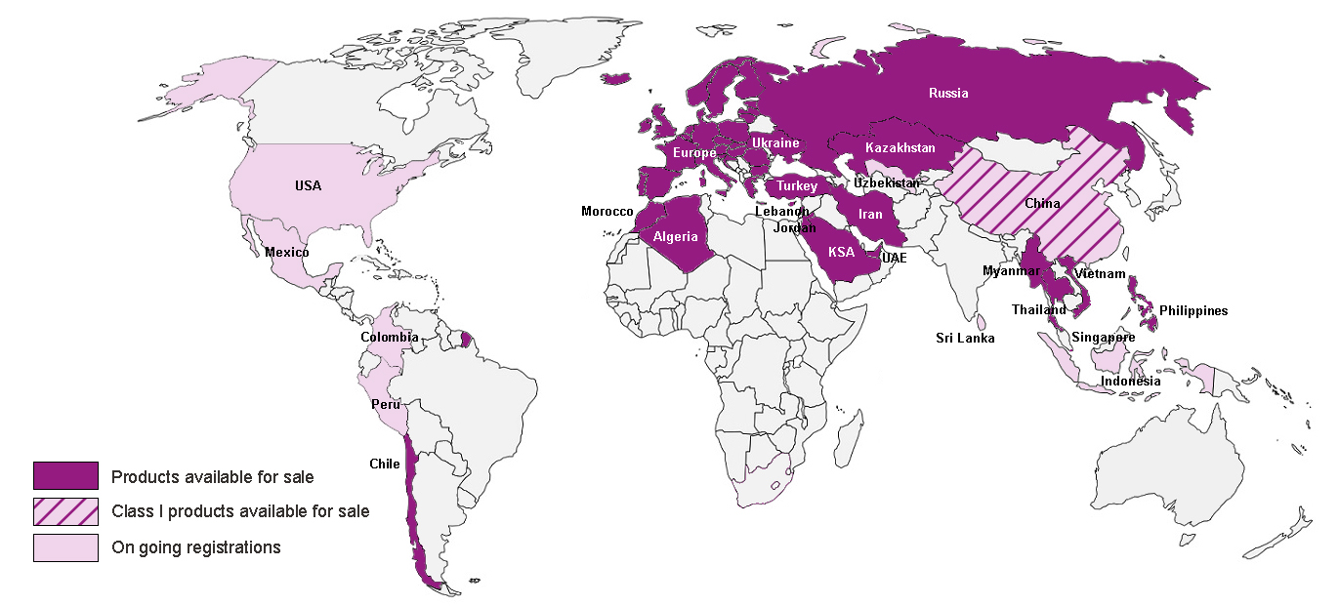
Regulatory

Slide 14

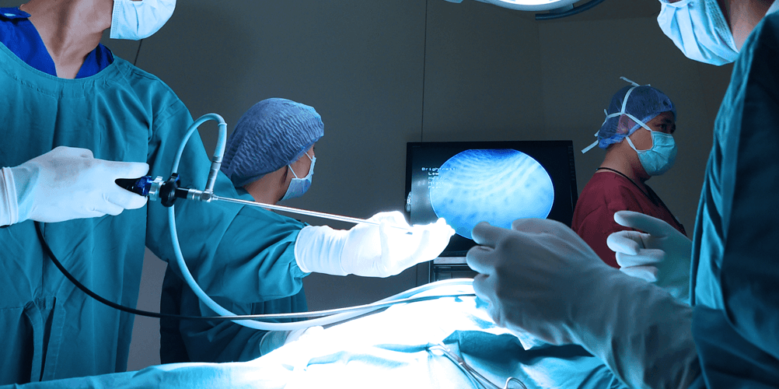

Research & Development
Innovation is in our DNA and at the very core of the company’s activity, with the firm commitment to provide surgeons with ever more efficient tools respecting patients
Our list of projects covers a wide variety of topics ranging from surgical instrumentation to new Apple applications!
Delmont already applied for several patents.

Slide 15





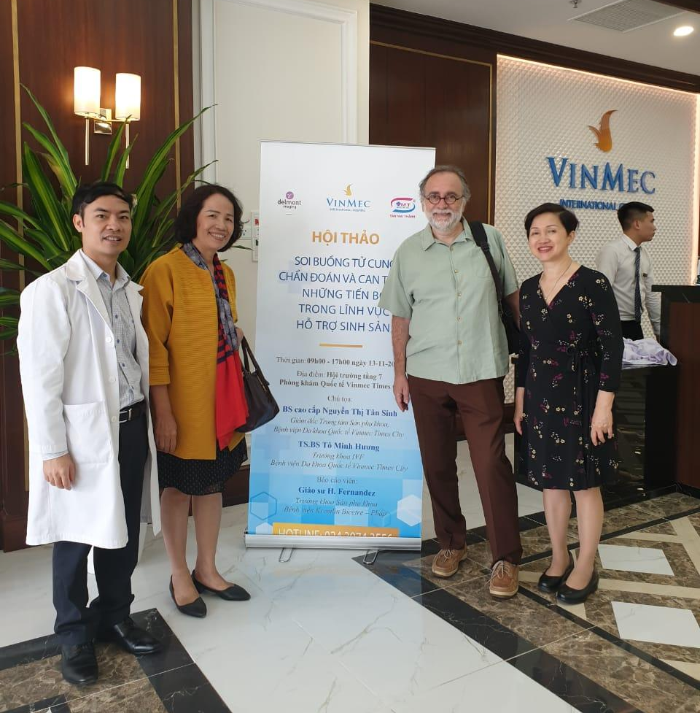
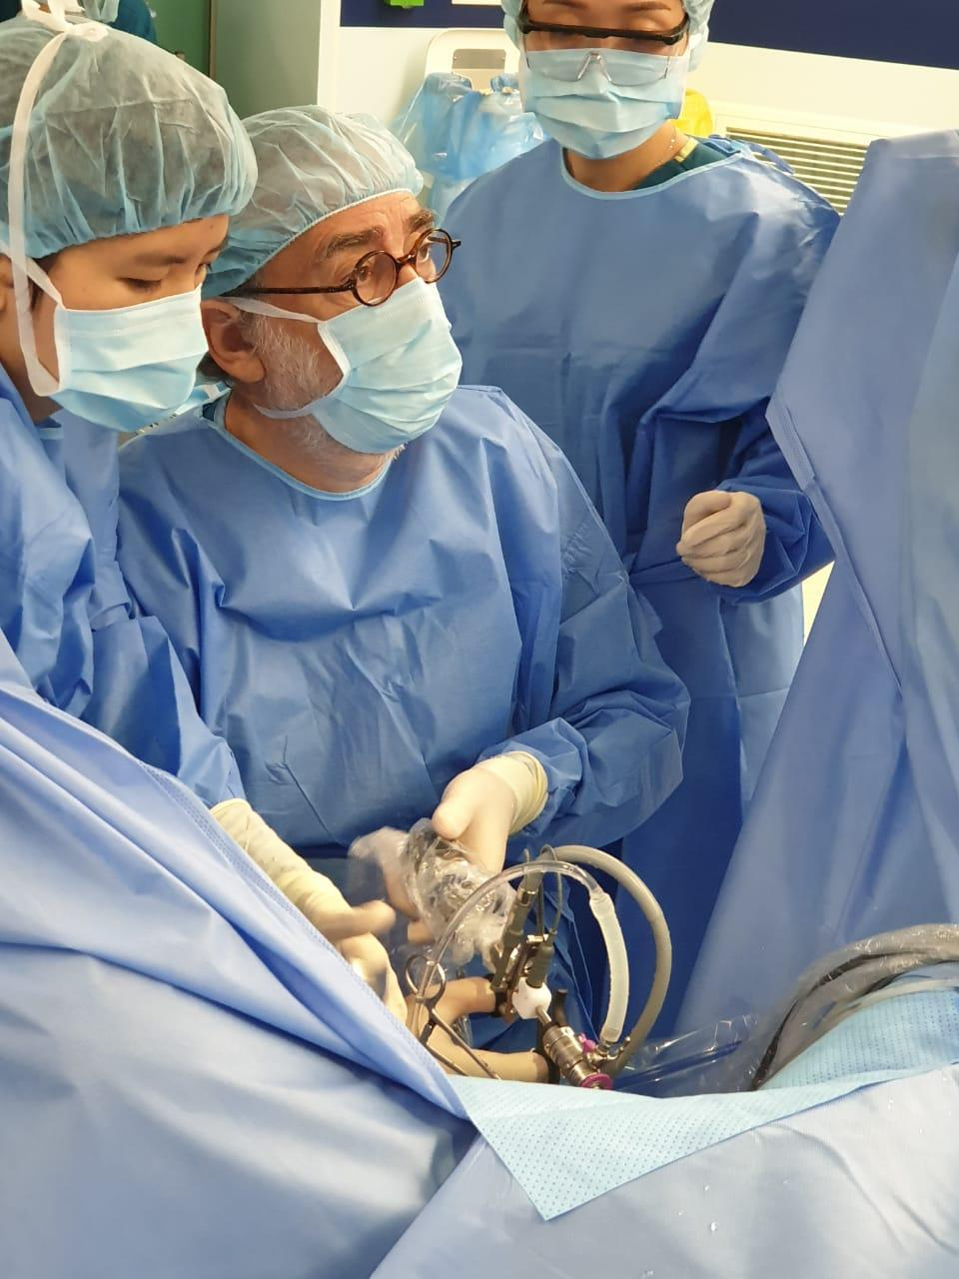
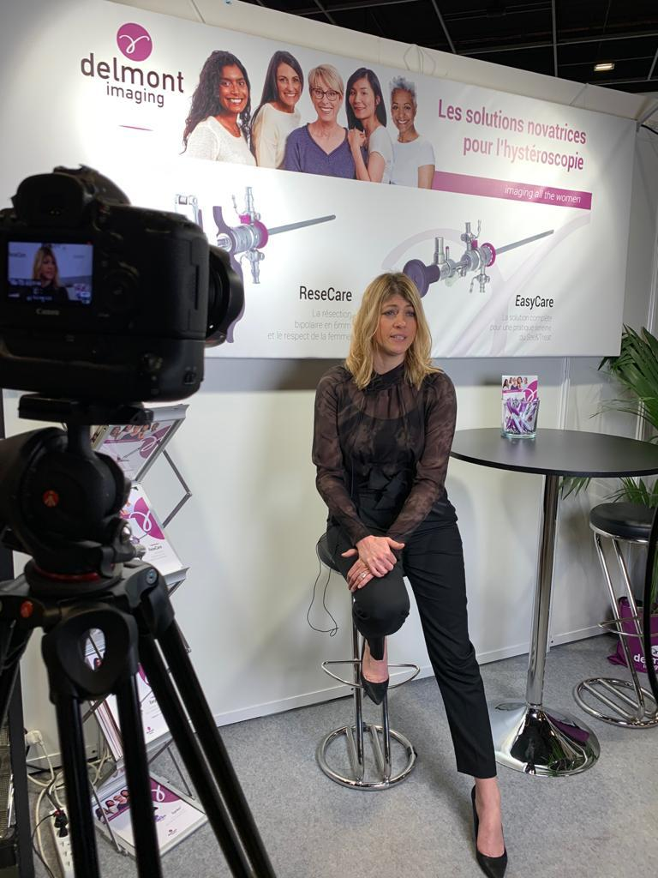
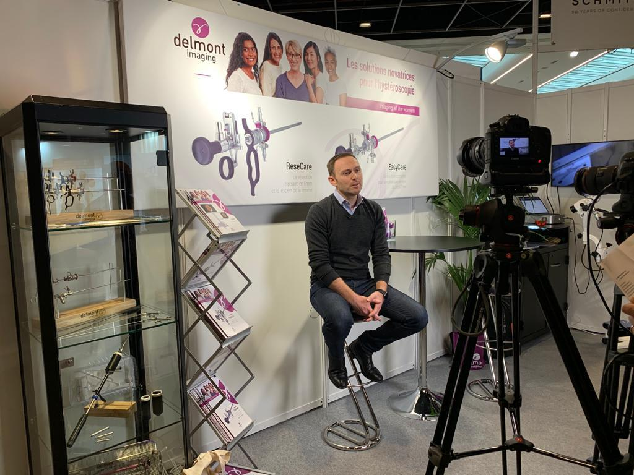
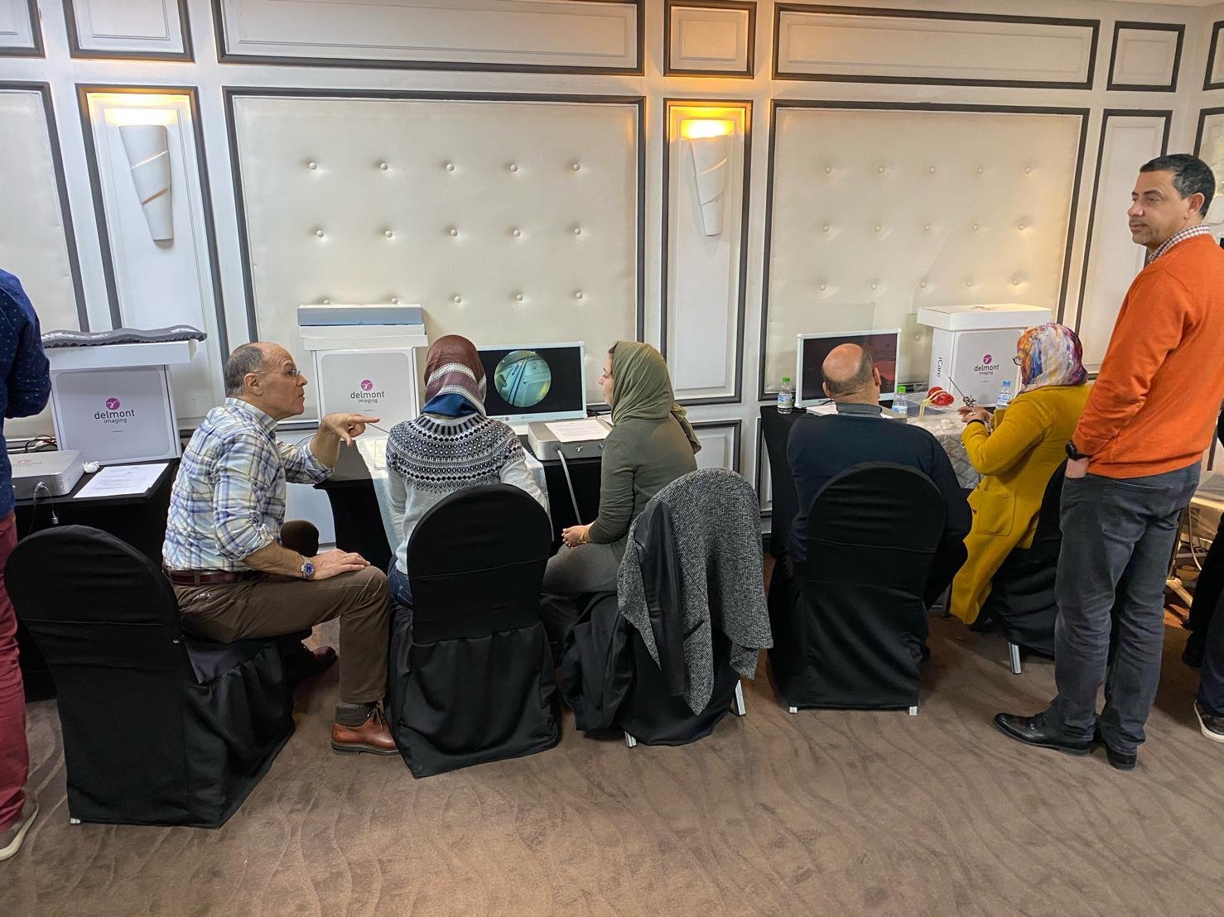
Marketing
Participation in many congresses and webinars
Participation in numerous workshops
Creation & publication of a serie that contains interviews of our users

Slide 16
Thank you for your attention !
Notes:
Des questions ? Qques remerciements…

