Slide 1
Company Profile
2019

Slide 2
KEY DATA

Slide 3


Ces solutions reposent sur les deux piliers que sont :
Des sets d'instruments de chirurgie plus respectueux de l'intégrité de la patiente.
Une station d'imagerie moderne, exploitant pleinement les possibilités offertes par internet et le Cloud.
Our ambition
Improving the health care and management of all patients, regardless of their age and future, by providing the profession with innovative, effective solutions more respectful of the patient's integrity.

Slide 4






Key markers
2 100 K€
1 500 K€
SAS registered in January 2016
RCS Marseille : 817 710 411
710 K€
Initial equity : 200 K€
Fundraising : 800 K€ over two years
June 2018 : New head office
R&D subventions (350 K€)
Refundable export advance (320K€)
ISO 13 485 Certification, version 2016
CE certificate for Class IIa and IIb products
Head Office: Athélia V
390, Avenue du Mistral
13600 La Ciotat - France
Offices : 228 rue de la Convention, 75015 Paris - France

Slide 5
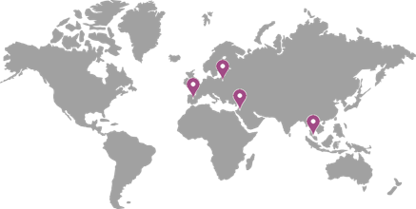





The teams
Our global presence
In 2018, Delmont imaging's teams were strengthened by the arrival of:
2
International agents
A scientific council to guide our R&D researches, the choice of the programs, the performances targeted, the evaluation of the devices.
1
R&D Engineer
Pr. Hervé Fernandez
Dpt, Head OB/GYN of KB
Paris - France
President of the scientific council
Pr. Grigoris Grimbizis
Genesis Hospital. Thessaloniki - Greece
1
In-house production engineer
Dr. Jan Palmø
Holbaek Hospital -Danmark
1
Sales Administration Manager
Dr. Olivier Chanelles
Centre médical du Château Paris - France
Pr. Ettore Cicinelli
Bari Polyclinic - Italy

Slide 6
KEY produCTS

Slide 7
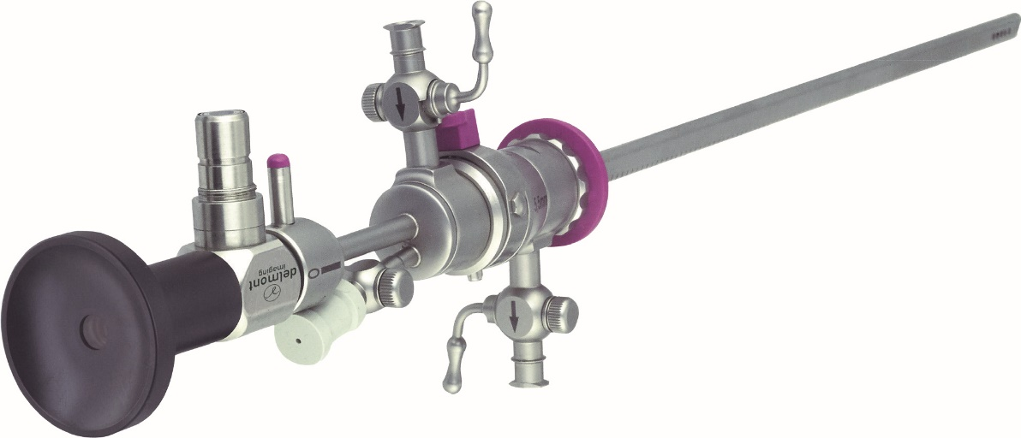
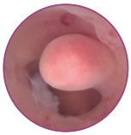
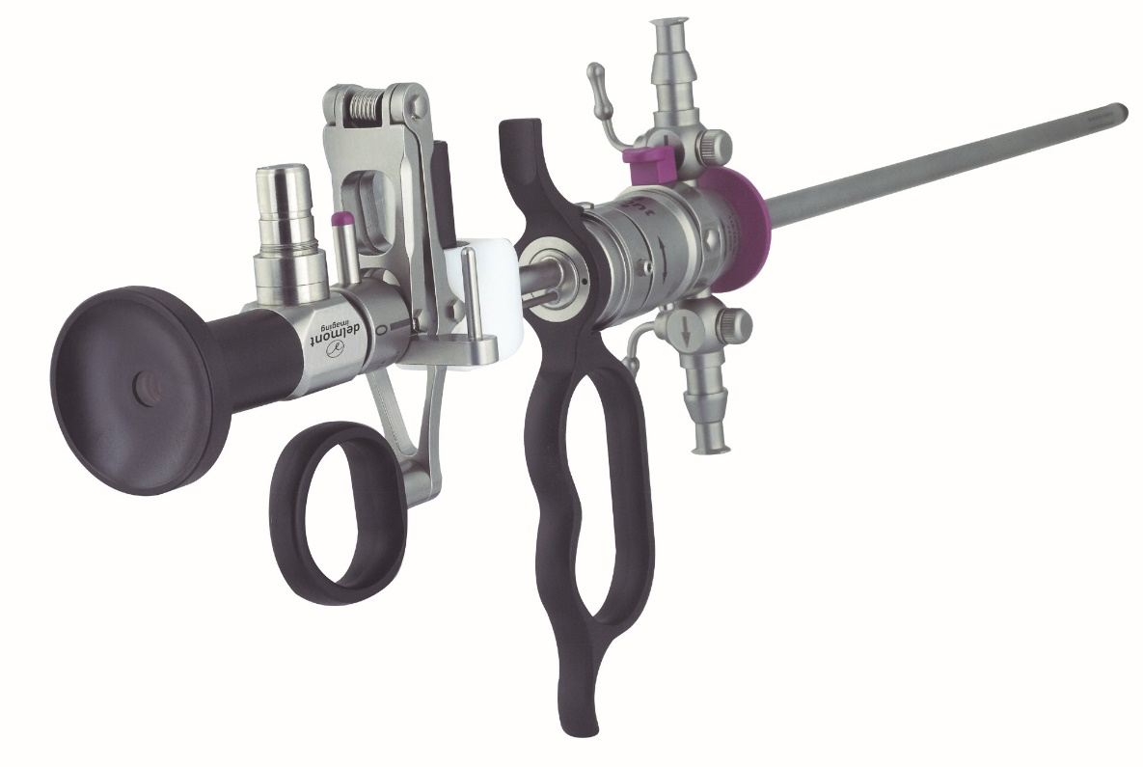
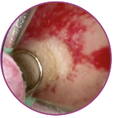
Hysteroscopic instrumentation
Our range of hysteroscopic instrumentation is divided into two families:
Cold instrumentation.
EasyCare combines a set of energy-free but efficient hysteroscopic instruments with a reduced diameter. Ideal for nulliparous patients and infertile couples.
Resectoscopy.
Two bipolar resectors that only differ in diameter:
6 mm for ReseCare. A smaller dilatation makes this solution perfectly adapted to nulliparous patients, infertile couples, postmenopausal women or with a stenosis cervix.
9 mm for MaxiCare. A classic.
Our electrodes are available sterile or reusable.

Slide 8
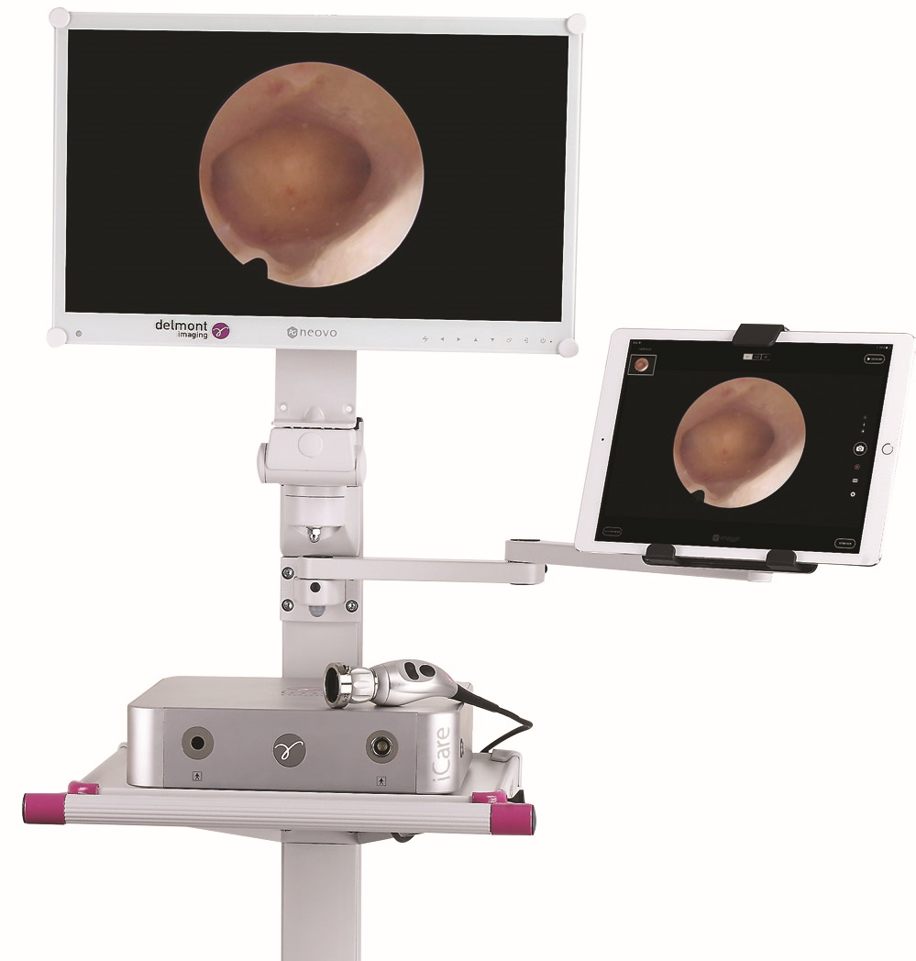


Imaging
iCare+. Imaging system dedicated to consulting room or outpatient hysteroscopies. This solution shares the same values as the Apple range products :
  Quality : design, performances and reliability
  Simplicity : intuitive and immediate
  Efficiency : Time saving use
iCare+ features an HD camera, a LED light source, a compact cart and an iPad Pro with imagyn.
imagyn : application available on the Apple Store.
It allows the management of the patients, to view the video flow of the camera on the iPad but most of all to make a complete and aesthetic report in a few clicks!
For those who simply want to control their camera, iZap control is also available on the Apple store.

Slide 9
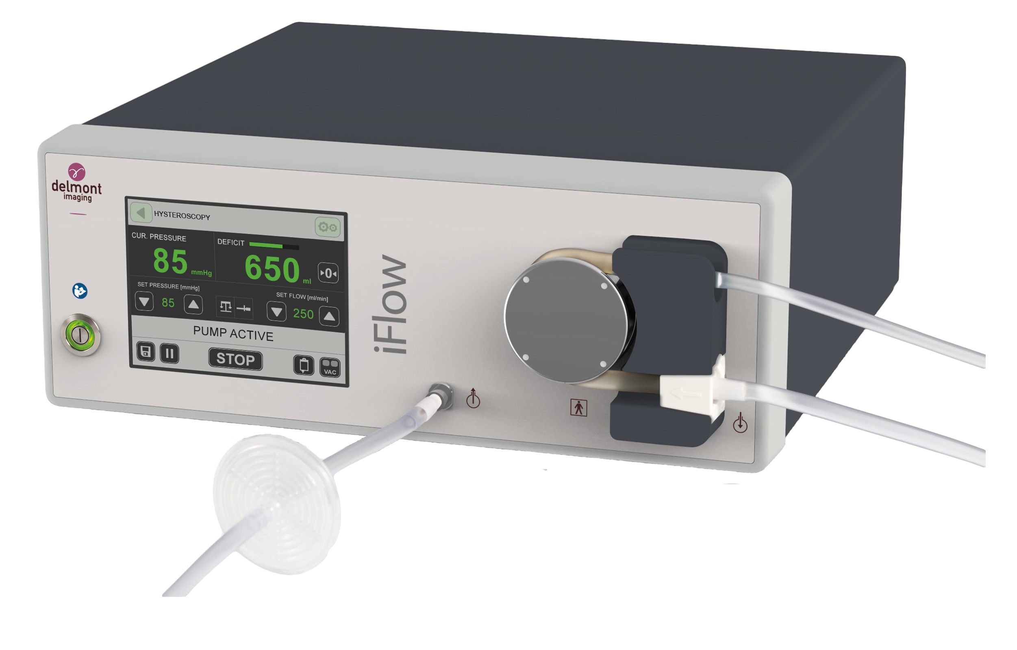
The irrigation pump
The irrigation pump is an essential complement to a quality and safe hysteroscopy.
iFlow is mainly proposed in hysteroscopy but its many programs make it suitable to operate also in Urology, Laparoscopy and Arthroscopy.
Its main key points:
Accurate pressure measurement
Controlled suction via 2 speeds
RFID control of irrigation tubes
Clear display of key information and alerts
Easy handling of the pump and tubing
Automatic deficit calculation

Slide 10
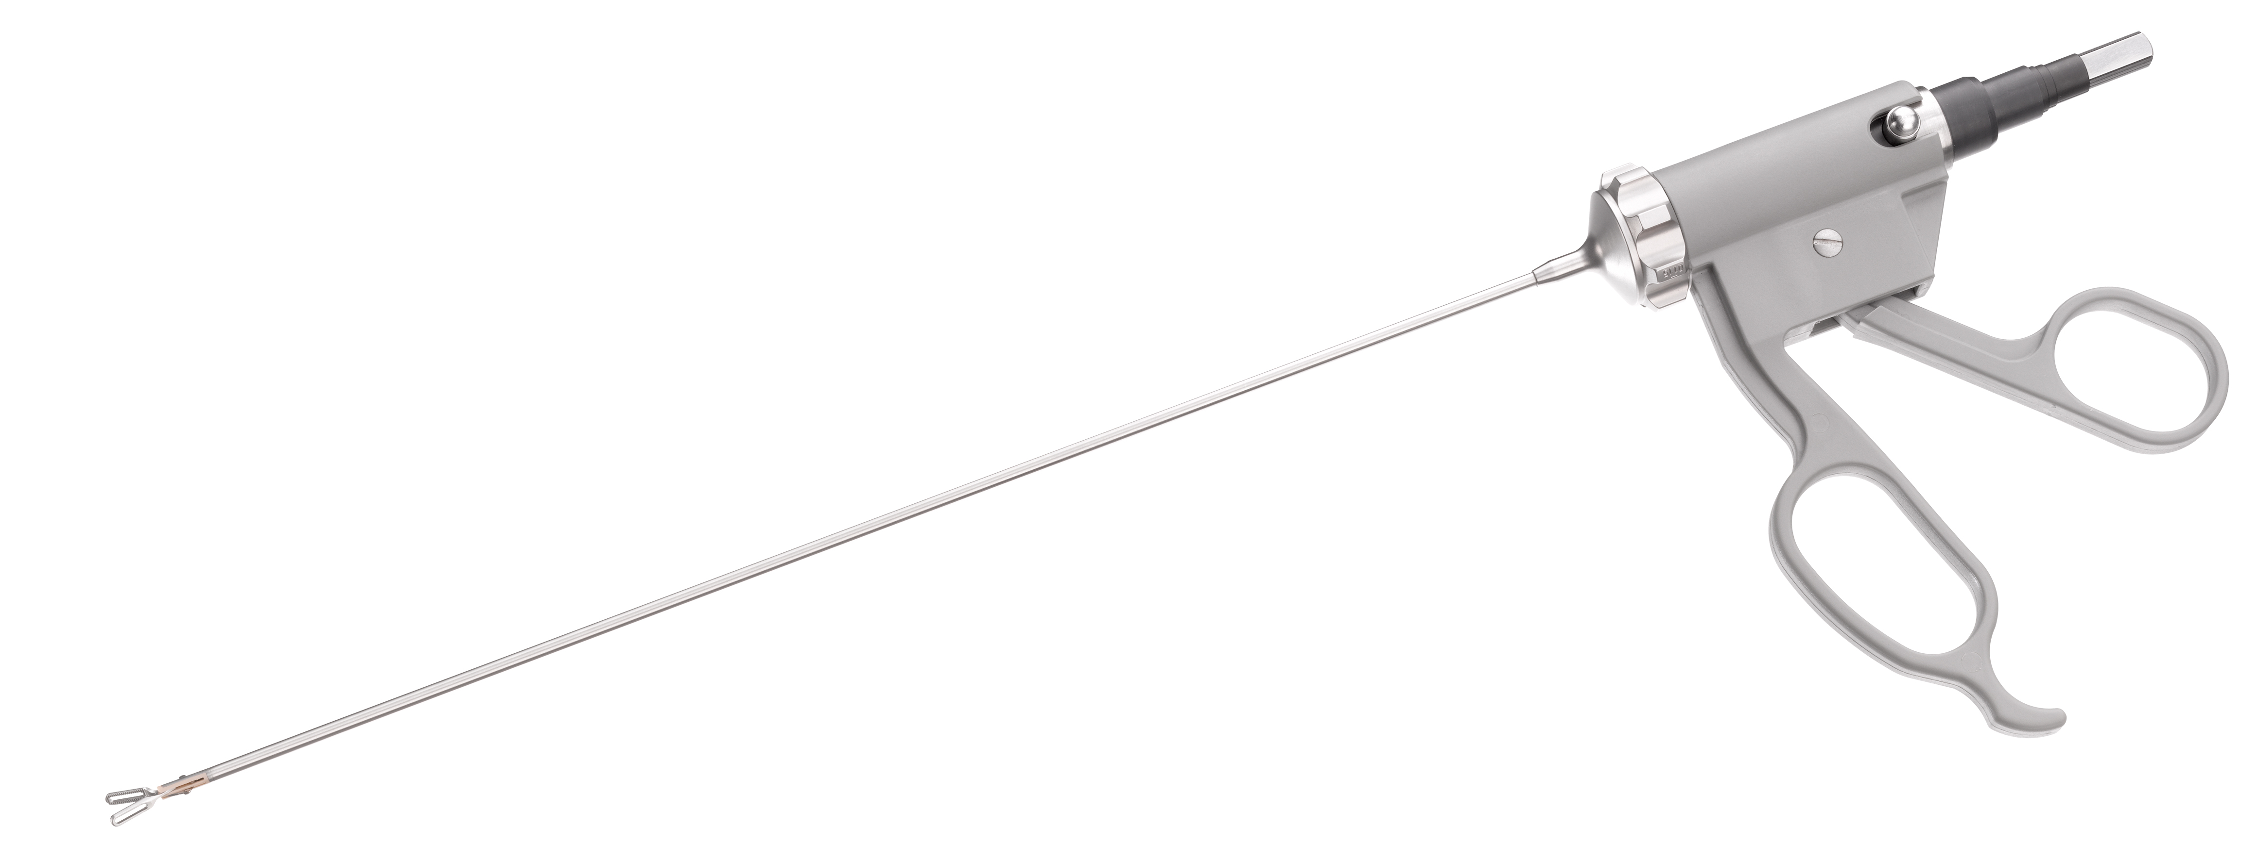
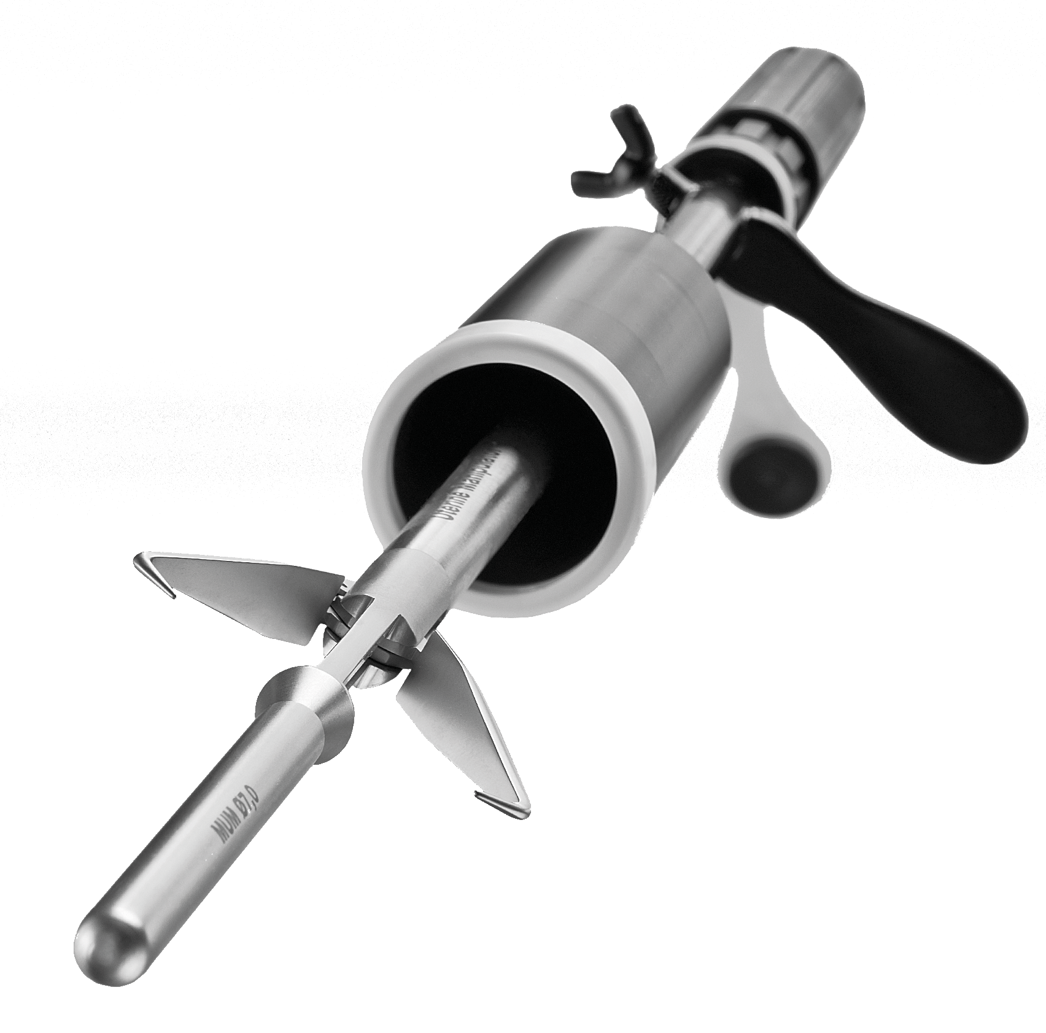
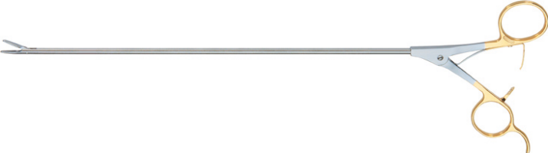
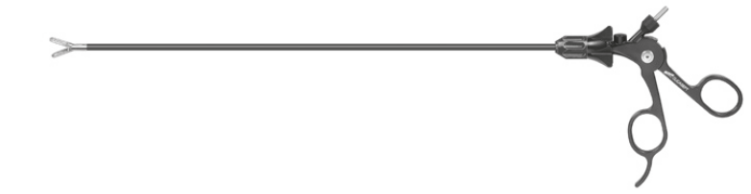
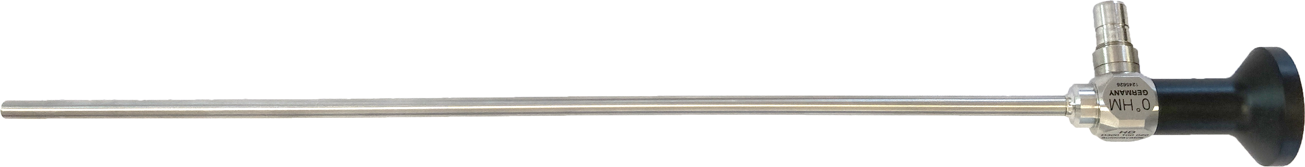
The laparoscopic range
This new catalogue contains more than 150 referenced instruments such as:
Laparoscopes
Trocars
Grasping and dissecting forceps
Biopsy instruments and scissors
Suture and ligature
Accessories
Uterine manipulators

Slide 11
DEPARTMENTS

Slide 12
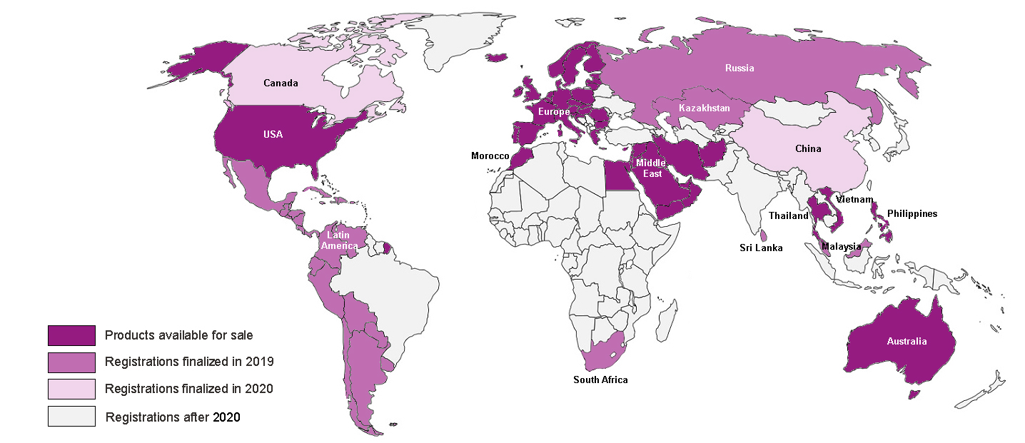
Regulatory
Our regulatory department has enabled us to access many countries. Other registrations are in progress at various levels:

Slide 13

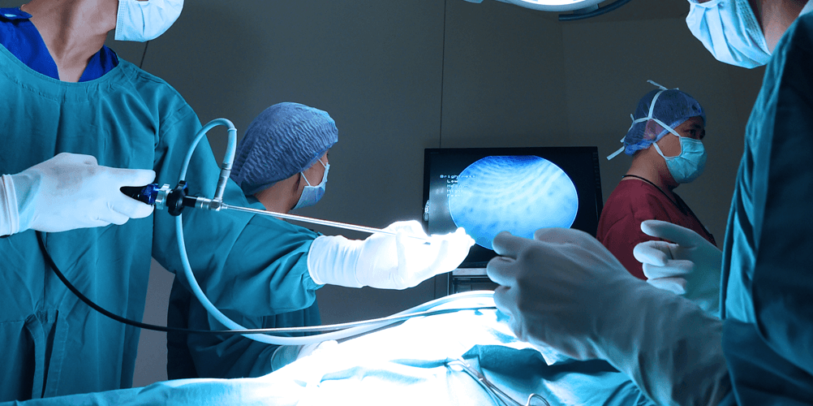

Research & Development
Innovation is in our DNA and at the very core of the company's activity, with the firm commitment to provide surgeons with ever more efficient tools respecting patients.
Our project pipeline includes:
Collaborative projects with research laboratories and other European companies on a major subject: endometriosis
Projects focused on surgical instrumentation
Projects focused on IT ( New App)
Projects focused on imaging

Slide 14






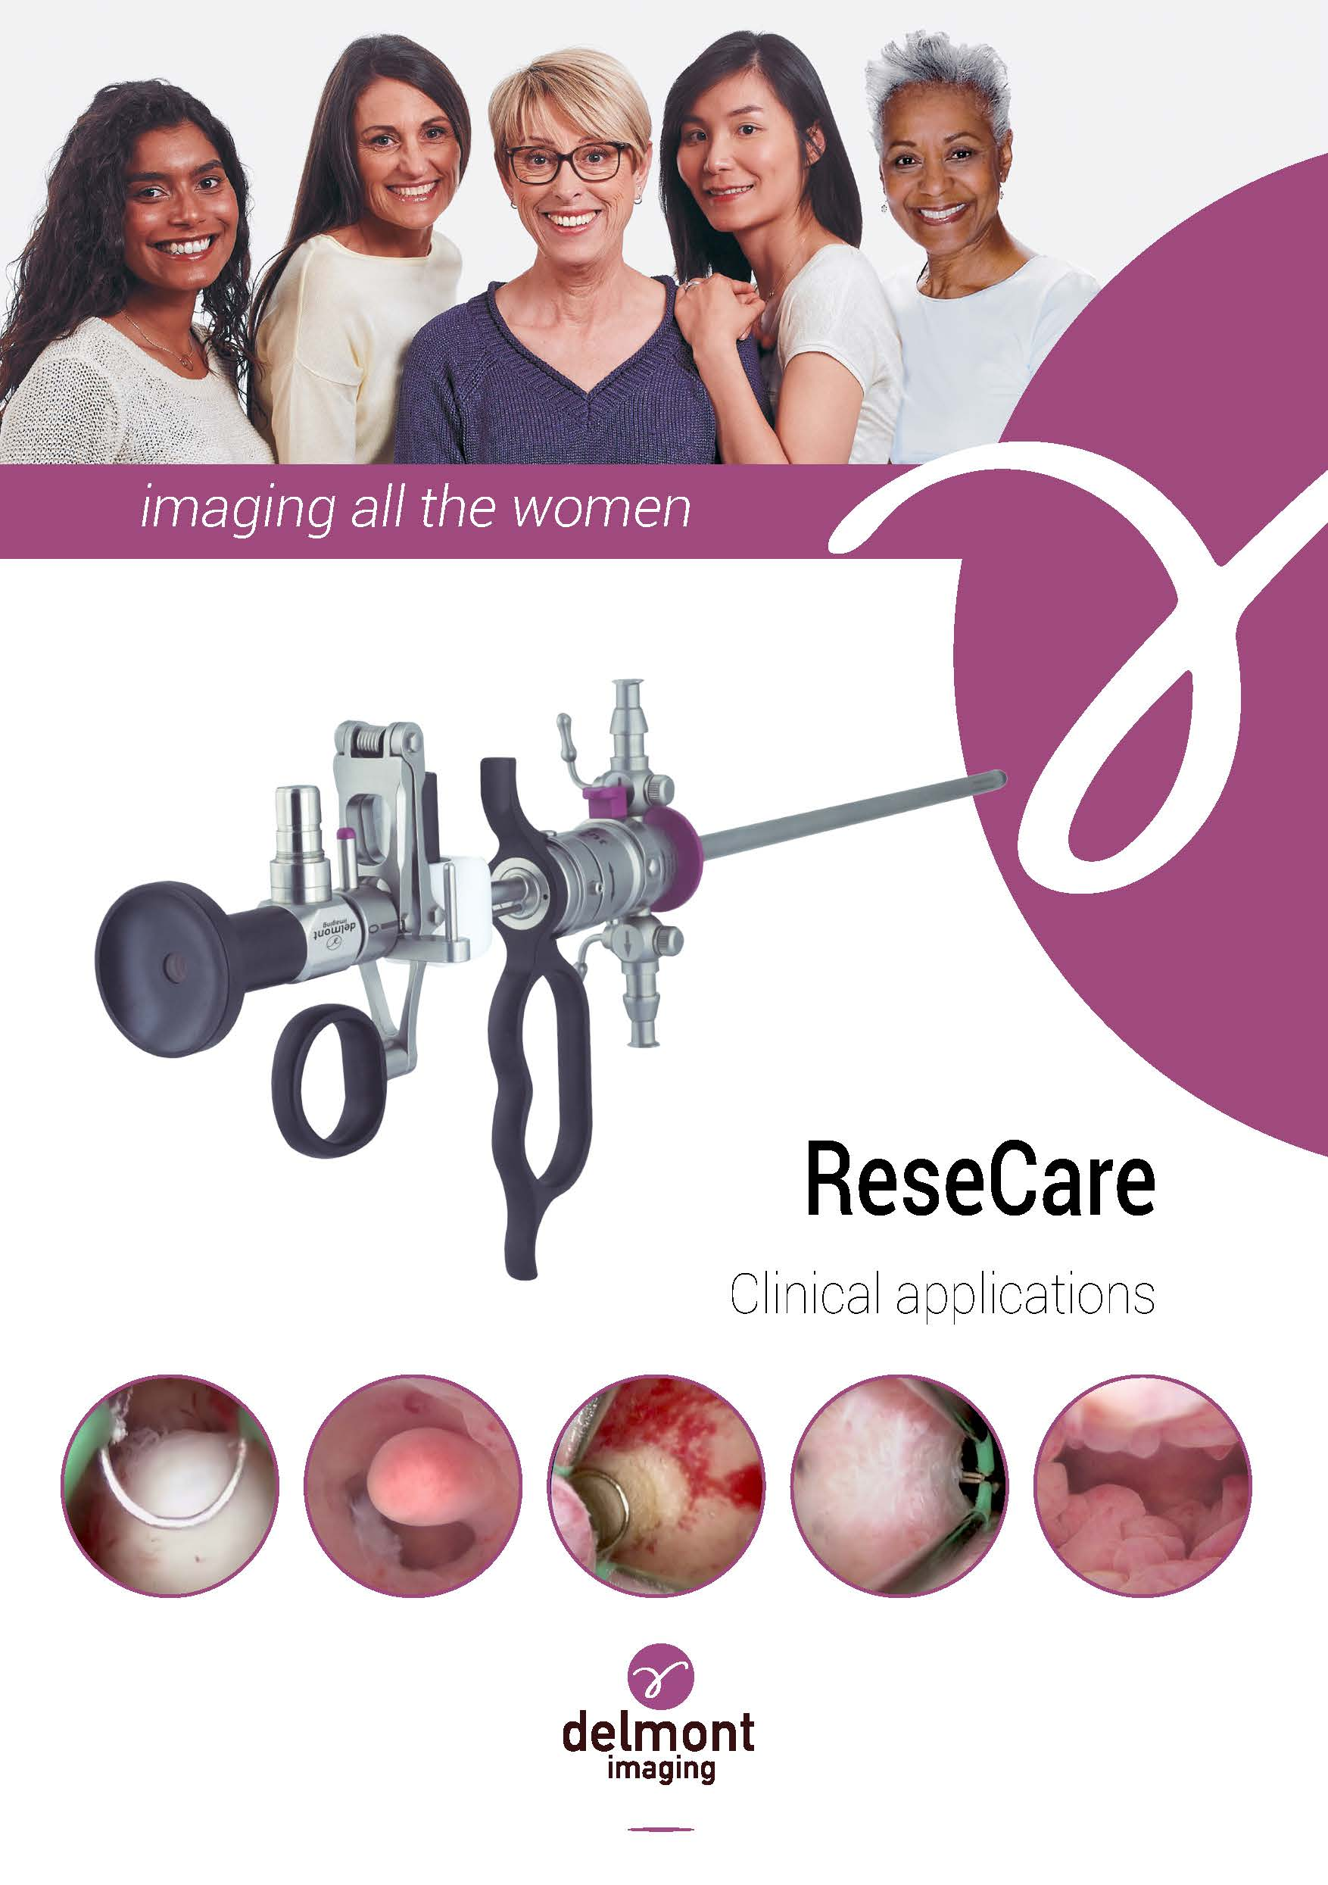
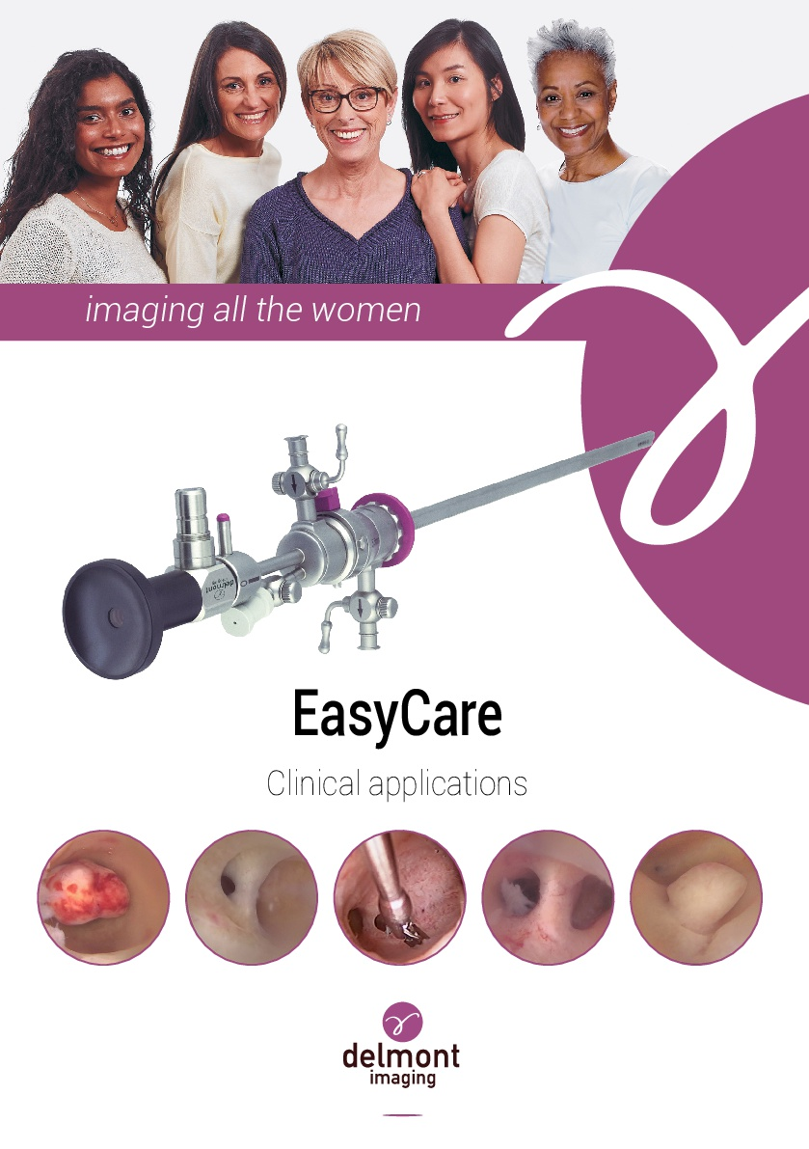


Marketing
24 congresses attended, including:
Two clinical booklets
In collaboration with 4 European KOLs, they cover all the pathologies that can be treated by our EasyCare and ReseCare sets. The digital version available on our website illustrates these acts through video sequences.
Efficient communication tools
A secured distributor area has been set up on our website, in order to make all our latest documents (marketing, regulatory, etc.) immediately accessible.

Slide 15
Thank you for your attention !
Notes:
Des questions ? Qques remerciements…

