Slide 1
iFlow
Outstanding performances for safer surgeries

Slide 2
Iflow OVERVIEW

Slide 3
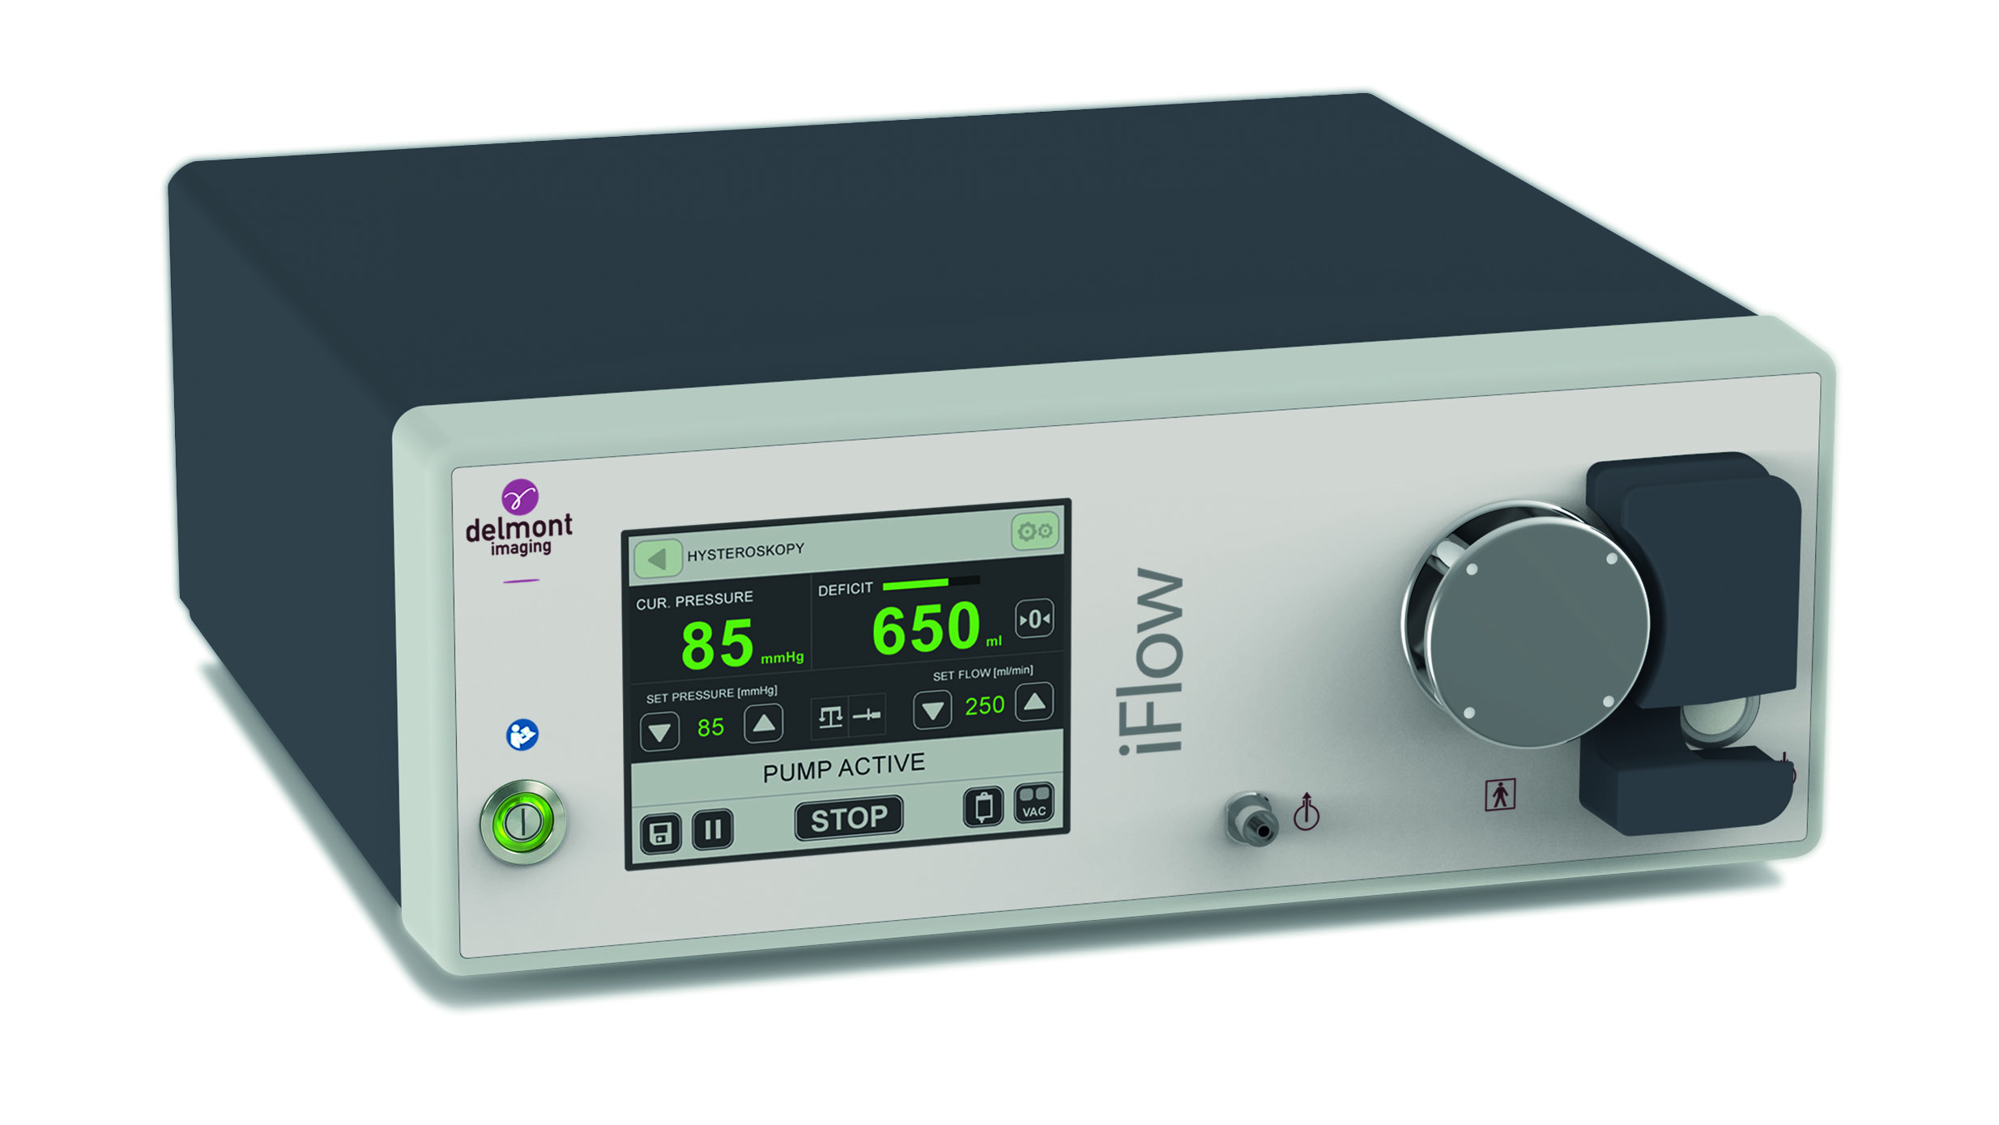
iFlow pump
User interface
Roller wheel
Transponder sensor (RFID)
Irrigation tube entrance
Start/stop button
Plug for suction tube

Slide 4

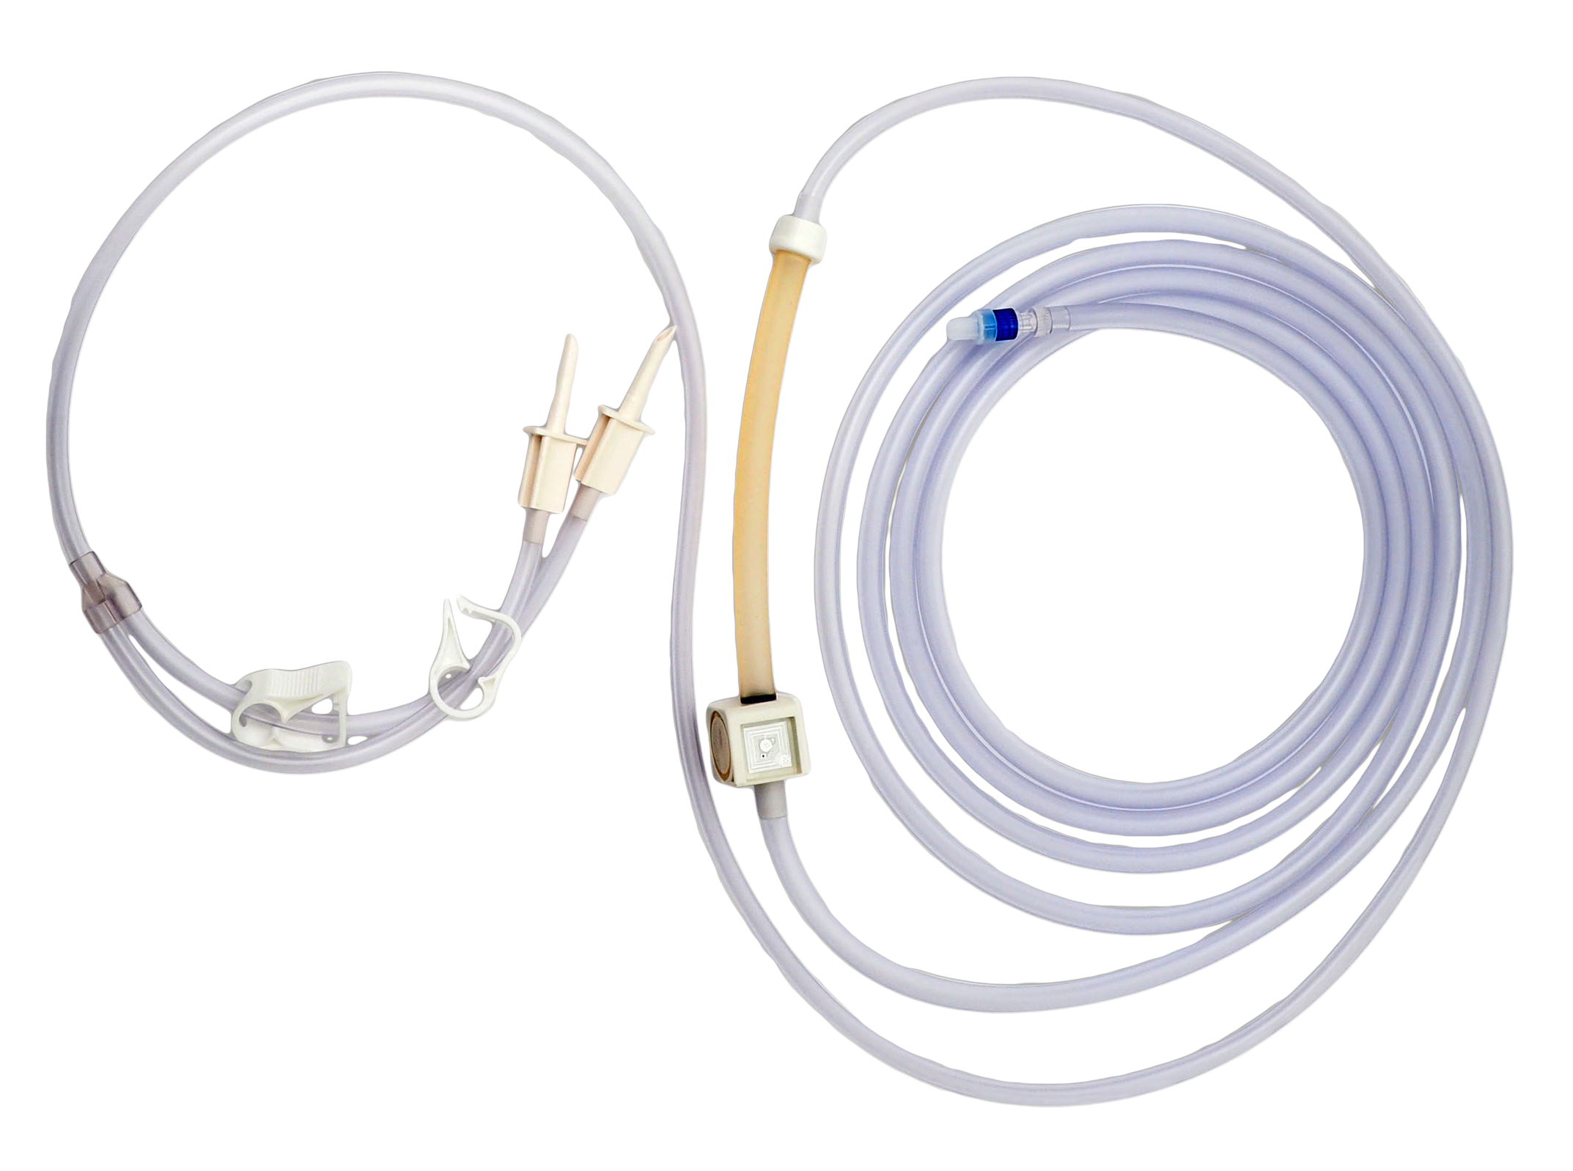
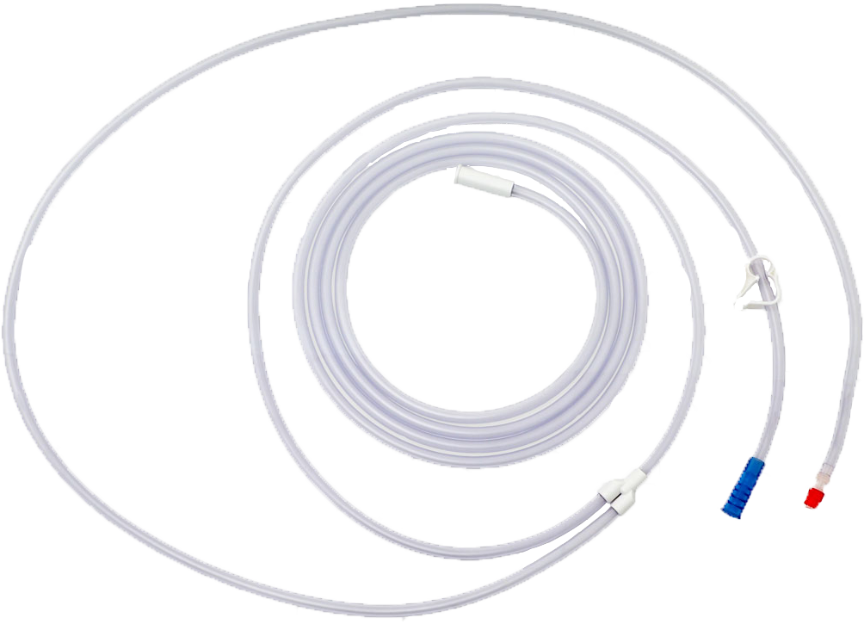
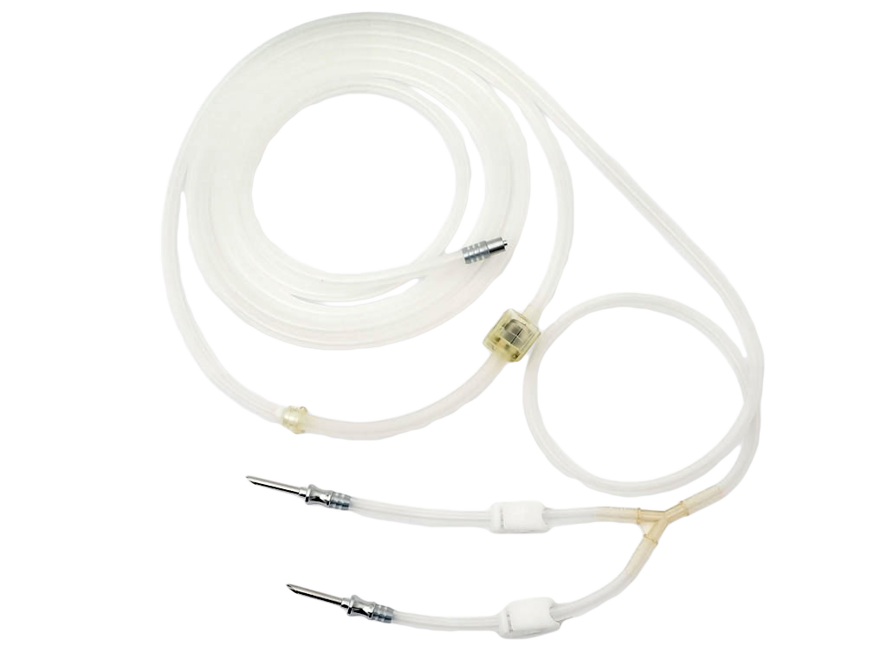
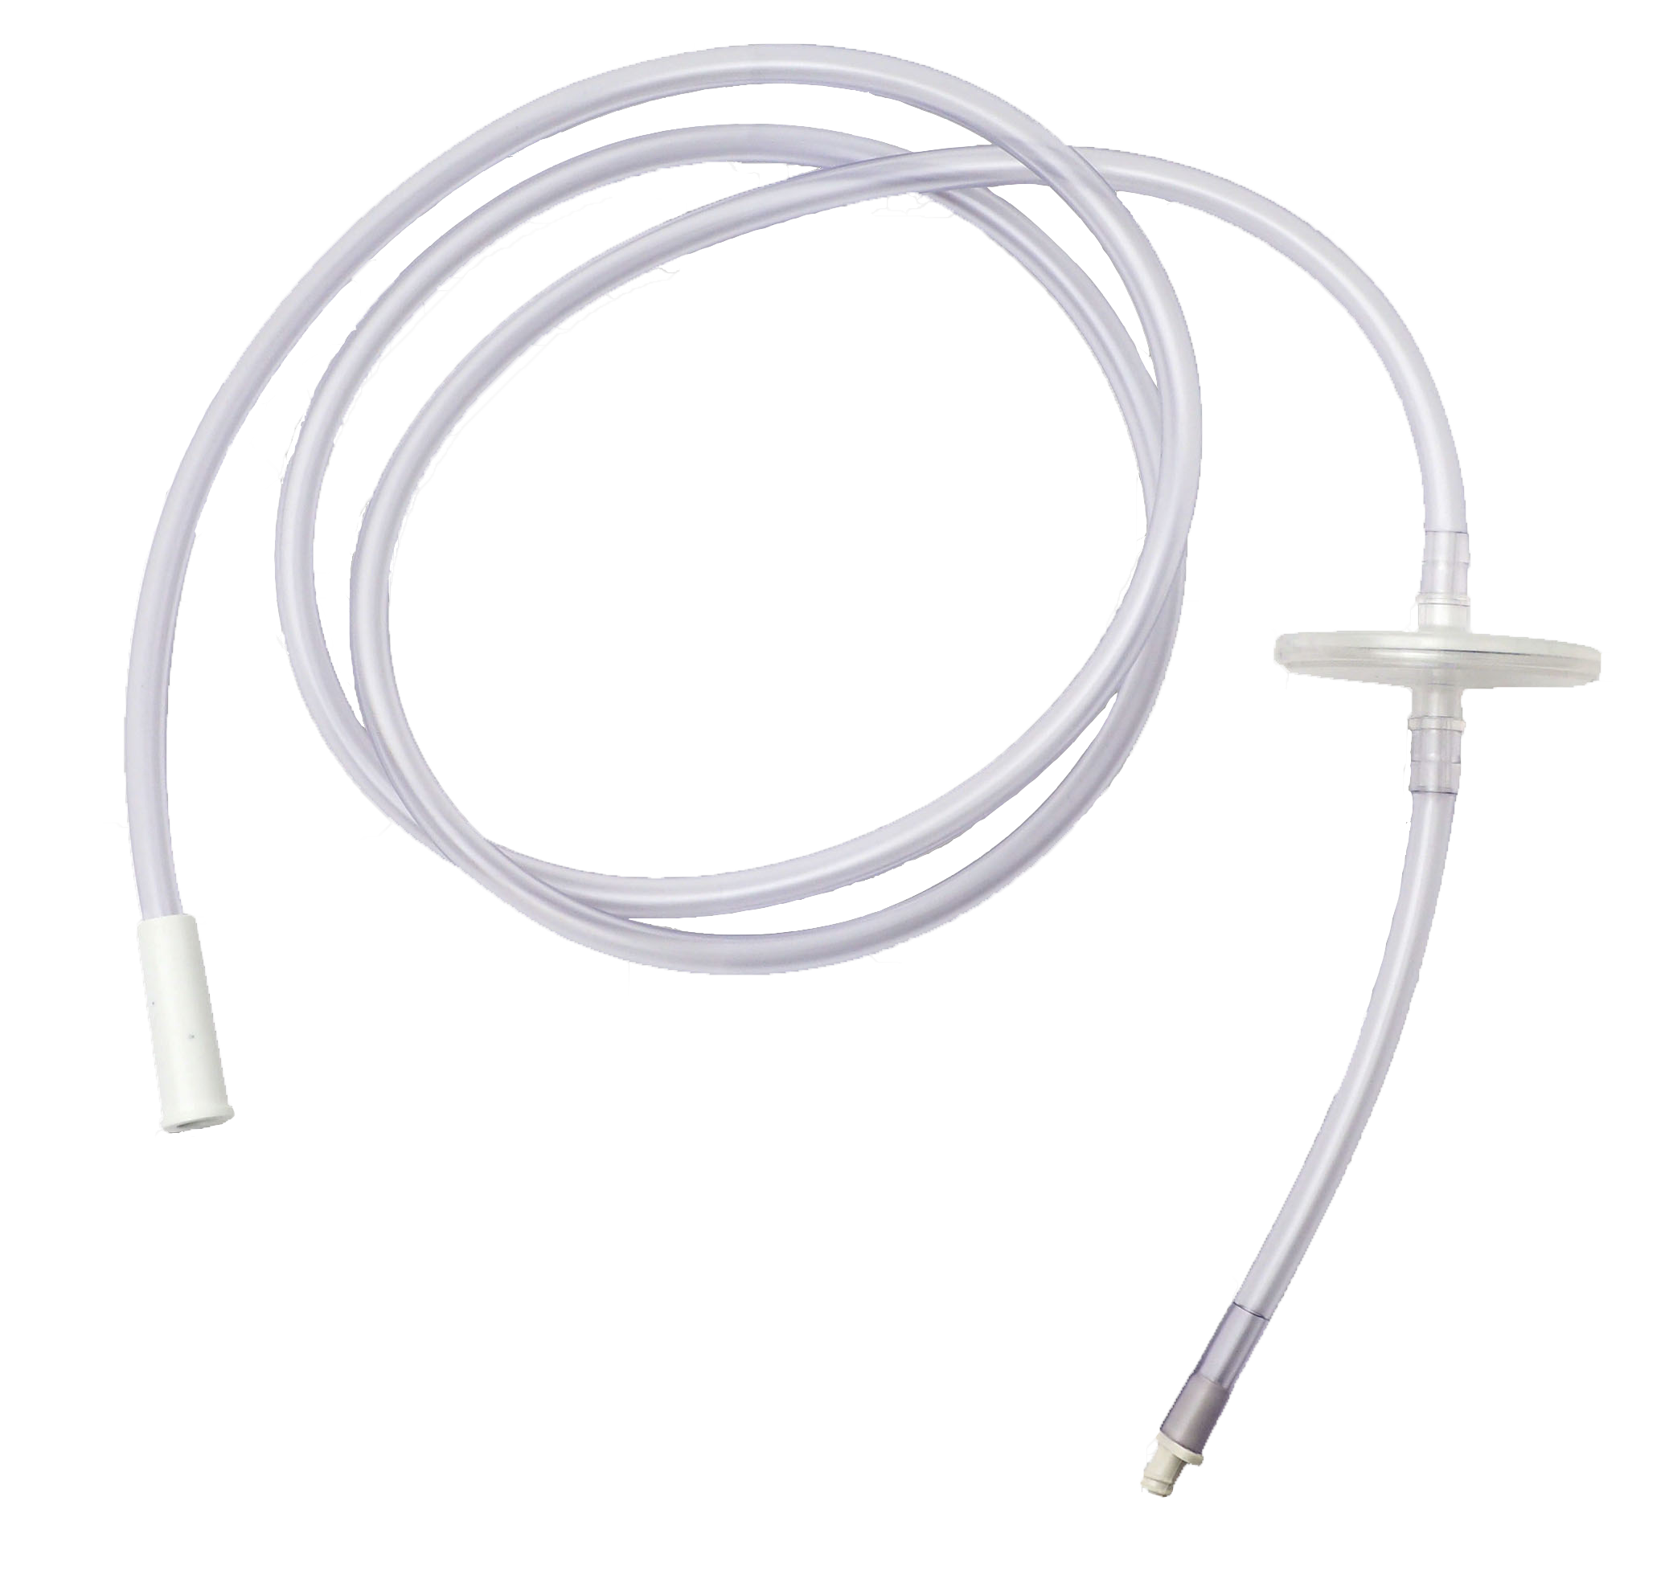
Accessories
Transponder that contains one or more programs: hysteroscopy, laparoscopy, urology and arthroscopy.
Sterile single-use suction tube: with 2 connectors.
Delivered by 10.
Sterile single-use irrigation tube: Delivered by 10.
Reusable irrigation tube: reusable 20 times.
Suction vacuum tube: for 30 days of use.

Slide 5
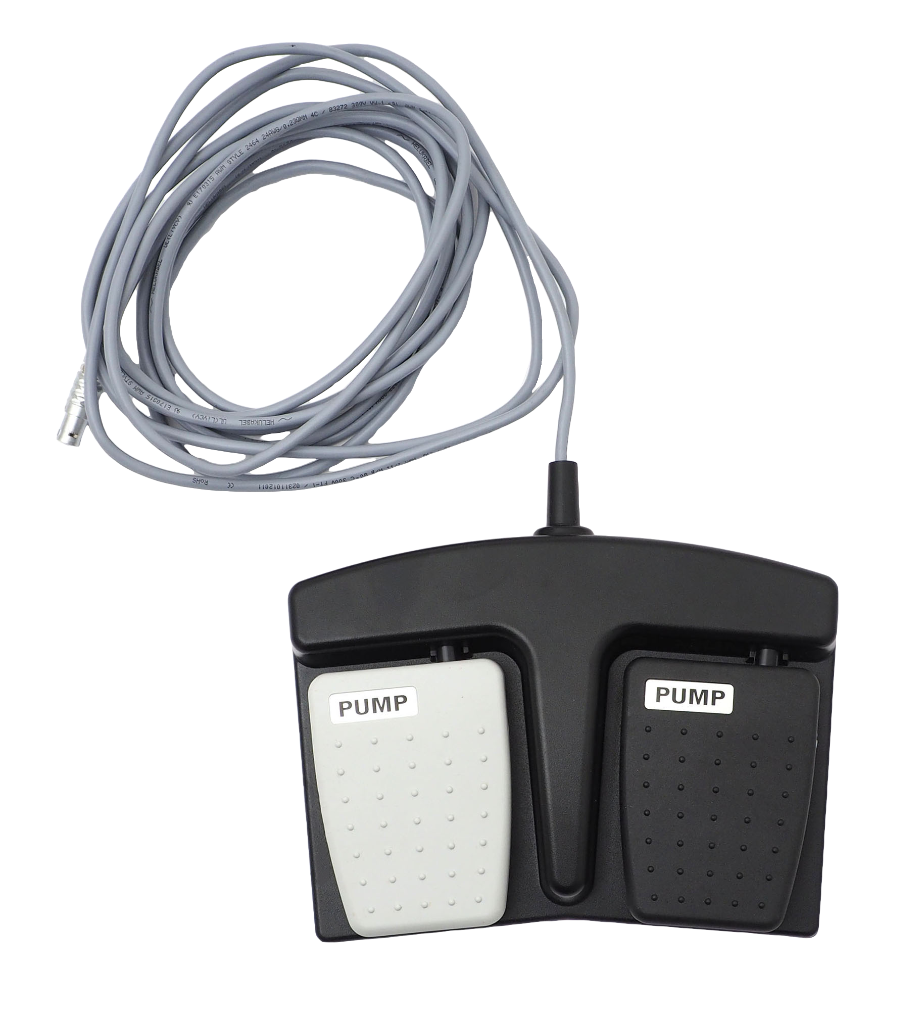
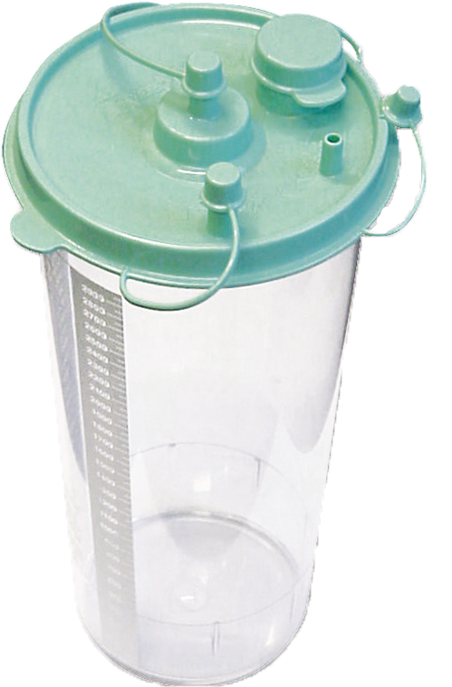
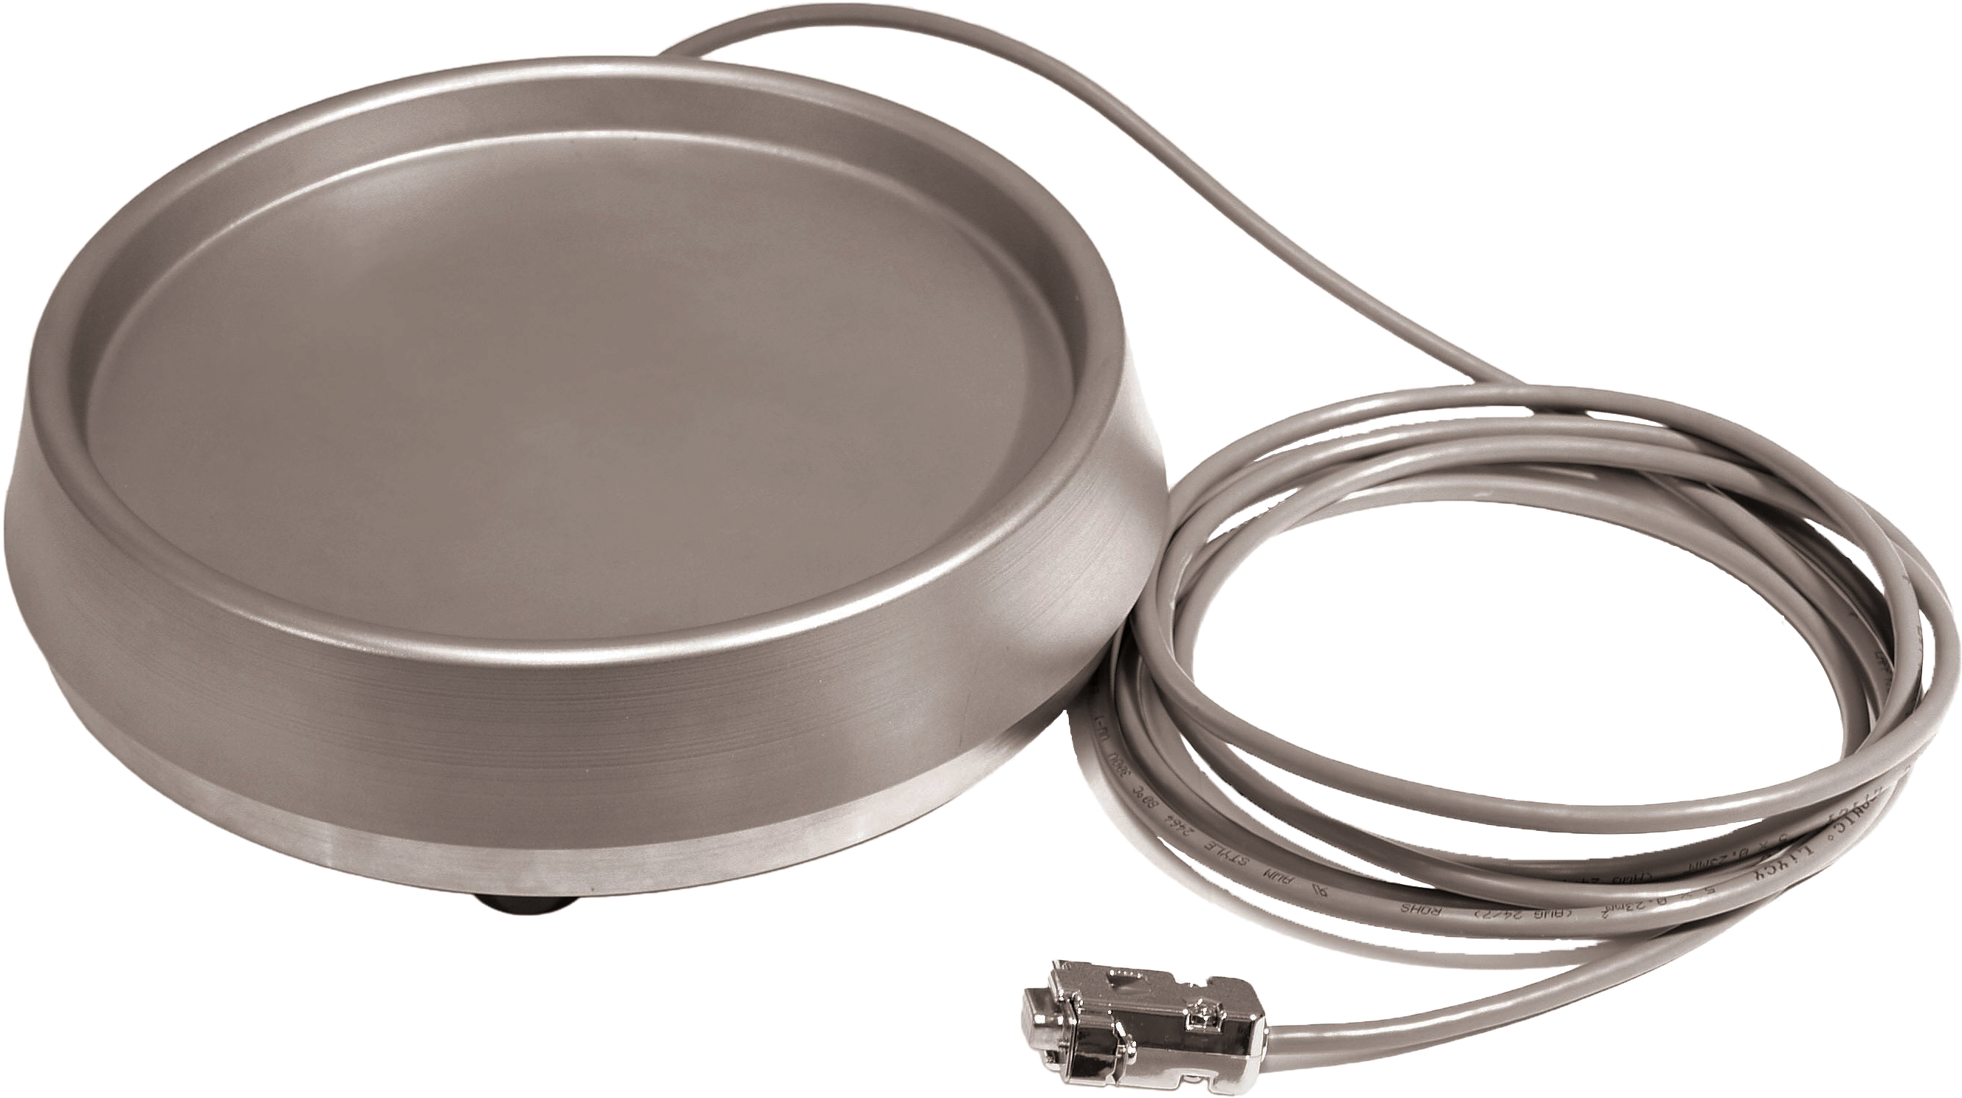
Accessories
Bemis container for secretions: 3L, delivered by 2.
Digital bottle scale: allows an automatic calculation of the input / output balance.
Double pedal foot switch: start, pause, stop of the irrigation

Slide 6
Strengths
  Permanent display of key information.
  Pressure and flow settings on the touch-screen.
  Easy handling: clear controls / alerts and simple insertion of irrigation tubes.
  Sterility control of irrigation tubes using RFID technology.
  → safety for the patient.
  Accurate pressure measurements in particular through the detection system of the instrument used technology.
  Display of the deficit calculation thanks to a digital balance.
  Controlled suction (2 speeds available).
  Transponder system by application (hysteroscopy, laparoscopy, urology, arthroscopy).

Slide 7
HOW TO install iflow?

Slide 8
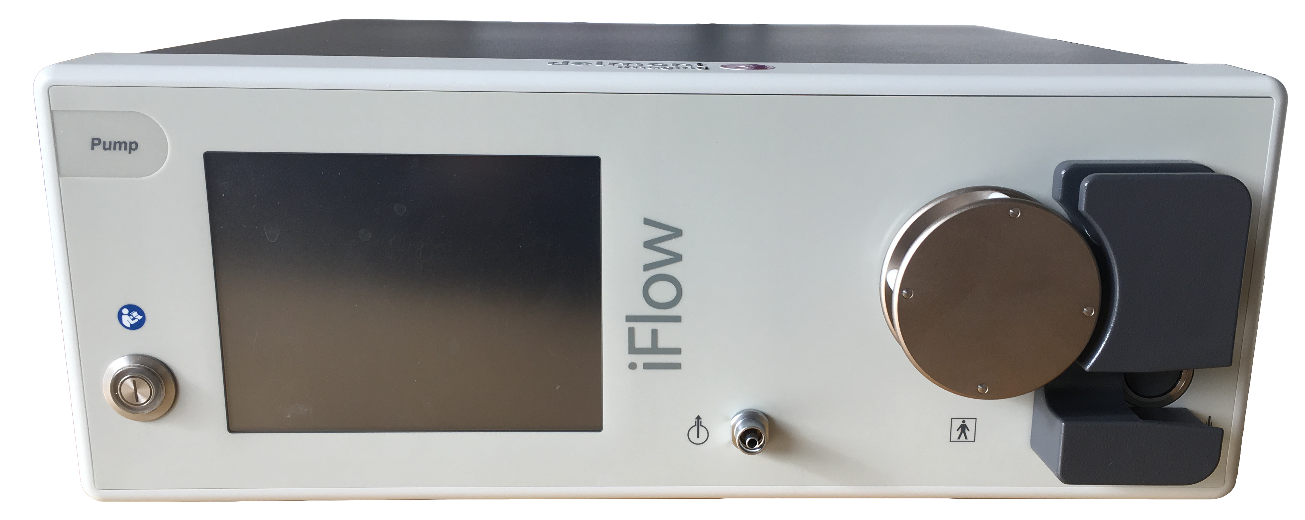
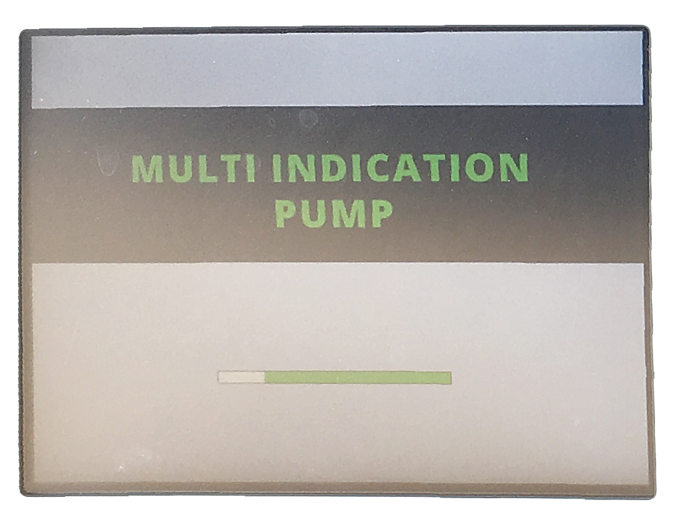
How to install iFlow?
Connect the power cable to the pump and a power socket.
Then, switch it on by pressing the button on the front panel.
A loading screen appears.

Slide 9
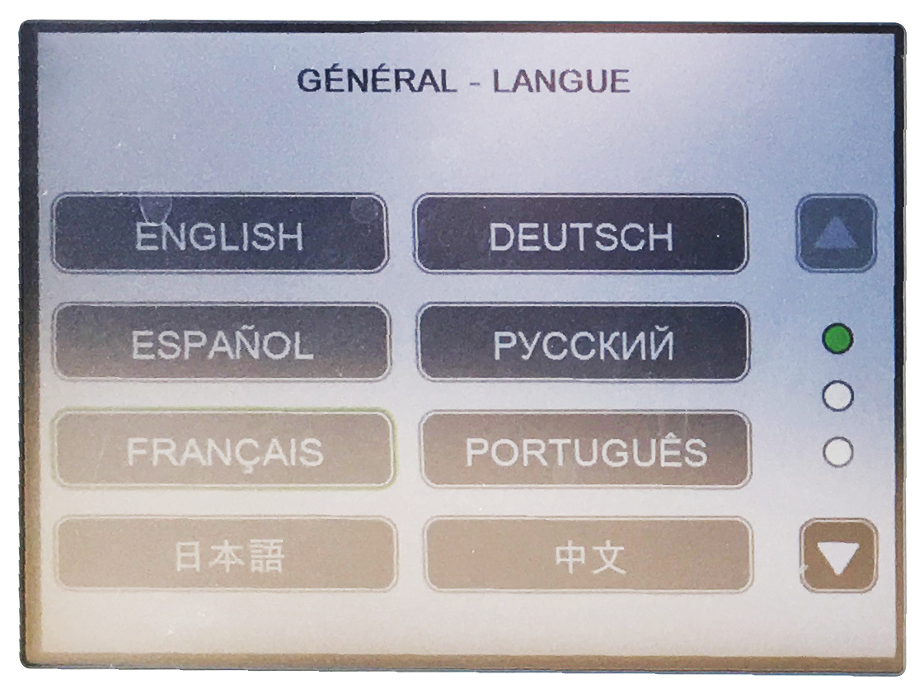
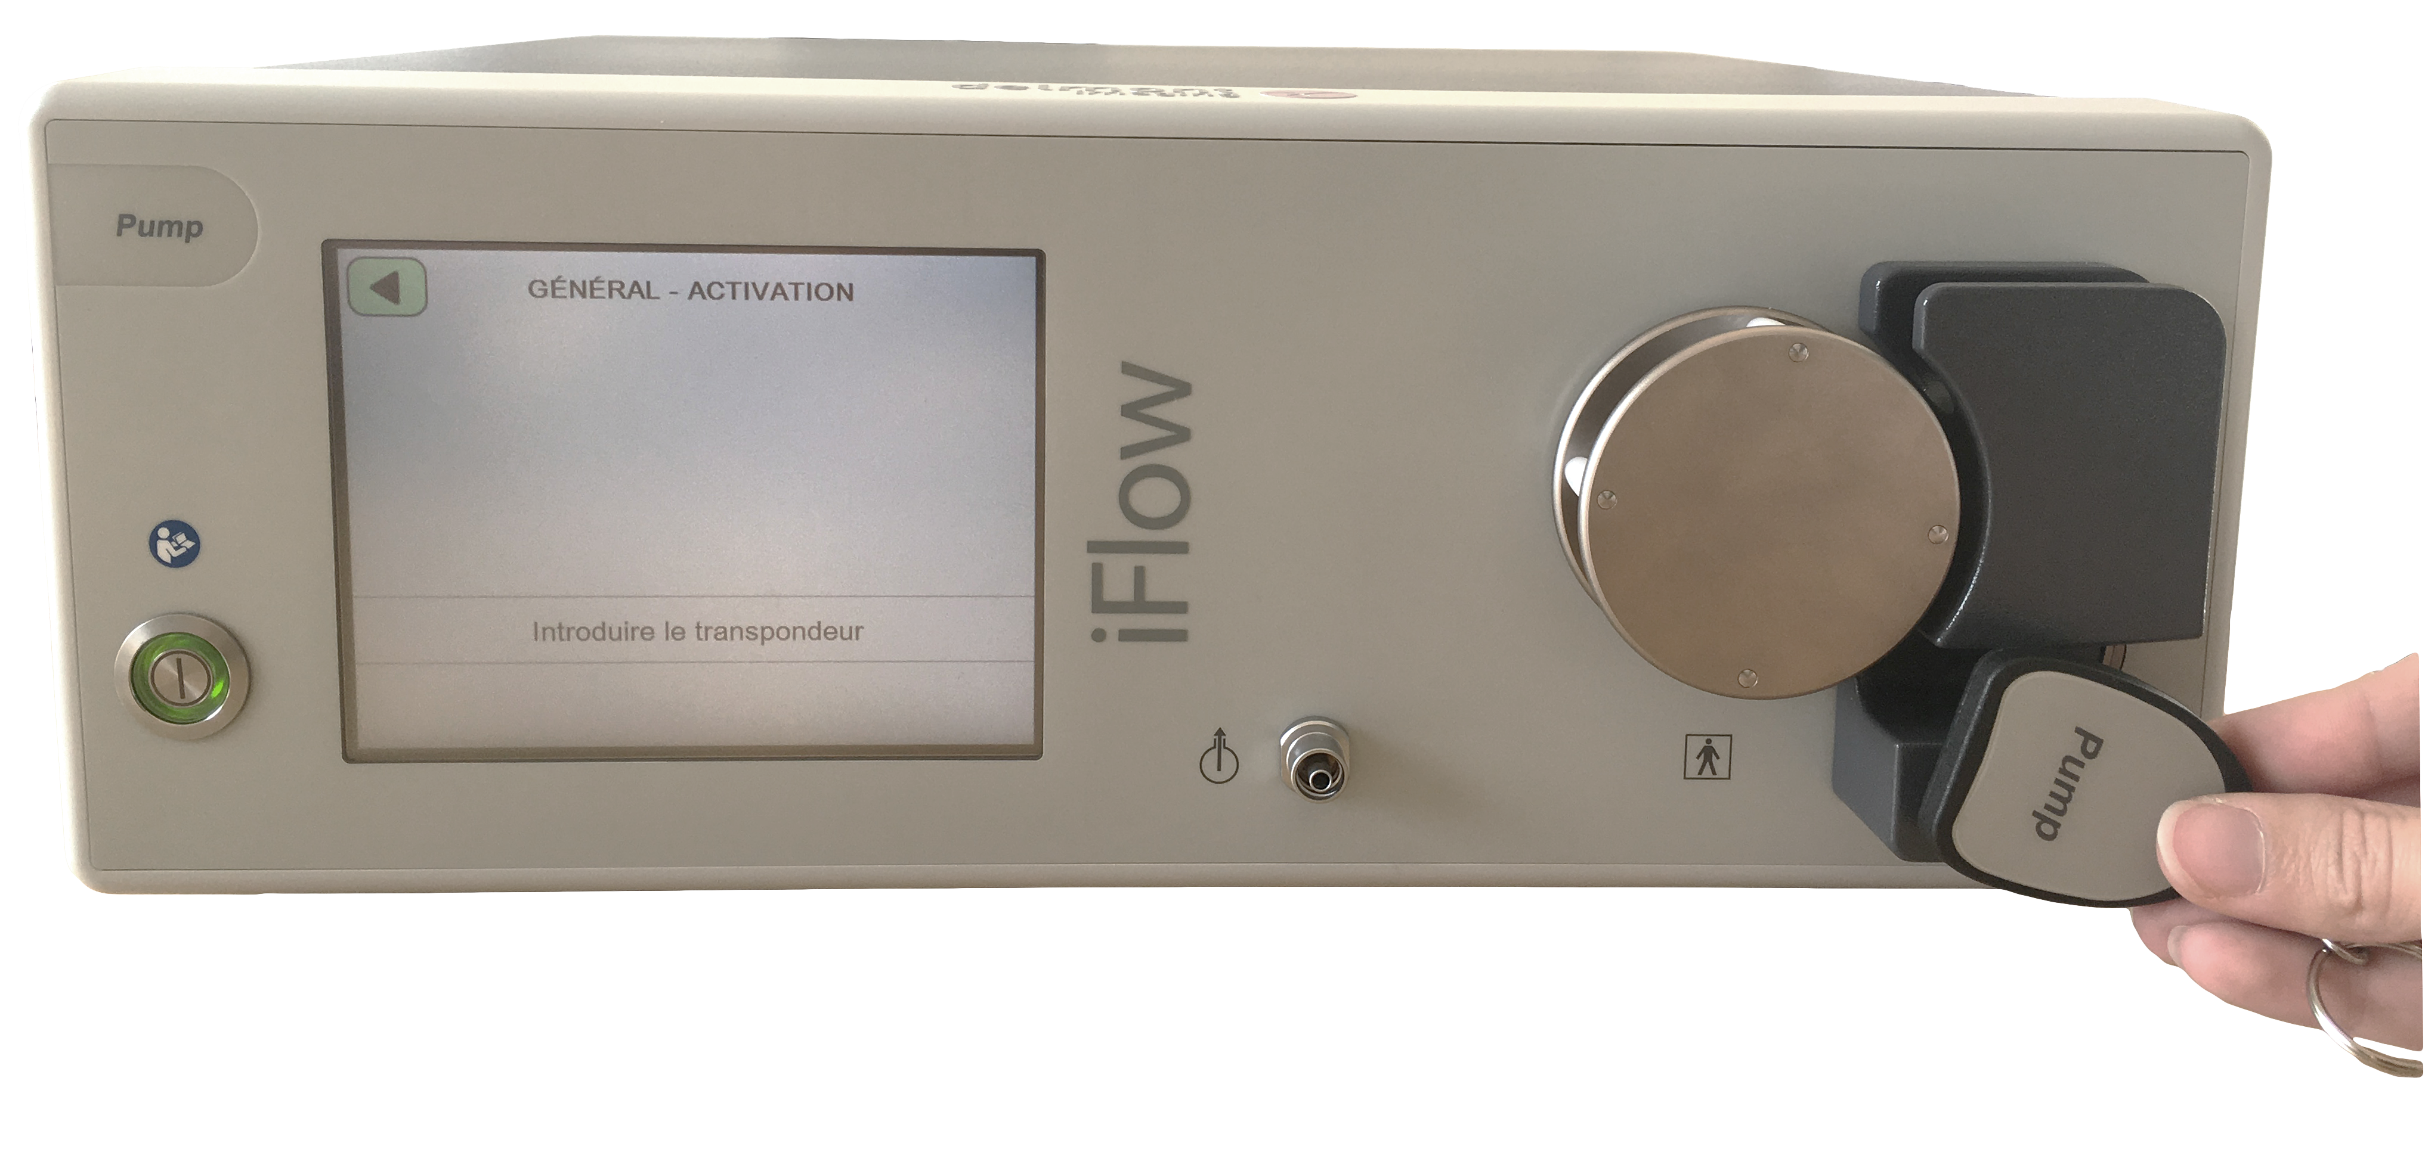
How to install iFlow?
At startup, you have to choose the language.
Then to activate the product, place the transponder delivered with the pump in front of the RFID sensor. After a few seconds, a confirmation message appears on the screen.

Slide 10
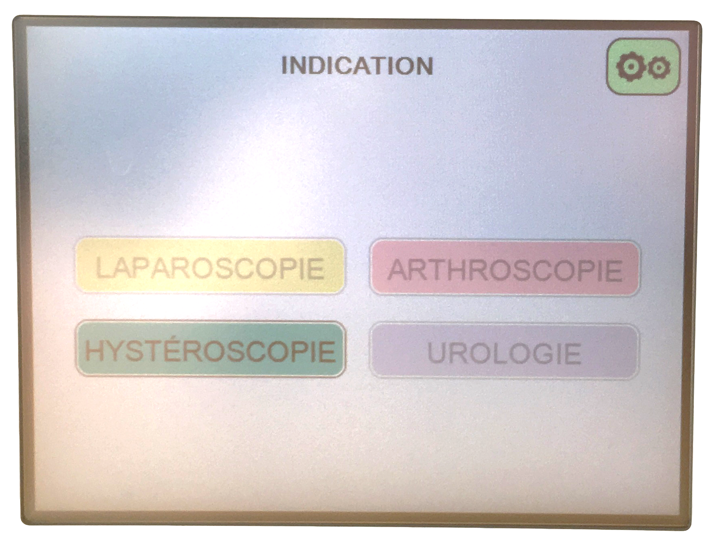
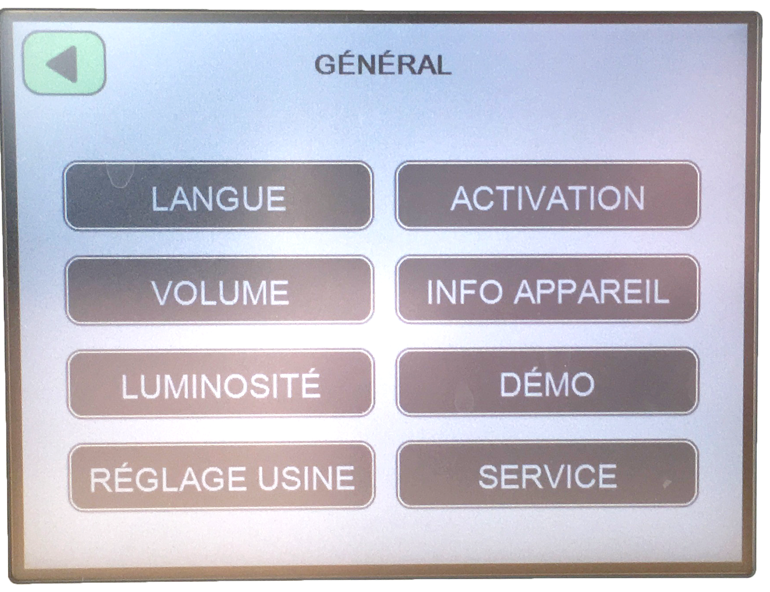
How to install iFlow?
Depending on the programs purchased, they are highlighted on the main screen.
(On the example: only the Hysteroscopy program is unlocked)
General settings can be accessed from the main screen.
Adding programs (available afterwards)
Access to all iFlow programs in demo mode (for viewing only)

Slide 11
Hysteroscopy function setting

Slide 12
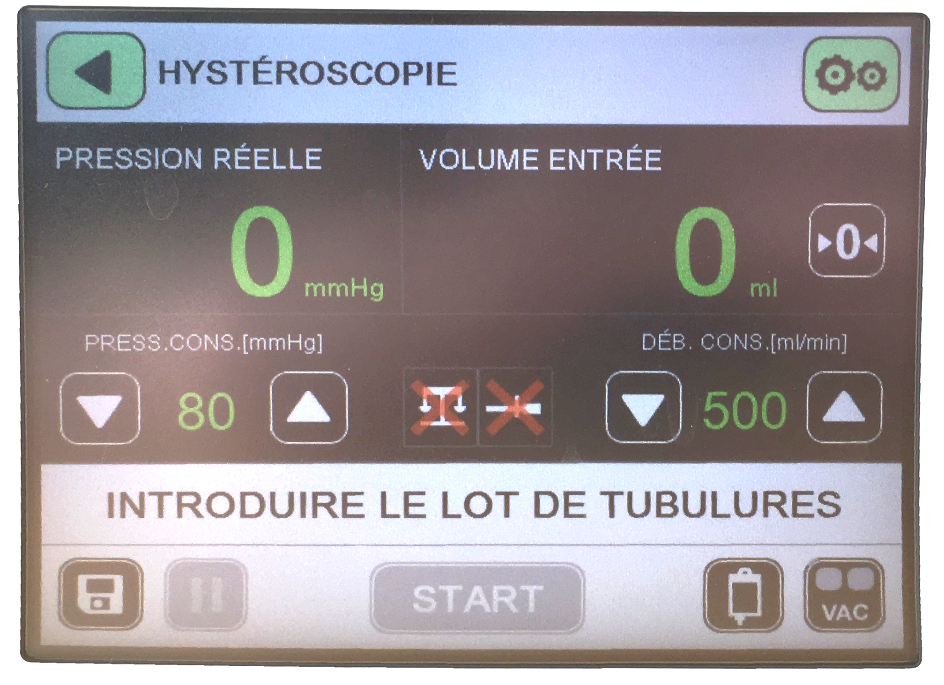
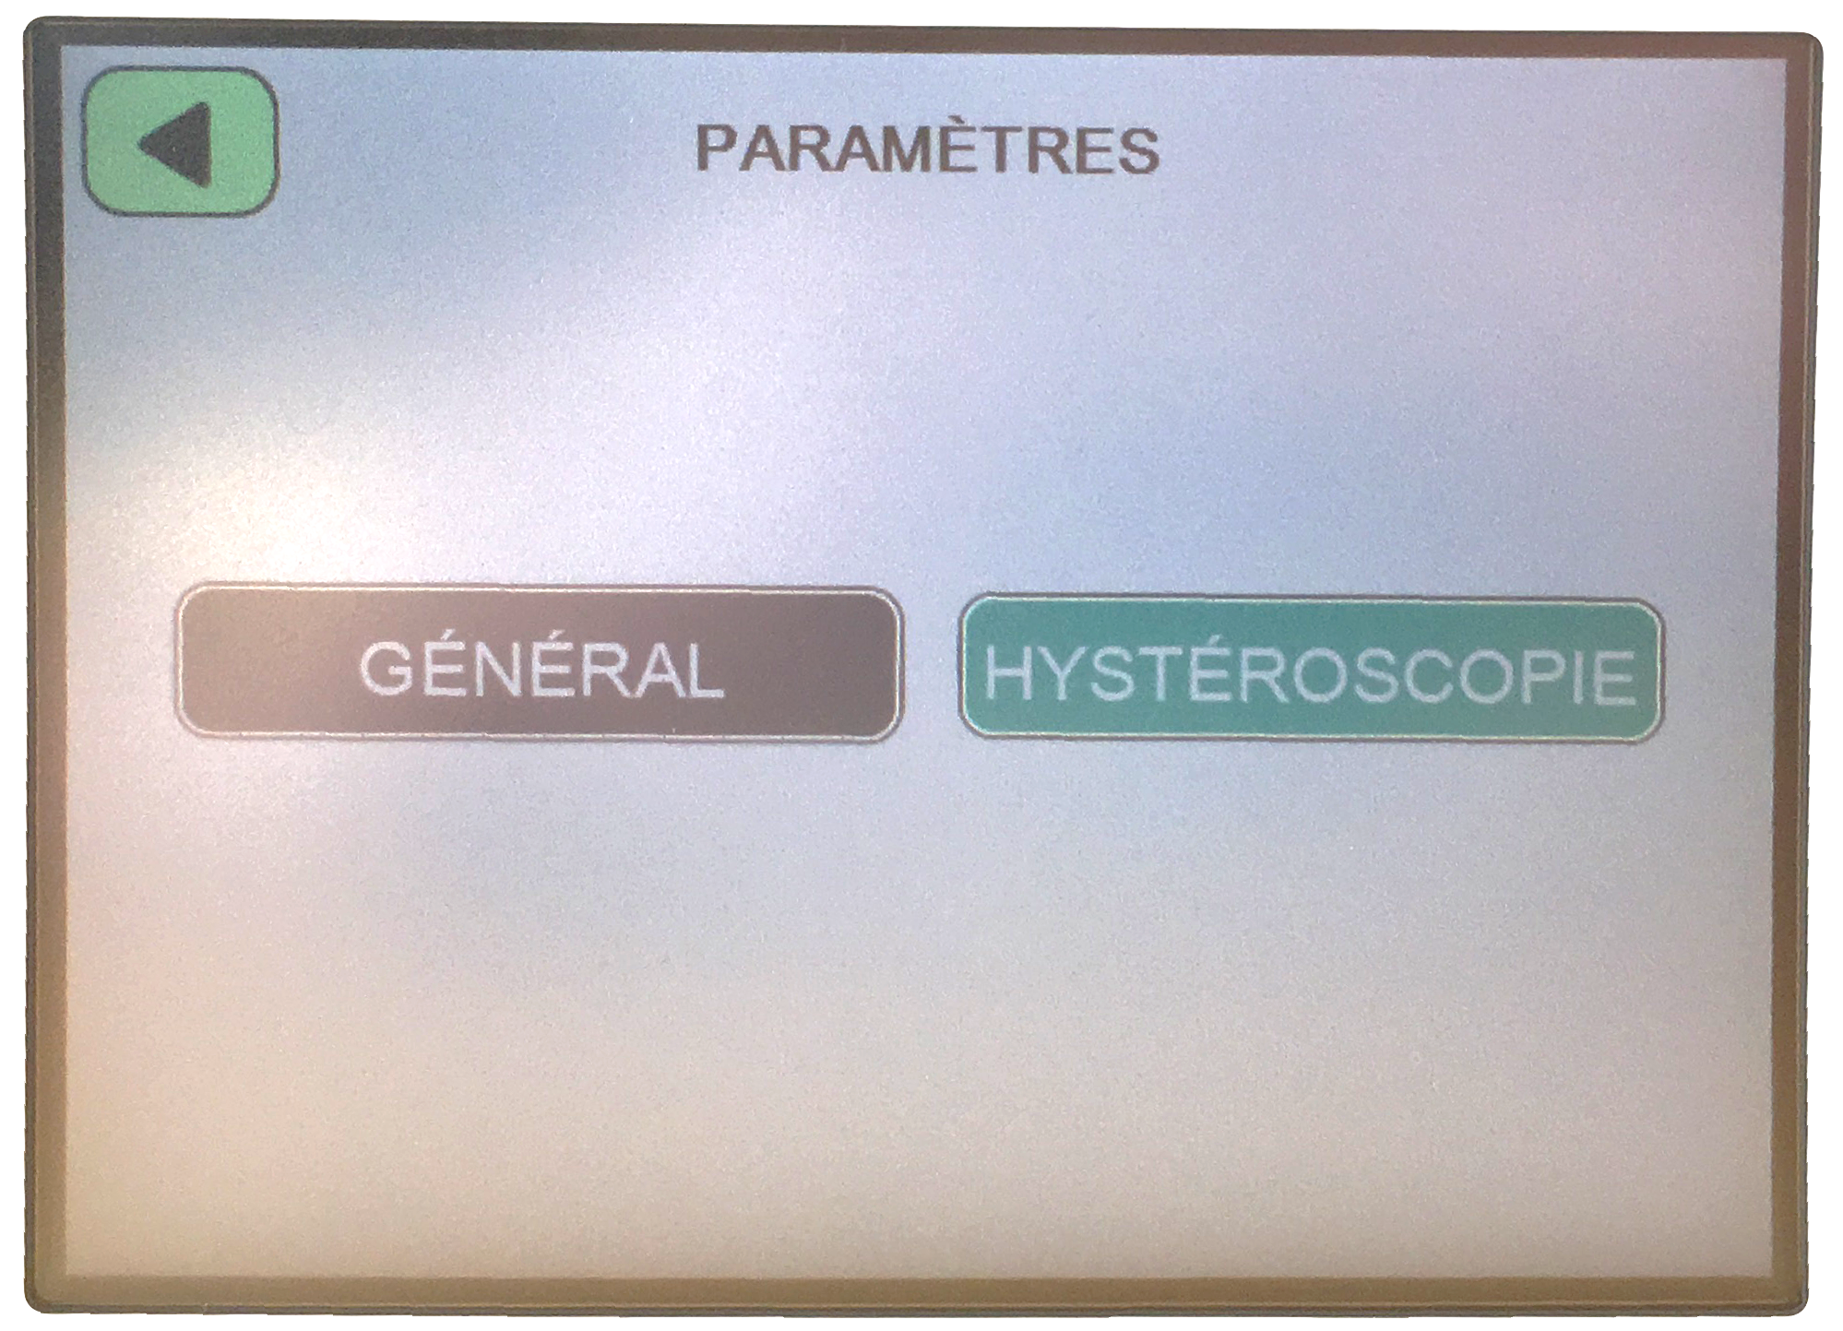
Hysteroscopy function setting
For the Hysterocopy program, a few parameters have to be set.
After clicking on the hysteroscopy function in the menu, select the “settings" button
Then on Hysteroscopy.

Slide 13
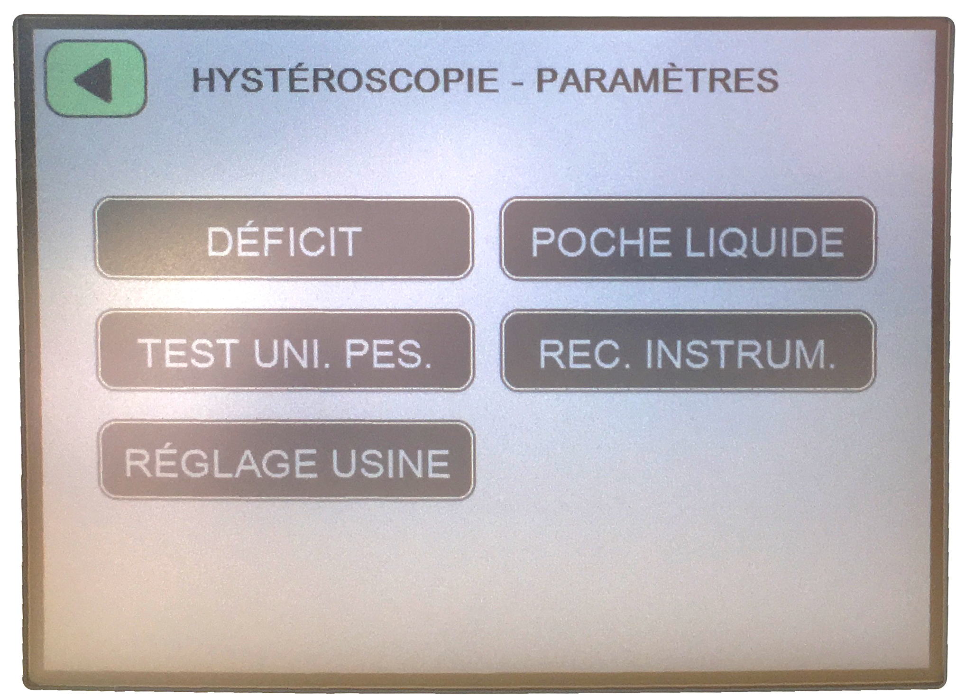
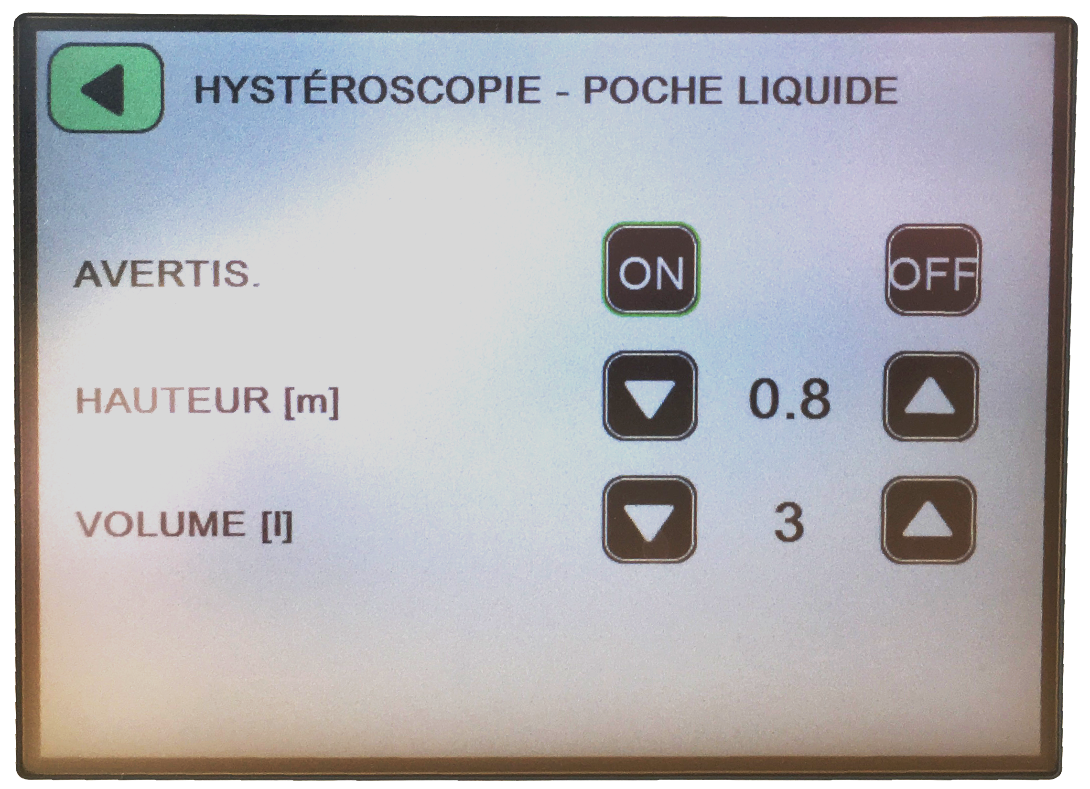
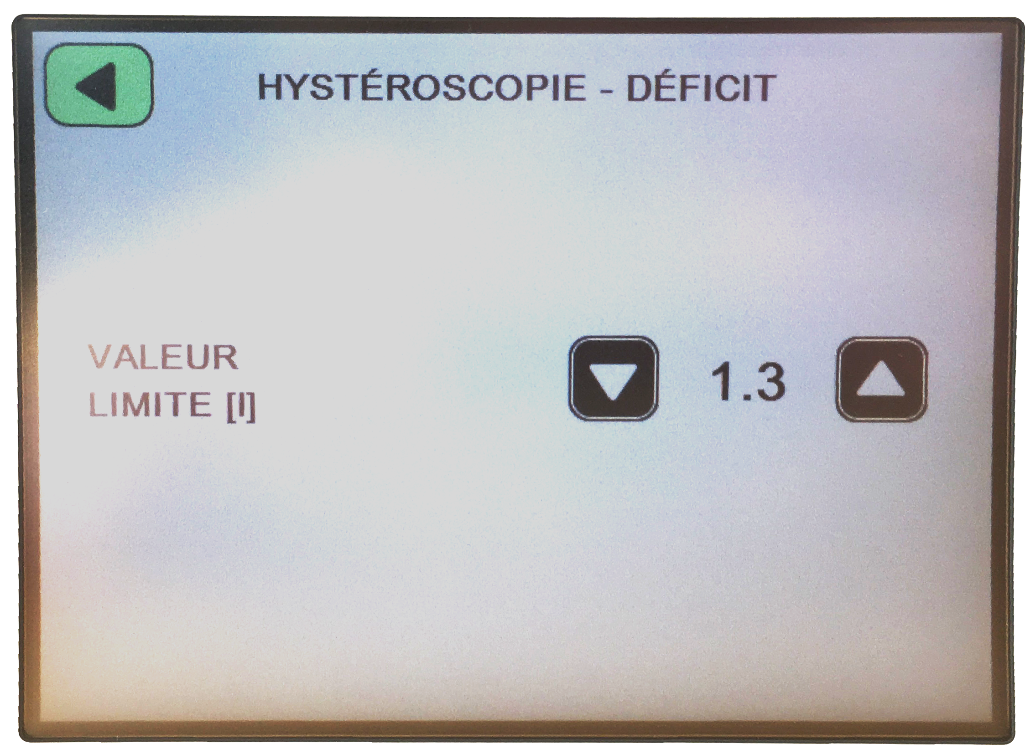
Hysteroscopy function setting
You access the settings below:
Settings for alerts related to the liquid bag (alerts when it is almost empty).
For this, you must know its volume and the height where it is placed.
Setting the limit value of the deficit in Liters. (Value from which alerts will start.)
To perform a digital balance test
Activation or not of the function “recognition of the instrument".

Slide 14
The use of iflow
(hystEroscopY program)

Slide 15
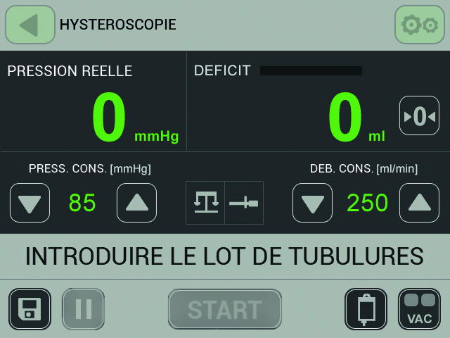
Interface for the hysteroscopy program
If the digital scale is plugged, you have this interface:
Display of actual measured pressure
Display of deficit
Defecit reset
Pressure setting:
from 15 to 150 mmHg
Flow setting:
from 50 to 500 mL/min
Line where messages are displayed
To press when a fluid bag is changed
Save current values as default values
Digital scale plugged
Instrument detection function activated
Selection of the suction speed

Slide 16
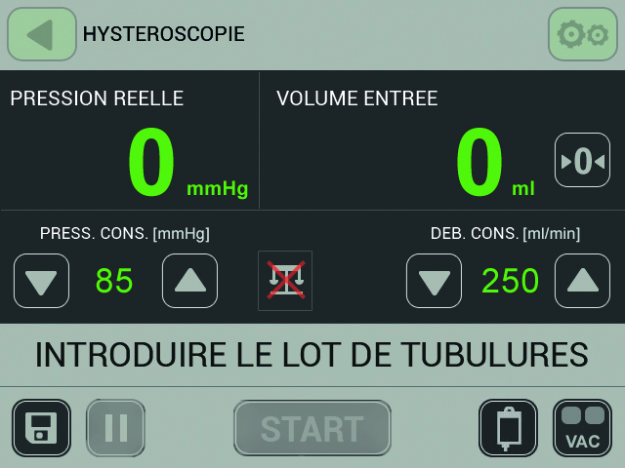
Interface for the hysteroscopy program
If the digital scale is not plugged (and the instrument detection is not activated), the differences are:
Display of the input volume since the beginning of the intervention
Reset input volume
Digital scale not plugged
Instrument detection function not activated

Slide 17
Instructions for use
For the sterile hand:
  Connect the irrigation tube to the corresponding stopcock on the surgical instrument.
  Then give the other side of the tube at the non-sterile hand.
  Connect the first connector of the suction tube to the corresponding stopcock on the surgical instrument and (if present) to the apron of surgical field.
  Then give the other side of the tube at the non-sterile hand.

Slide 18
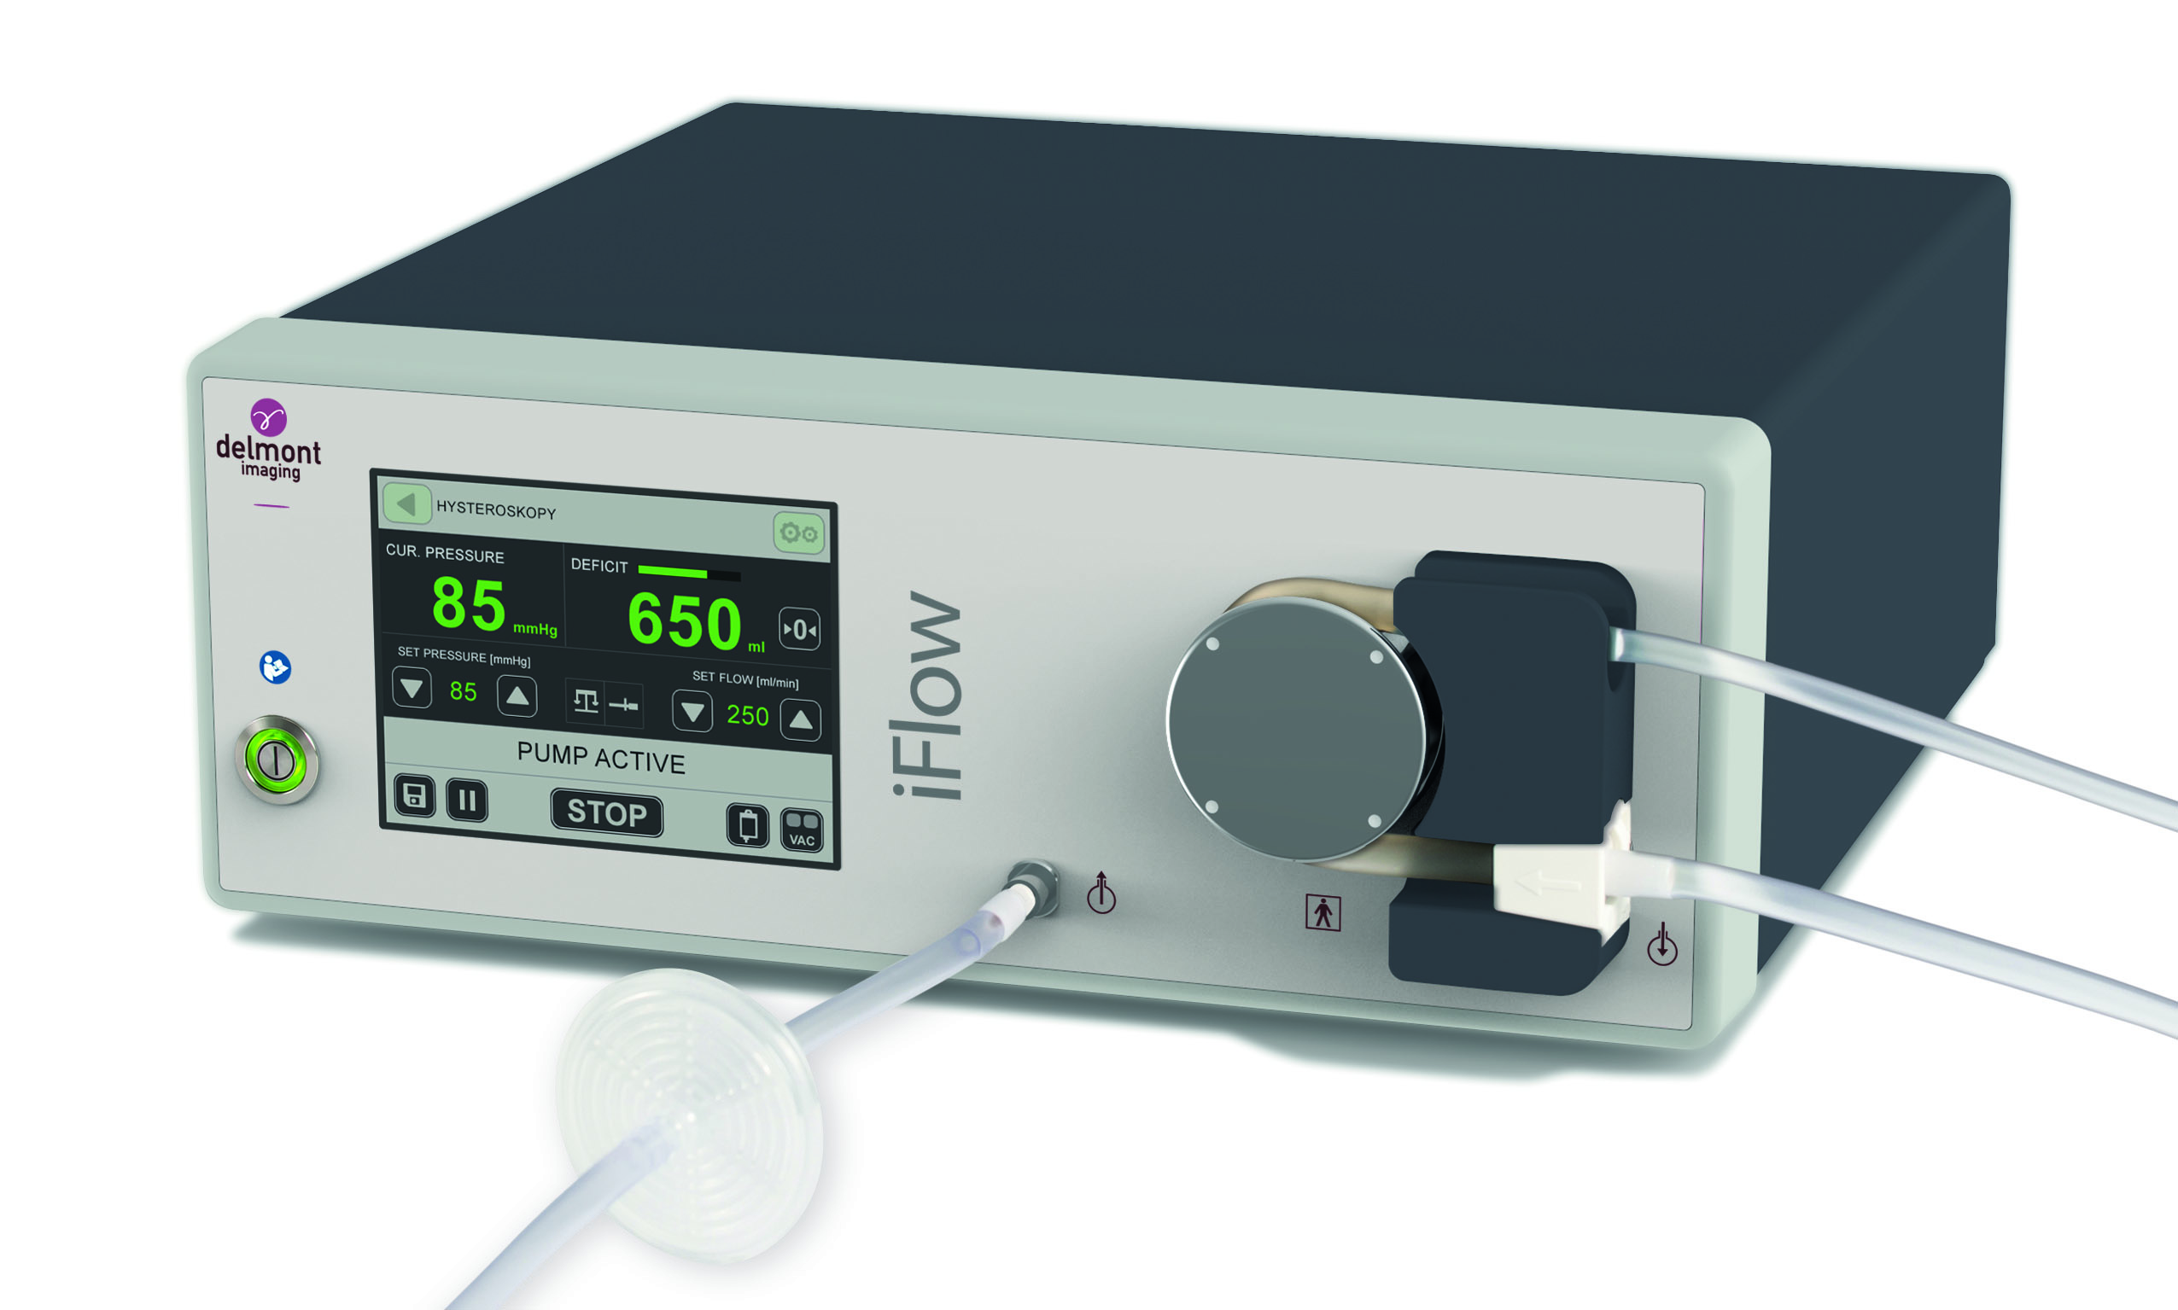
Instructions for use
For the non-sterile hand :
  Place the Bemis container on the digital scale if present.
  Connect the vacuum suction tube to the pump and to the Bemis container.
  Take the irrigation tube from the sterile hand. Insert it around the pump roller and then, connect the two tips (or one) to two bags of irrigation fluids.
  Take the suction tube from the sterile hand, and connect it to the Bemis container.
  Check / adjust pressure and flow settings.
  Start the pump.
2
3
1

Slide 19
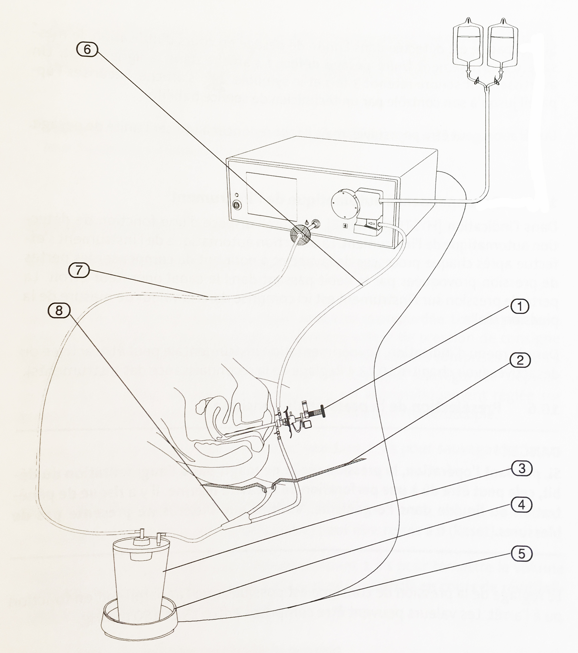
Summary diagram of the setup
Surgical instrument
Apron of surgical field
Bemis Container
Digital scale
Connection cord from the scale to the pump
Irrigation tube
Vacuum suction tube
Suction tube with 2 connectors

Slide 20
Iflow AND ITS COMPETITORS
Notes:
Seront présentés que les chemises qui fonctionnent avec des hystéros 2,7 ou 2,9 !

Slide 21
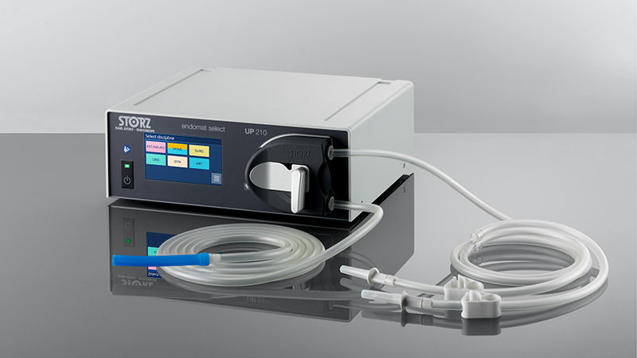
STORZ
Storz proposes the Endomat Select:
The | The
Many programs available (ENT & Spine) | No RFID Adding a program requires the intervention of Storz No suction module integrated into the pump Does not perform deficit calculation

Slide 22
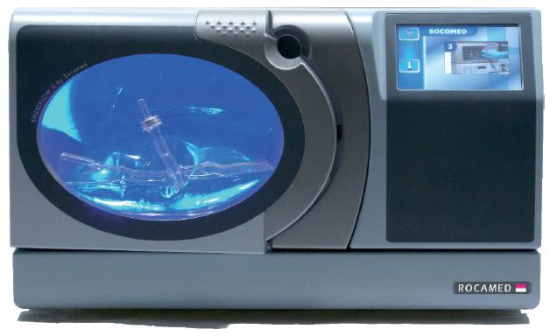
ROCAMED
The | The
Optimized flow : pressure chamber Heated and constant temperature at 38°C | Large Does not perform deficit calculation Mandatory stop of the flow to change the fluid bag No suction module integrated into the pump 4 automatically integrated programs
Rocamed proposes the EndoFlow II Single Chamber:

Slide 23
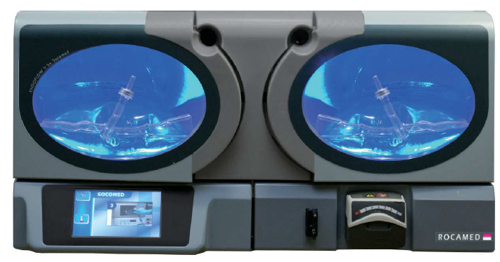
ROCAMED
Rocamed proposes the EndoFlow II Double Chamber:
The | The
Optimized flow : pressure chamber Heated and constant temperature at 38°C | Large Does not perform deficit calculation 4 automatically integrated programs

Slide 24
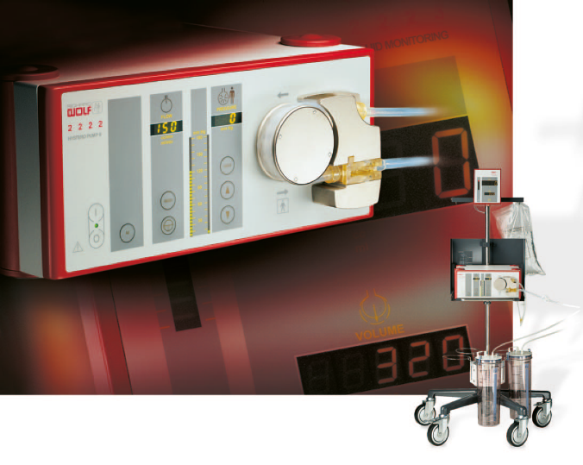
RICHARD WOLF
Richard Wolf proposes the Fluid Manager:
The | The
Solution with an ergonomic trolley | No programs available other than hysteroscopy No RFID No suction module integrated into the pump Difficult insertion of irrigation tube

Slide 25
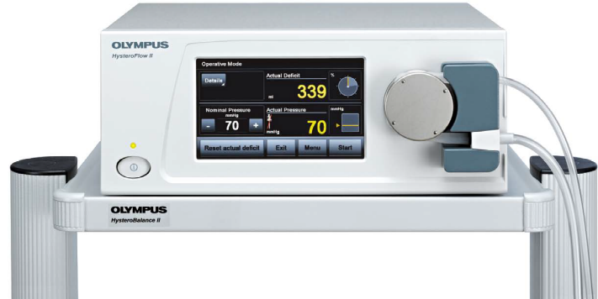
OLYMPUS
Olympus proposes the HysteroFlow:
The | The
Easy insertion of irrigation tube | No programs available other than hysteroscopy No RFID No suction module integrated into the pump

