Slide 1
Endojack
The smart uterine manipulator

Slide 2
Endojack OVERVIEW

Slide 3
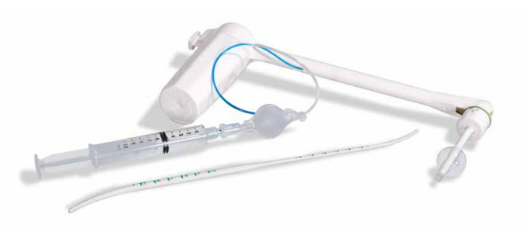
A sterile & single use uterine manipulator
Tubing for the blue test
Locking system of the position
Piece to change the length of the tip by 1cm
Handle for anteversion or retroversion of uterus
Fixation balloon
10cc syringe included
Atraumatic tip to prevent perforations
Dilator hysterometer

Slide 4
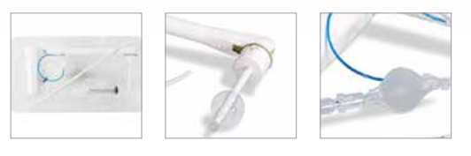
Highlights
Endojack has many advantages:
  No assembly to make before using it → easy to use
  Single use → no risk of cross-contamination
  Light
  Very good fixation of the uterus thanks to the balloon
  Rotative lockable handle with marking for direction of rotation
  Easy adjustment of the length of the manipulator tip
  Atraumatic and resistant tip (stainless steal inside the tip)
  Presence of a cannula for the blue test (tubal permeability)
  Dilator hysterometer included

Slide 5
Endojack AND ITS COMPETITORS

Slide 6
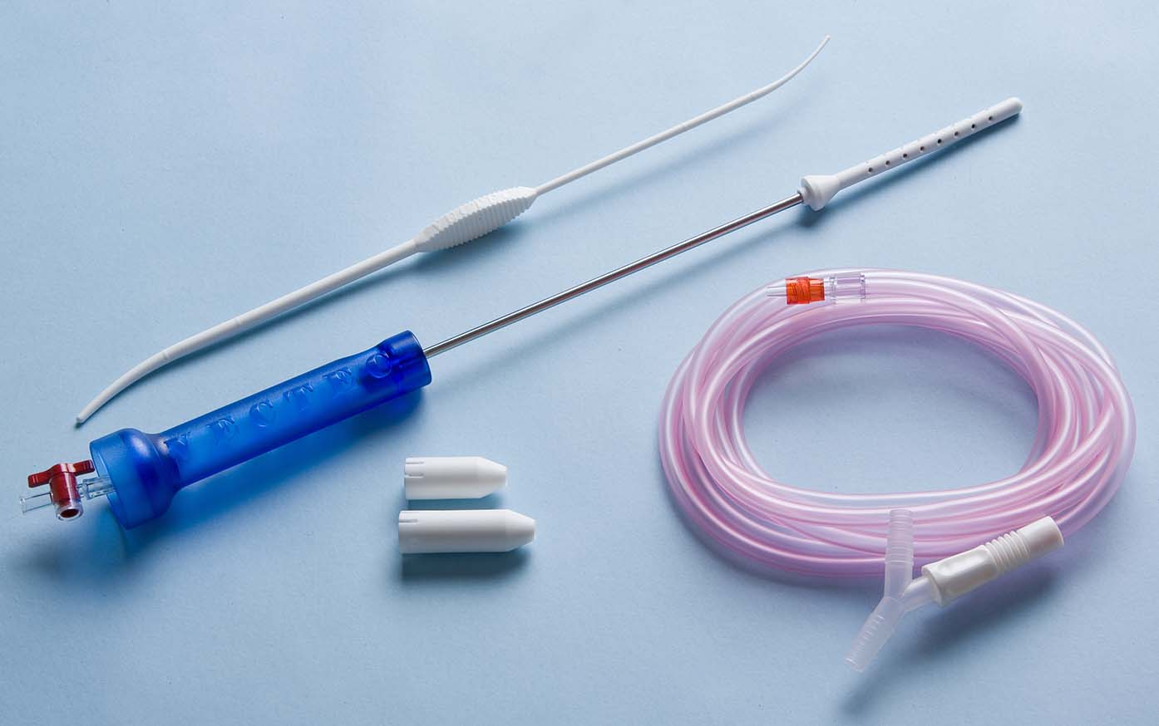
VECTEC
The | The
- Price (22€ price for health centers groups) | Bad fixation of the uterus by suction (connection to the vacuum of the OR) The orientation of the uterus and the ability to lock the position are impossible: an assistant must be there to hold the manipulator Tip adapters for the lenght are in spare parts
Vectec proposes CAUT60:

Slide 7
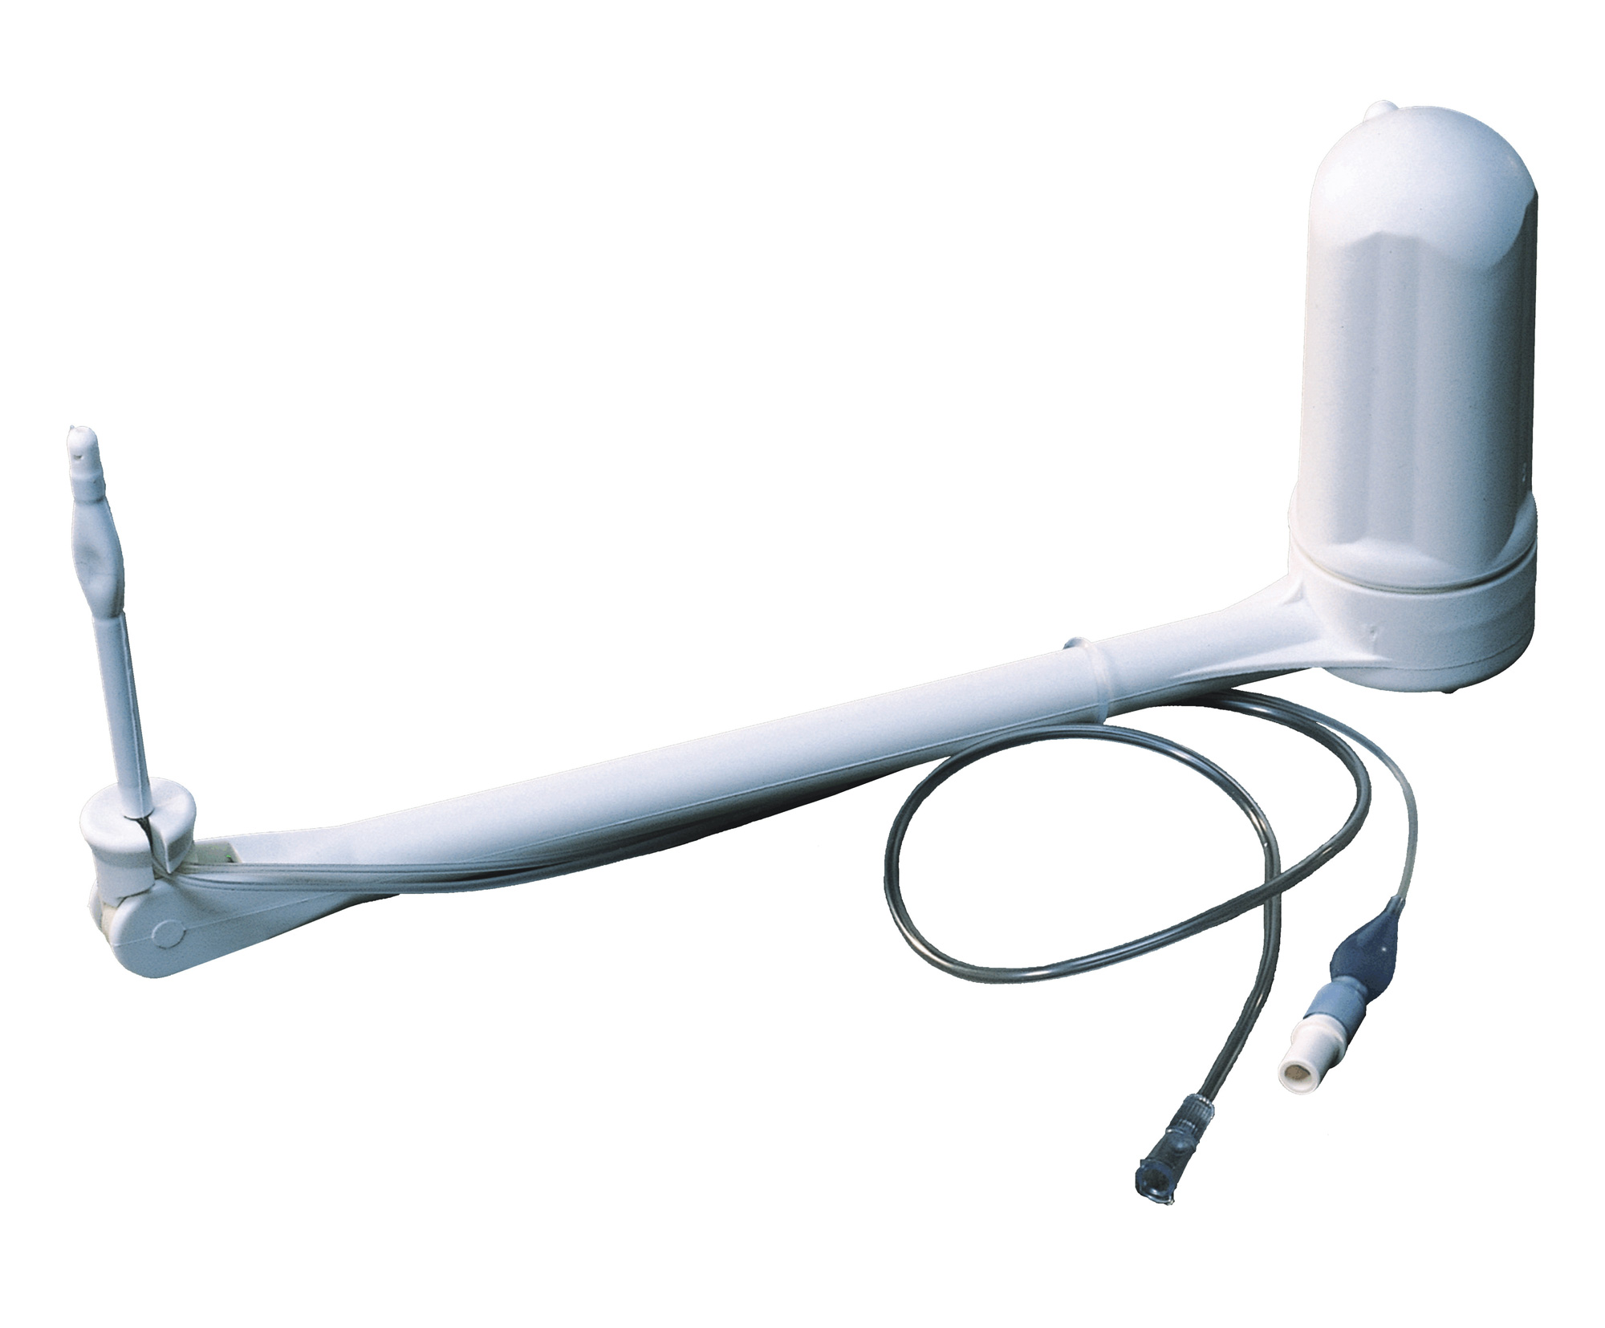
CLINICAL INNOVATIONS
The | The
 | Price (61€ Hospital price) The two tubings aren’t integrated in the uterine manipulator: troubles during rotations No position locking possible Tip adapter for the lenght is in spare part Retroversion at 120° changes the aspect of the anatomy (too pronounced) making the surgical procedure complicated.
Clinical innovations proposes Clearview:

Slide 8
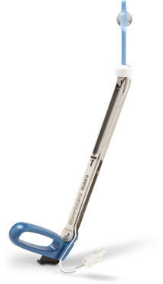
COOPER SURGICAL
Cooper surgical proposes Rumi II, a semi-reusable manipulator (only the tip is single use) :
The | The
Available with the cup | Assembly to do 6 tips available: stock management

Slide 9
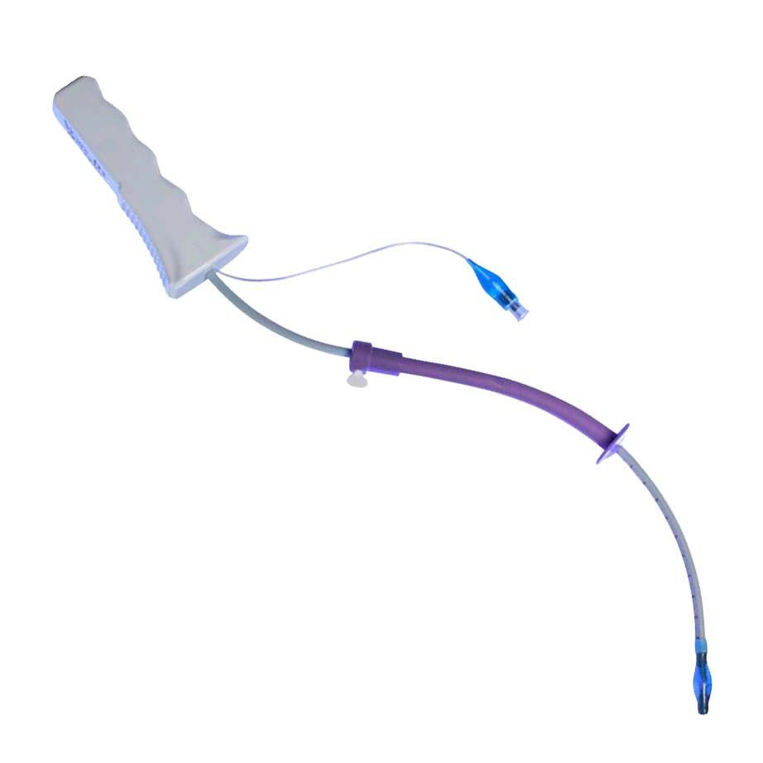
CONMED
Conmed proposes VCare DX Plus :
The | The
Easy change of the length of the tip Available with the cup | The orientation of the uterus and the ability to lock the position are impossible: an assistant must be there to hold the manipulator

Slide 10
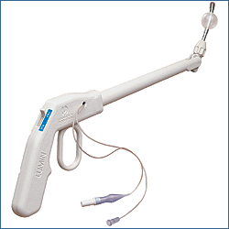
UTAH MEDICAL PRODUCTS
Utah medical products proposes Lumin which is overall identical to EndoJack.
The only differencies are:
The tip is fully made in stainless steal
The handle shape and the mechanism to rotate the tip

Slide 11
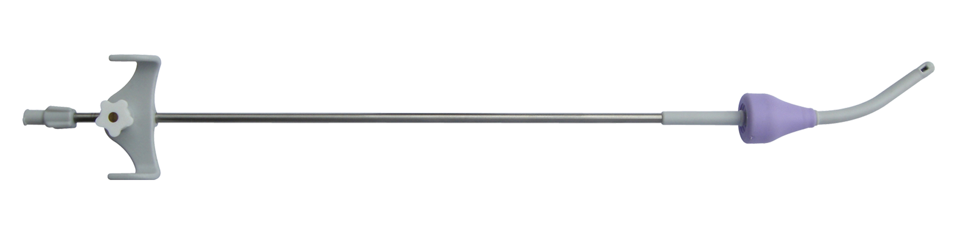
Spackman cannula
Namely, the cannulae of Spackman can be used for manipulation of the uterus. They are “cheap” uterine manipulators.
There is no fixation of the uterus, meaning its manipulation more difficult: an assistant is essential! They are mainly made for the injection of liquids into the uterus.
There are many suppliers!!
Hysterometers can also be used for the manipulation of the uterus. Compresses and Pozzi forceps are used to hold everything.

Slide 12
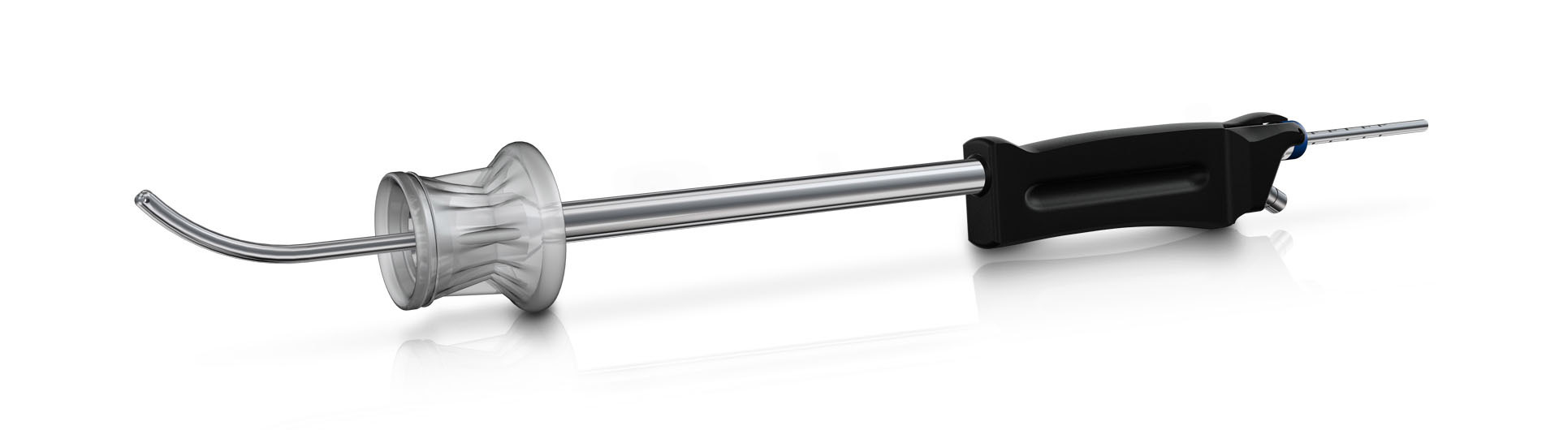
Reusable uterine manipulators
Namely also the presence on the market of reusable uterine manipulators. However these are generally complicated to assemble and difficult to use, resulting in a longer operating time for the OR.
In addition to the cost generated by this longer operating time, the cost of purchase and sterilization make the product unattractive economically as well.
The two main manufacturers are:
Storz (7 different manipulators)
Richard Wolf

Slide 13
HOW TO USE Endojack ?

Slide 14
The indications
Pathologies:
  Tubal sterilization
  Myomectomy
  Removal of cysts
  Diagnostic laparoscopy
  Chromoperturbation
  Treatment of endometriosis
  Promontofixation
  Subtotal hysterectomy

Slide 15
Instructions of use
Open the uterine manipulator packaging.
Use the dilator hysterometer to dilate the cervix and measure the depth of the uterus.
Modify the lenght of the manipulator tip if necessary.
Fully insert the manipulator tip into the uterine cavity. The handle should be facing up.
Inject 10cc of saline using the syringe provided to inflate the balloon. Check the correct fixation of the manipulator.
Rotate the handle to perform an anteversion or a retroversion of the uterus. Block this position if necessary.
Use the blue tubing to perform the blue test if necessary.

